Slide 1
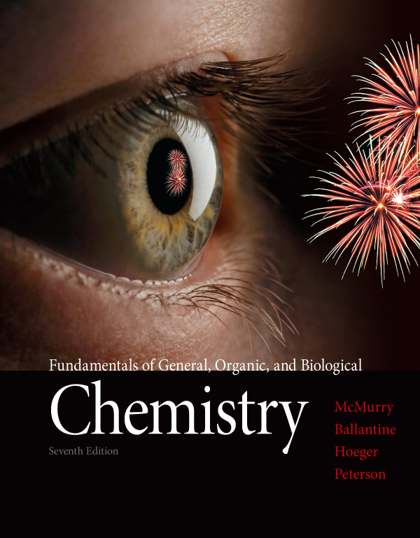
Chapter Eight
Chapter 8 Lecture
Fundamentals of General, Organic, and Biological Chemistry
7th Edition
McMurry, Ballantine, Hoeger, Peterson
Gases, Liquids, and Solids
Julie Klare
Gwinnett Technical College
© 2013 Pearson Education, Inc.

Slide 2
lecture 1: 8.1-8.4
lecture 2: 8.5- 8.10
lecture 3(beginning of): 8.11-8.15

Slide 3
Outline
8.1 States of Matter and Their Changes
8.2 Intermolecular Forces
8.3 Gases and the Kinetic–Molecular Theory
8.4 Pressure
8.5 Boyle’s Law: The Relation between Volume and Pressure
8.6 Charles’ Law: The Relation between Volume and Temperature
8.7 Gay-Lussac’s Law: The Relation between Pressure and Temperature
8.8 The Combined Gas Law
8.9 Avogadro’s Law: The Relation between Volume and Molar Amount
8.10 The Ideal Gas Law
8.11 Partial Pressure and Dalton’s Law
8.12 Liquids
8.13 Water: A Unique Liquid
8.14 Solids [skip]
8.15 Changes of State

Slide 4
1. What are the major intermolecular forces, and how do they affect the states of matter?
Be able to explain dipole–dipole forces, London dispersion forces, and hydrogen bonding, recognize which of these forces affect a given molecule, and how these forces are related to the physical properties of a substance.
2. How do scientists explain the behavior of gases?
Be able to state the assumptions of the kinetic–molecular theory and use these assumptions to explain the behavior of gases.
3. How do gases respond to changes in temperature, pressure, and volume?
Be able to use Boyle’s law, Charles’s law, Gay-Lussac’s law, and Avogadro’s law to explain the effect on gases of a change in pressure, volume, or temperature.

Slide 5
What is the ideal gas law?
Be able to use the ideal gas law to find the pressure, volume, temperature, or molar amount of a gas sample.
What is partial pressure?
Be able to define partial pressure and use Dalton’s law of partial pressures.
6. What are the various kinds of solids, and how do they differ?
Be able to recognize the different kinds of solids and describe their characteristics.
What factors affect a change of state?
Be able to apply the concepts of heat change, equilibrium, vapor pressure, and intermolecular forces to changes of state.

Slide 6
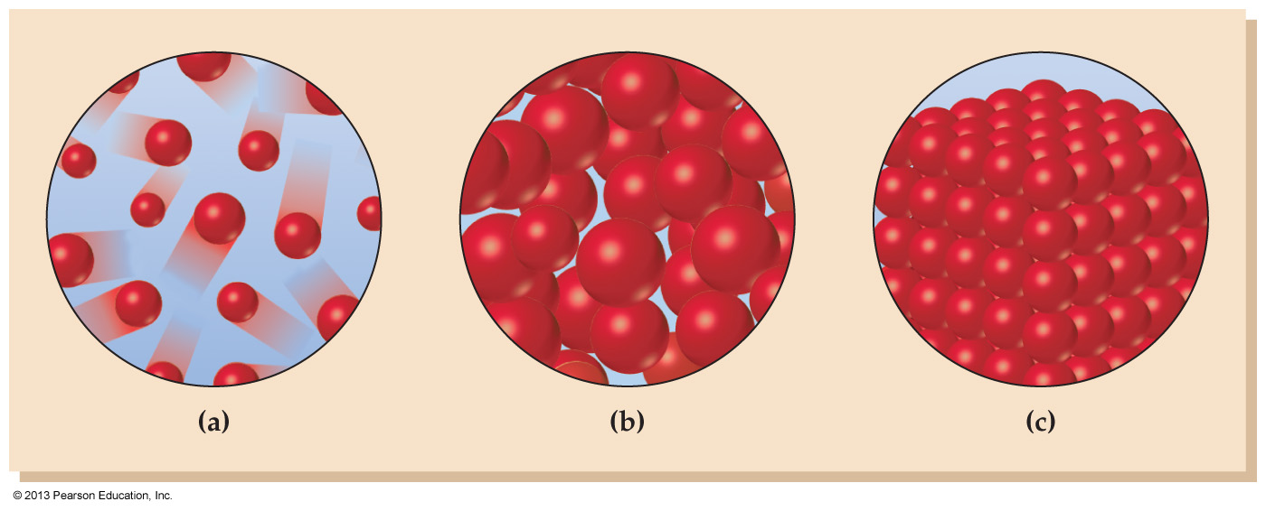
8.1 States of Matter and Their Changes

Slide 7
In Intro, matter always exists in one of these three phases, or states
solid, liquid, and gas
Which state depends on the strength of the forces between particles compared to their kinetic energies

Slide 8
fyi
Chemical reactions in Introductory chemistry always take place in the liquid phase
In the solid state, compounds are too immobile to react
In the gas phase, they are too far apart to react

Slide 9
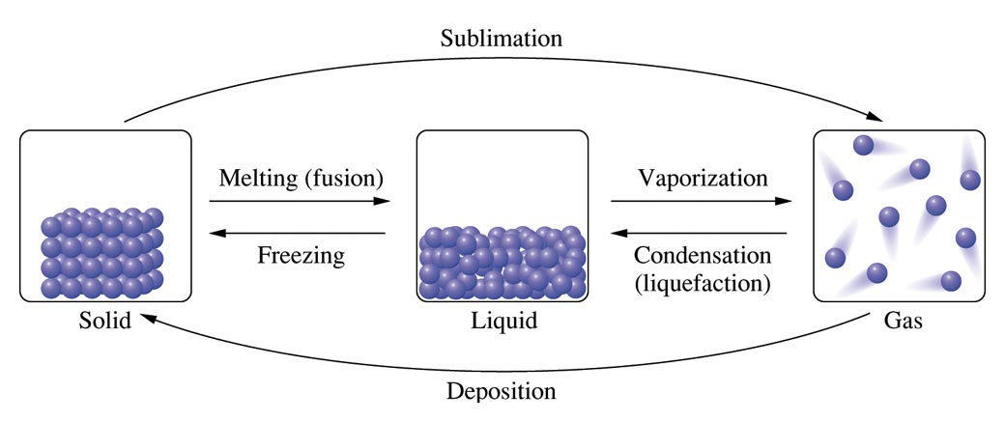
The transformation of a substance from one state to another is called a phase change
or a change of state
change of states are reversible in Intro

Slide 10
A free-energy change can be calculated for these phase changes
so as to determine how reversible the reaction is (next slide)
Note the sign of ΔG is temperature-dependent

Slide 11
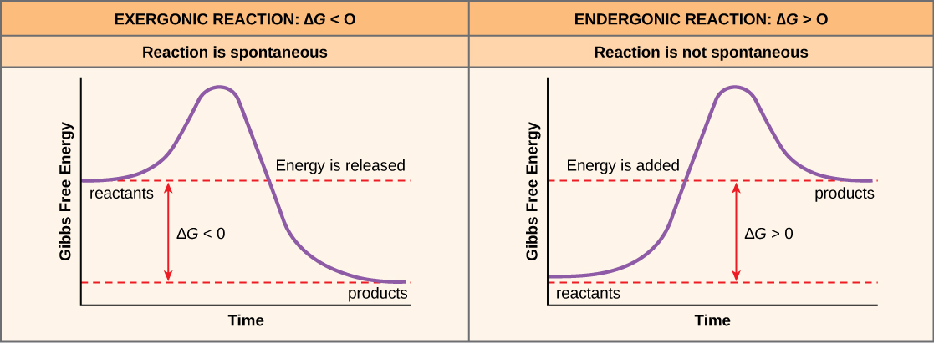
The smaller the ΔG
the more reversible the reaction

Slide 12
Worked Example 8.1 Change of State: Enthalpy, Entropy, and Free Energy
The change of state from liquid to gas for chloroform has these values
ΔH = +6.98 kcal/mol
ΔS = +20.9 cal /(mol•K)
(a) Is the change of state from liquid to gas favored or unfavored by ΔH? by ΔS?

Slide 13
ΔH = +6.98 kcal/mol, and ΔS = +20.9 cal /(mol•K)
Is the change of state from liquid to gas favored or unfavored by ΔH? by ΔS?
Enthalpy (ΔH = +) does NOT favor the change
Entropy (ΔS = +) DOES favor the change
But because the two factors conflict, the actual phase state present will depend on temperature
So we must use our equation for free-energy change to determine which phase actually exists at a given temperature: ΔG = ΔH − TΔS

Slide 14
ΔH = +6.98 kcal/mol, and ΔS = +20.9 cal /(mol•K)
(a) Is the change of state from liquid to gas favored or unfavored by ΔH? by ΔS?
(b) Is the change of state from liquid to gas favored or unfavored at 35°C?
(c) Is this change of state spontaneous by 65°C?

Slide 15
ΔH = +6.98 kcal/mol, and ΔS = +20.9 cal /(mol•K)
Continued
(b) Substituting the values for ΔH and ΔS into the equation for free-energy change we can determine if ΔG is
positive or negative at 35 °C (308 K). Note that we must first convert degrees celsius to kelvins and convert
the ΔS from cal to kcal so the units can be added together.
Since the ΔG = positive, this change of state is not favored at 35 °C.
(c) Repeating the calculation using the equation for free-energy change at 65 °C (338 K):
bp = 61ºC
Because ΔG is negative in this case, the change of state is favored at this temperature.

Slide 16
The figures below depict mercury in three different states. Identify the change of state occurring when mercury is taken from the state in figure (c) to the state in figure (b), and give the name of the quantity of energy involved.
Boiling, heat of vaporization
Dissolution, heat of solution
Melting, heat of fusion
Sublimation, heat of sublimation

Slide 17
When isopropyl alcohol (CH₃)₂CHOH vaporizes on your skin, you feel cold. What are the signs of ΔH and ΔS for the vaporization process?
ΔH = – and ΔS = –
ΔH = – and ΔS = +
ΔH = + and ΔS = –
ΔH = + and ΔS = +

Slide 18
8.2 Intermolecular Forces
Intra vs. inter

Slide 19
An Intermolecular force is a force that acts whenever molecules are physically adjacent
Thus in gases, intermolecular forces are by definition negligible (kinetic theory)
For liquids and solids, intermolecular forces are by definition engaged
the stronger the intermolecular force…
…the higher the melting and boiling points

Slide 20
Concept Check
Which gas would behave more ideally at the same conditions of P and T?
CO or N₂
Why?
Notes:
N₂ would behave more ideally because it is nonpolar and only exhibits London dispersion forces, therefore the intermolecular forces between N₂ molecules are weak (and thus the collisions will be more “elastic”). CO also exhibits dipole-dipole interactions.

Slide 21
Liquids and solids

Slide 22
There are two major types of intermolecular forces in liquids and solids:
dipole–dipole forces
More properly, permanent dipole–dipole
Hydrogen bonding an especially strong and biologically crucial permanent dipole-dipole force
London dispersion forces

Slide 23
(Permanent) Dipole-Dipole Forces

Slide 24
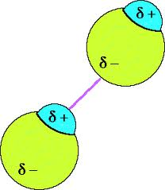
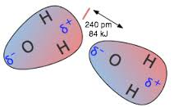
Polar molecules are those that have a significant dipole moment
The positive and negative ends of different water molecules are permanently attracted to one another in condensed phases

Slide 25
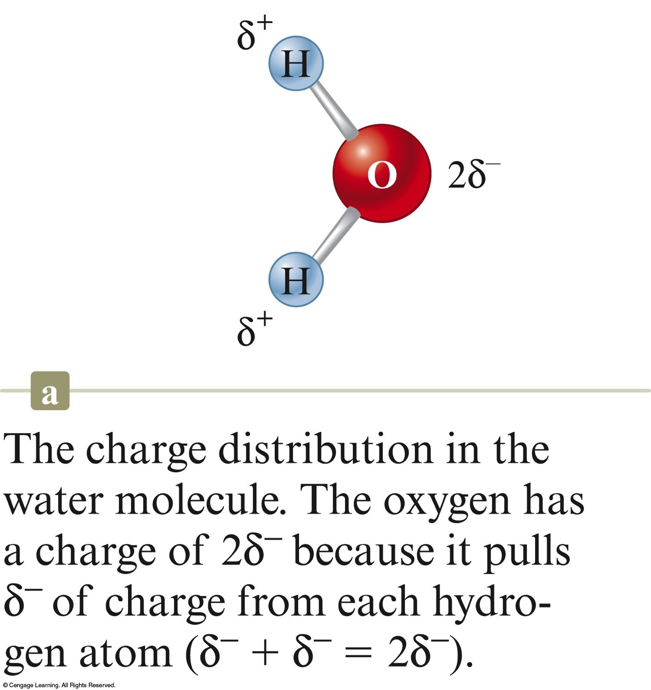
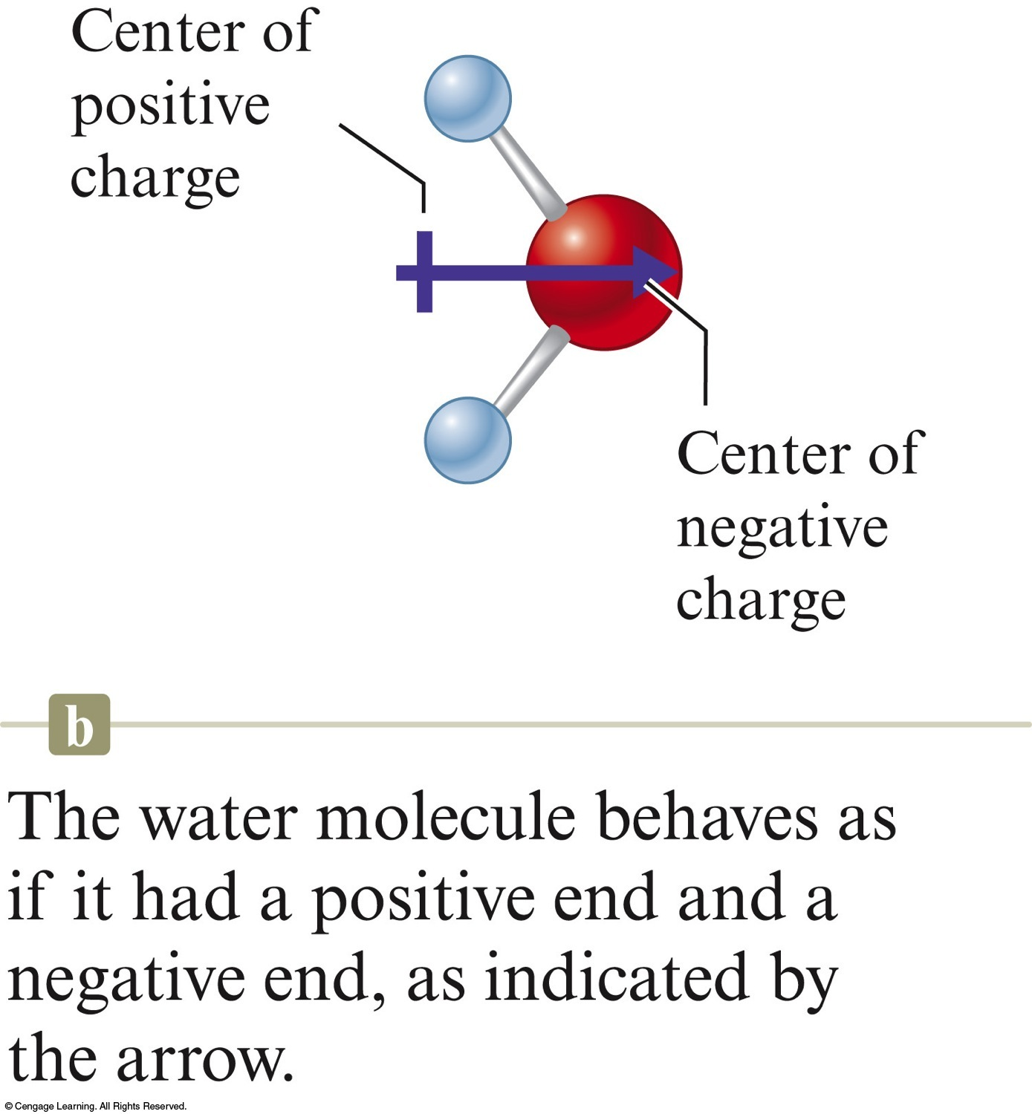
Water is polar because it has a very large dipole moment

Slide 26
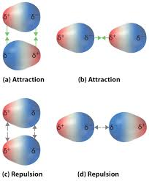
Individual dipole-dipole forces

Slide 27
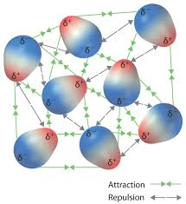
The resulting balance of forces

Slide 28
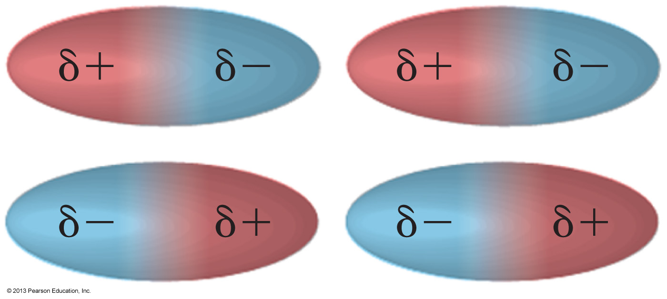
(Permanent) Dipole-Dipole Forces
Dipole-dipole forces are much weaker than those in ‘true’ bonds, but the effects of large collections of dipole–dipole forces are immense
as can be seen by looking at the difference in boiling points between polar and nonpolar molecules

Slide 29
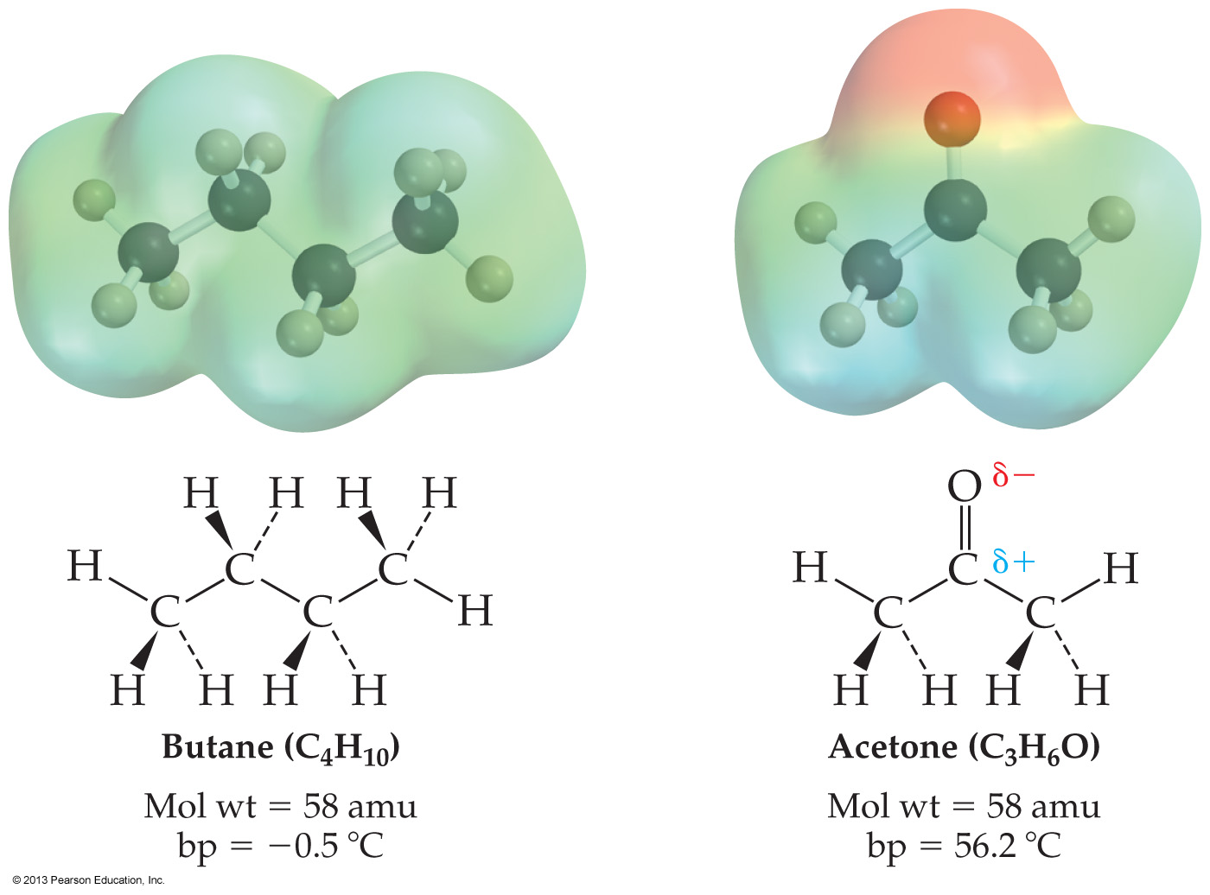
bp = −0.5ºC
bp = +56.2ºC
nonpolar:
molecules do not attract
polar:
molecules attract

Slide 30
Hydrogen Bonding
An unusually strong (permanent)
dipole-dipole attraction

Slide 31
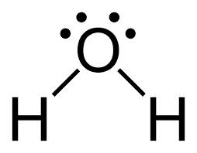
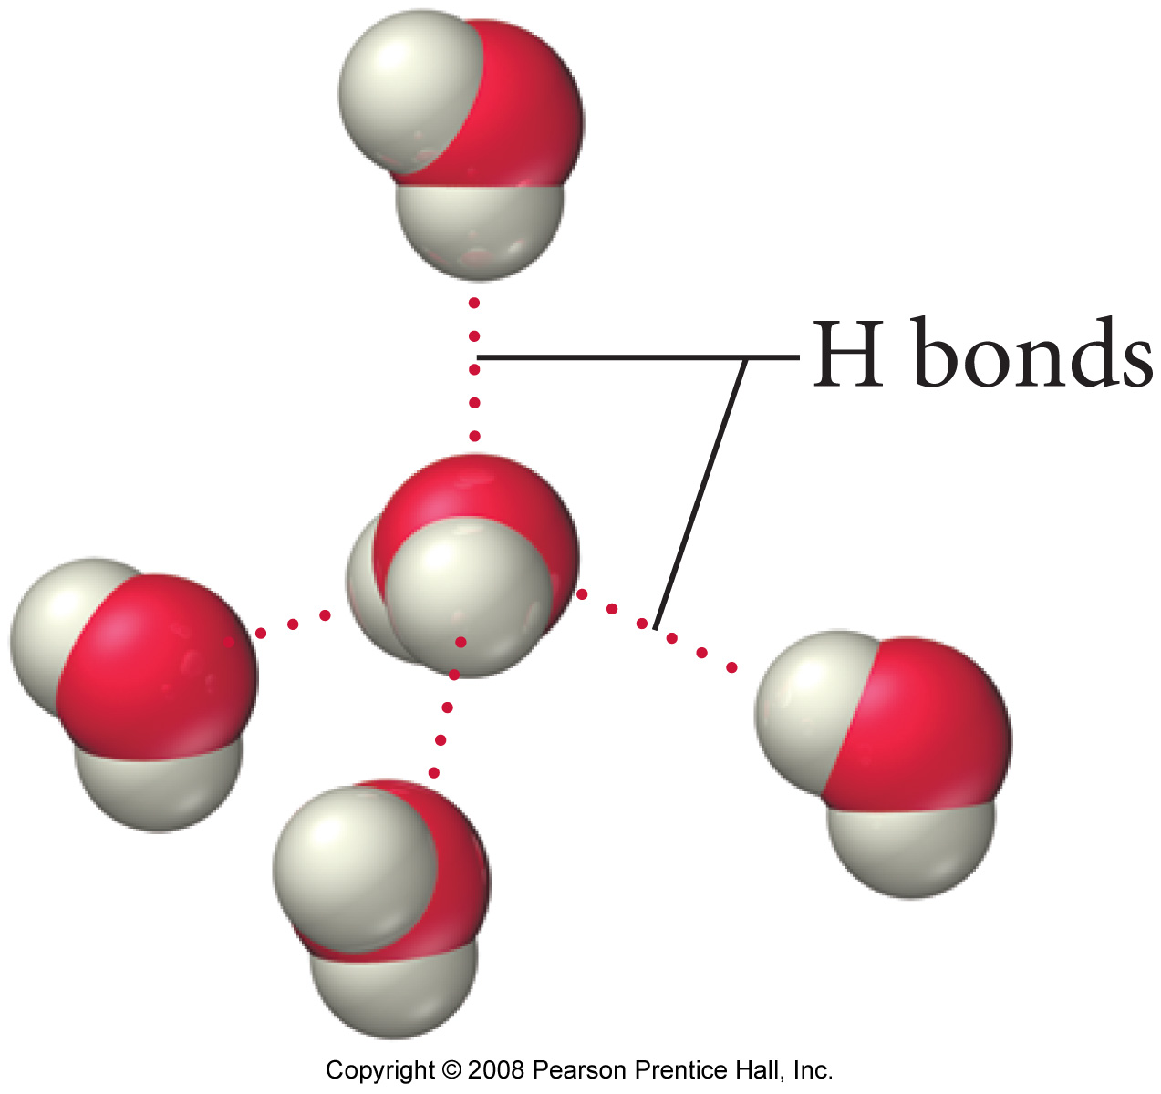
Hydrogen Bonding is…
...the attraction between a hydrogen atom which is bonded to an O, N, or F atom…
…with any nearby O, N, or F atoms

Slide 32
Hydrogen Bonding
In water, each oxygen atom has two lone pairs and two hydrogen atoms, allowing the formation of four hydrogen bonds

Slide 33
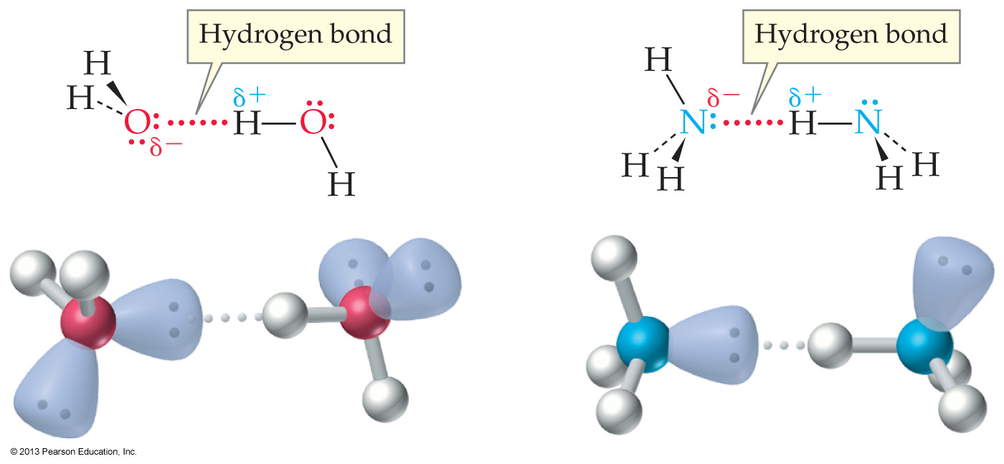

Slide 34
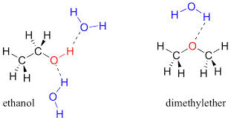
water and beyond
miscible with water
soluble in water

Slide 35
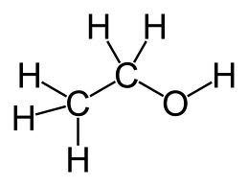
focus on ethanol alone
can two ethanol molecules
hydrogen bond to each other?

Slide 36
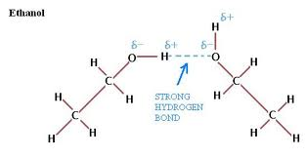
focus on ethanol alone
can two ethanol molecules
hydrogen bond to each other? YES

Slide 37
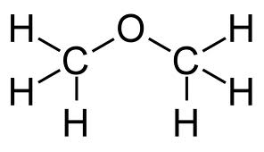
focus on dimethyl ether alone
can two dimethyl ether molecules
hydrogen bond to each other?
NO
because there are no O-H bonds
(and of course, no N-H or F-H bonds)

Slide 38
Can ethanol hydrogen bond with dimethyl ether?
Yes!
There are two oxygens present, and one is an O-H

Slide 39
nitrogen
can two ammonia molecules
hydrogen bond to each other
YES
Because there are N-H bonds present

Slide 40
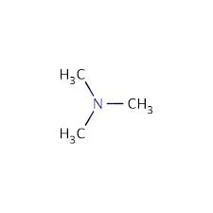
nitrogen
can two trimethyl amine molecules
hydrogen bond to each other?
NO
because there are no N-H bonds

Slide 41
nitrogen and oxygen together
Can trimethyl amine
hydrogen bond to ethanol?
YES
because there is an O-H bond

Slide 42
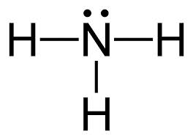
Can ammonia hydrogen bond to dimethyl ether?
YES
Because there is an N-H present

Slide 43
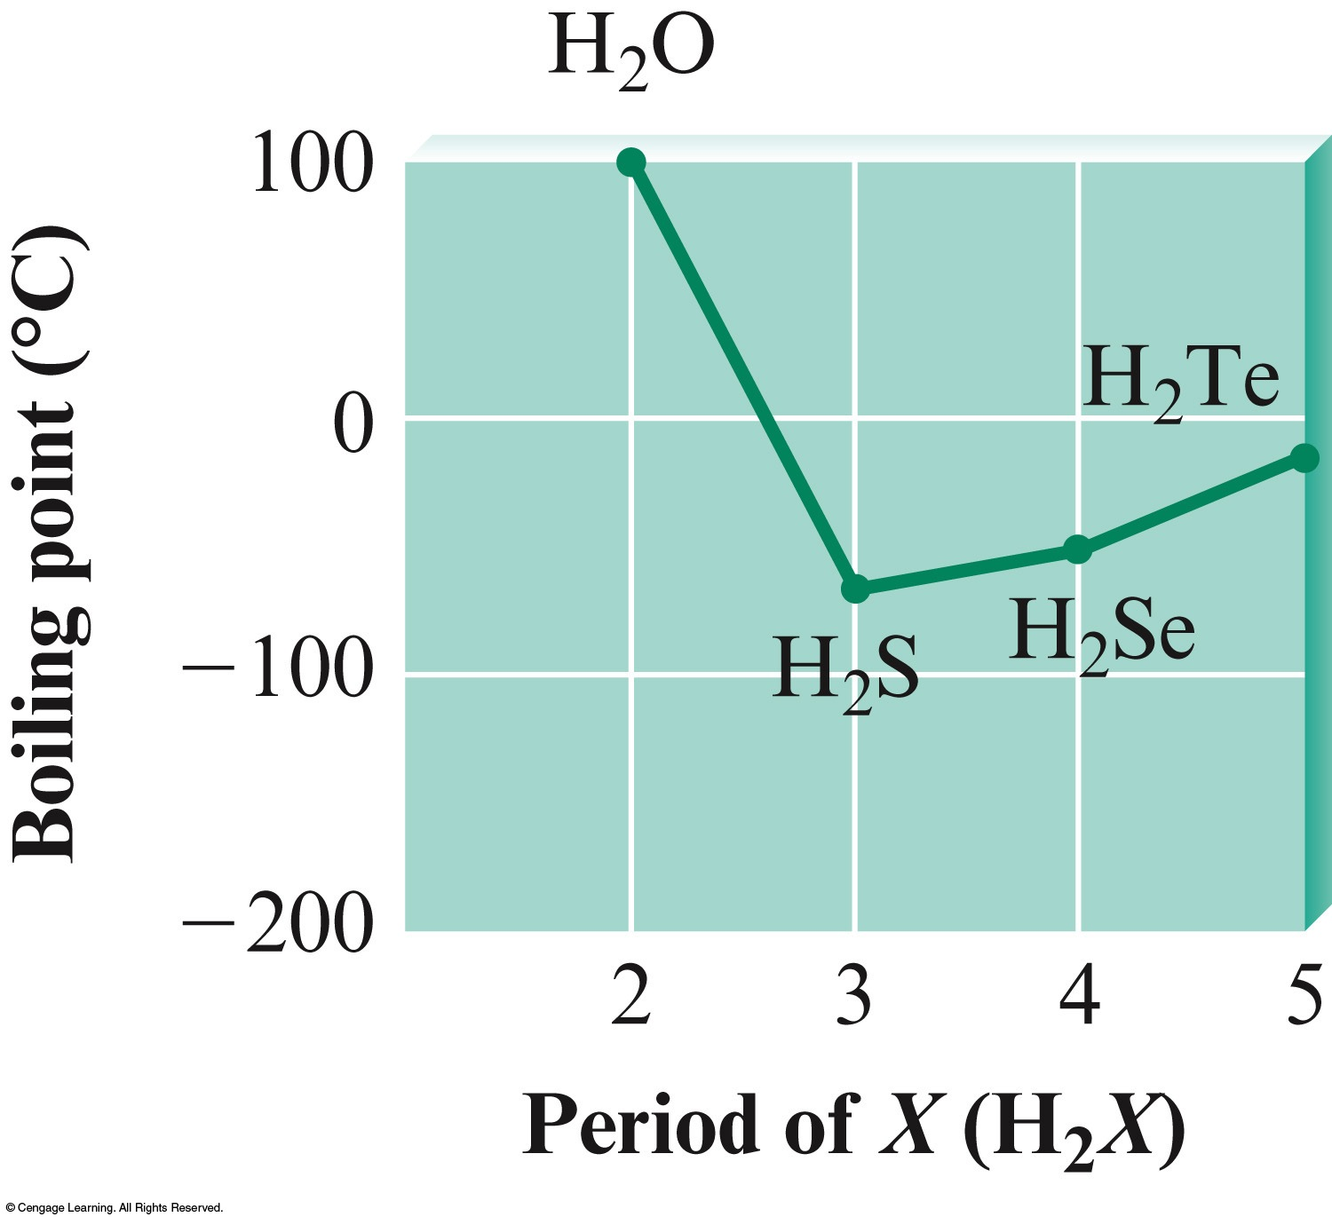
Effects of hydrogen bonding
Hydrogen bonding affects physical properties
Boiling point

Slide 44
strong in numbers
Individual hydrogen bonds are much weaker than covalent bonds
But in huge numbers, there is huge strength

Slide 45
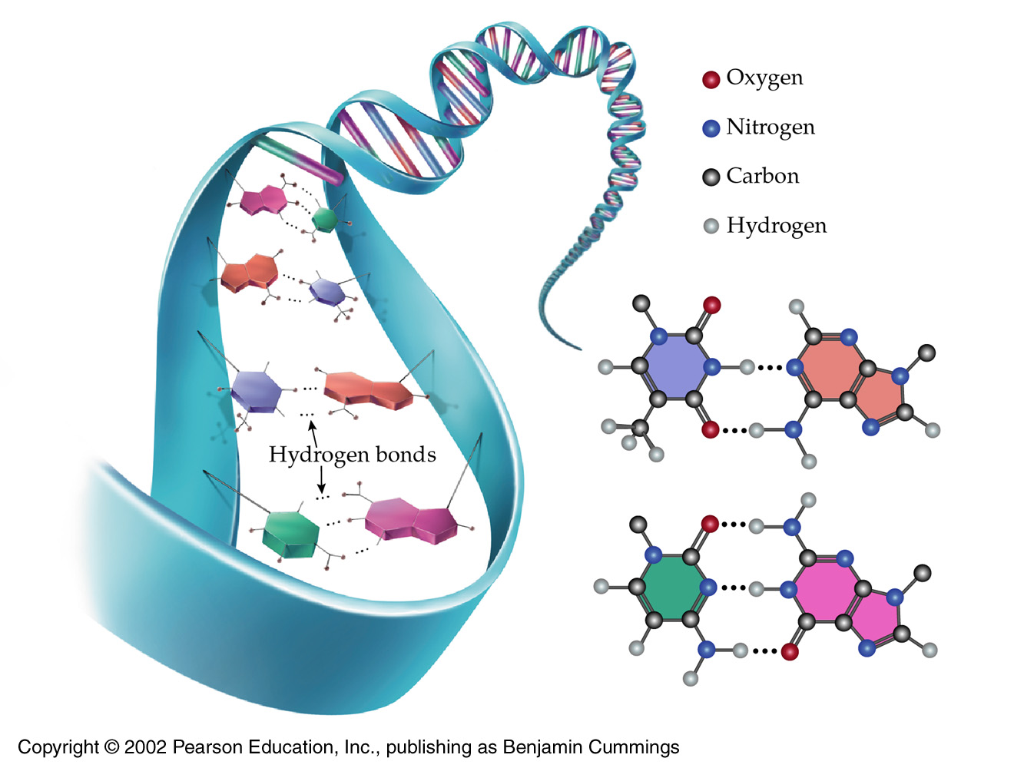

Slide 46
Concept Check
Below are two Lewis structures for the formula C₂H₆O
How would their boiling points differ?
Notes:
One Lewis structure could be ethanol and one Lewis structure could be dimethyl ether. Ethanol will have a higher boiling point than dimethyl ether because ethanol exhibits hydrogen bonding and dimethyl ether exhibits dipole-dipole interactions. Hydrogen bonding is an especially strong type of dipole-dipole interaction and will thus raise the boiling point of ethanol.

Slide 47
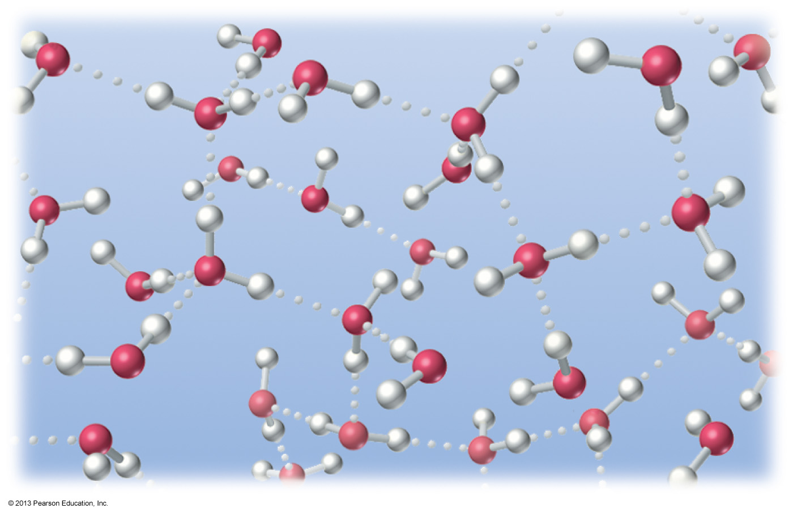
Shown below is a model of liquid water. What is the major intermolecular force of attraction responsible for water being a liquid?
Covalent bonding
Dipole–dipole
Hydrogen bonding
London dispersion

Slide 48
Which of the following is not capable of hydrogen bonding?
HF
H₂O
NH₃
CH₄
Methane has H atoms, but none of
them are connected to an O, N, or F

Slide 49
London Dispersion Force
How non-polar molecules condense

Slide 50
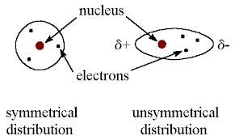
London Dispersion Forces
Left: Time
averaged
Right:
Instantaneous
Molecules and atoms are always experiencing London forces
Though strong dipole-dipole forces overwhelm them
These forces are easier to visualize with atoms

Slide 51
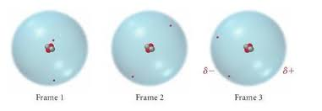
London Dispersion Forces
Before London Forces were recognized, it was thought impossible to liquefy helium
Because atoms are not polar and cannot experience those dipole-dipole forces which normally cause liquefaction in polar molecules

Slide 52
London Dispersion Forces
But helium’s two electrons occasionally find themselves on the same side of the atom (frame 3)
This random occurrence presents a moment of uneven charge distribution
Creating a weak, instantaneous polarity

Slide 53
Since neon has more electrons, it is easier to see the London mechanism in action
When cooled, a collection of neon atoms moves more slowly, and gradually succumb to each other’s London influence – and liquefy!

Slide 54
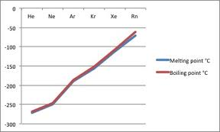
London forces easily explain this trend
The more electrons, the stronger the London forces
The stronger the London forces, the easier to liquefy

Slide 55
Molecules and London Forces

Slide 56
All molecules also experience London force moments
But in highly polar molecules like water, the permanent dipole-dipole overwhelms the much weaker London contribution
Note: this is a favorite ‘trick question’ on multiple choice exams
Yes, water does experience London forces, but they are overwhelmed by water’s permanent dipole

Slide 57
At any instant there may be more electrons at one end of a molecule than at the other
Imparting a short-lived negative influence
Leaving a positive influence at the other end
The larger the molecular weight and surface area, the larger and more frequent these temporary polarities become

Slide 58
When cooled, molecules move more slowly and thus fall under each other’s influence
When close to each other, any temporary polarity will induce a similar ‘matching’ polarity in a neighboring molecule
and the collection of molecules will liquefy

Slide 59
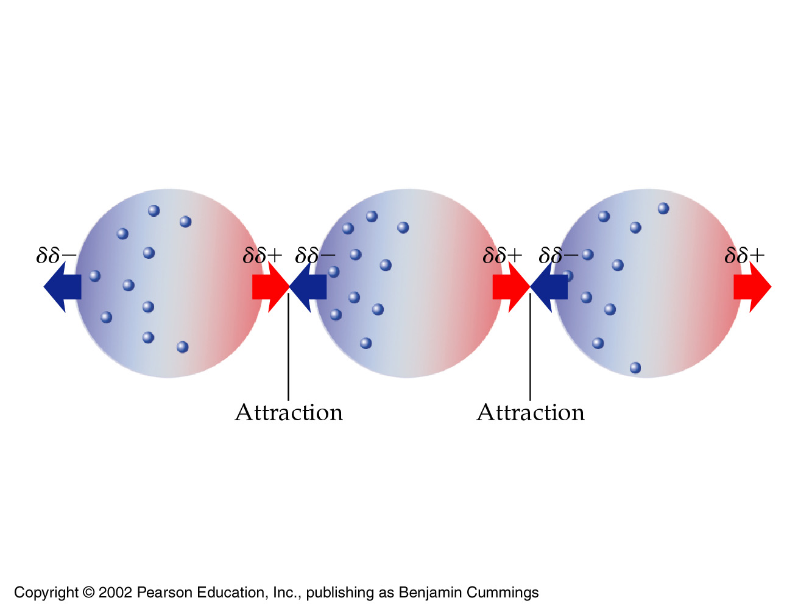
Methane has 10 electrons

Slide 60
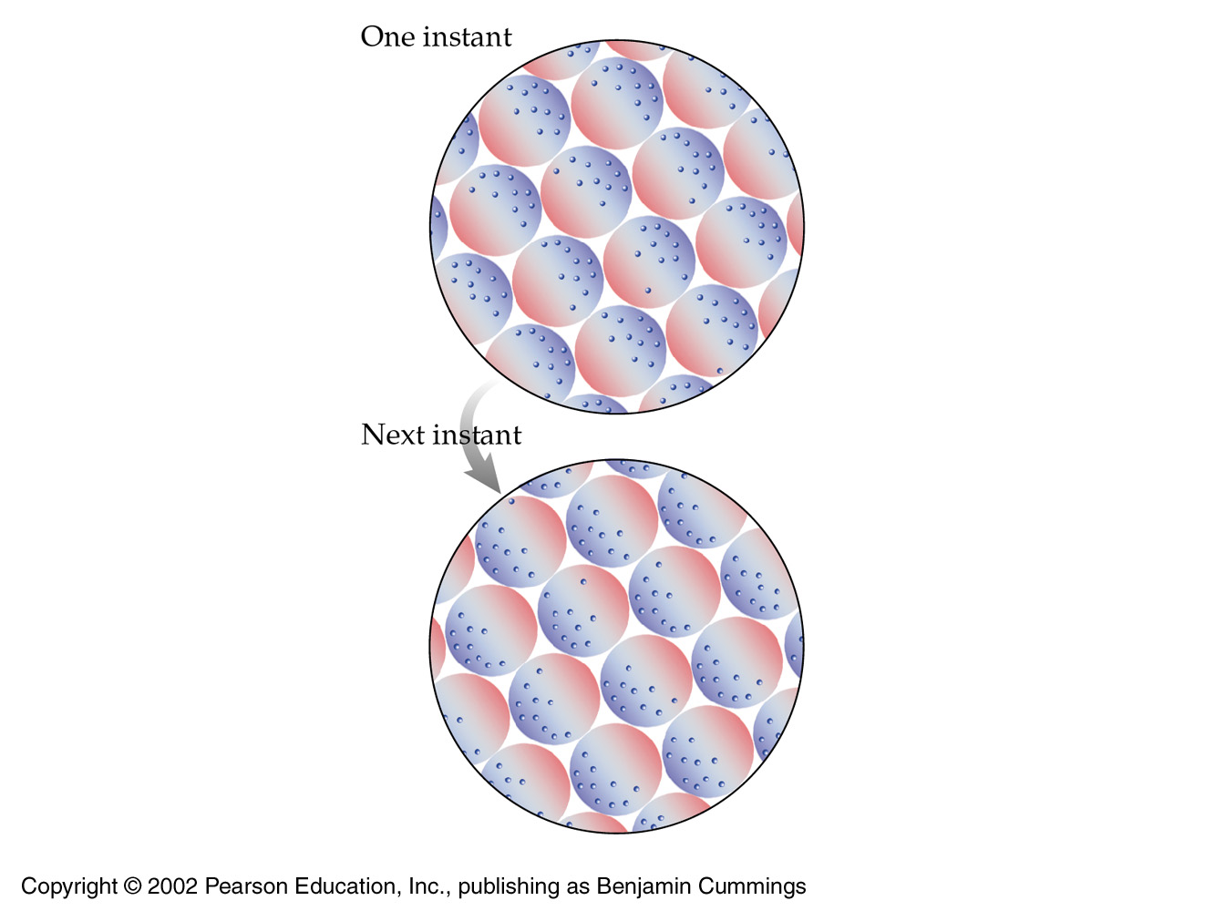
These forces are dynamic
In a video, these would
ripple like waves
on the surface of water
Such a sustained
intermolecular attraction
we call a liquid
Further cooling leads to
a solid

Slide 61
Concept Check
Consider the following compounds:
NH₃ CH₄ H₂
How many of the compounds above exhibit London dispersion forces?
a) 0
b) 1
c) 2
d) 3
Notes:
The correct answer is d. All molecules, whether nonpolar or polar, exhibit London dispersion forces.

Slide 62
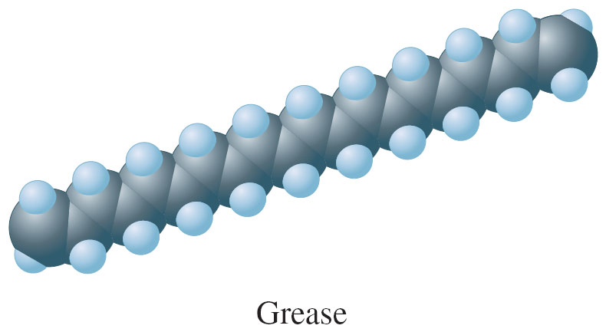
fyi: Grease Molecule
lots of electrons
lots of molecular surface area
so there are numerous London ‘sites’
resulting in a semi-solid at room temperature

Slide 63
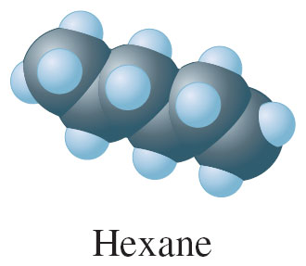
fyi: Hexane Molecule
fewer electrons
very little molecular surface area
resulting in fewer London sites
resulting in a liquid at room temperature

Slide 64
fyi

Slide 65
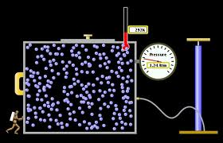
8.3 Gases and the Kinetic Molecular Theory

Slide 66
The kinetic–molecular theory (model) of gases is a collection of assumptions that help us make predictions regarding the behavior of common gases
Is the model ‘real’?
It normally gives ‘real’ approximations of reality

Slide 67
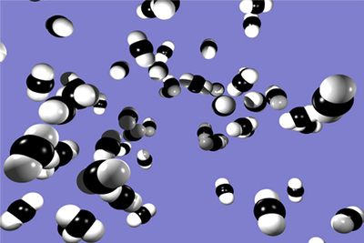
Postulates of the Kinetic Molecular Theory (of the Ideal Gas)
1. The ideal gas consists of hypothetical particles moving perfectly at random with no attractive forces between them
But real gases
always have some
attraction

Slide 68
Postulates of the Kinetic Molecular Theory
2. The volume of the ideal gas particle is insignificant compared with the volume of its container

Slide 69
Postulates of the Kinetic Molecular Theory
Of course, whether the sizes of the particles are indeed ‘insignificant’ depends on the accuracy that your calculations demand

Slide 70
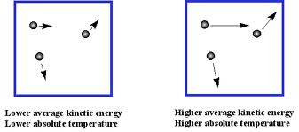
Postulates of the Kinetic Molecular Theory
3. The average kinetic energy of ideal gas particles is proportional to the Kelvin temperature

Slide 71
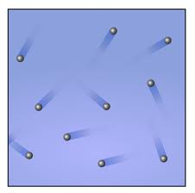
Postulates of the Kinetic Molecular Theory
4. All collisions of ideal gas particles are perfectly elastic in other words…
the total kinetic energy of a pair of colliding particles is unchanged following impact
collisions either with
other particles or with
the container

Slide 72
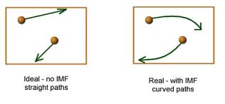
Postulates of the Kinetic Molecular Theory
5. An ideal gas is defined as one that obeys all the assumptions of the kinetic–molecular theory
IMF = intermolecular force

Slide 73
1. The ideal gas consists of hypothetical particles moving perfectly at random with no attractive forces between them
2. The volume of the ideal gas particle is insignificant compared with the volume of its container
3. The average kinetic energy of ideal gas particles is proportional to the Kelvin temperature
4. All collisions of ideal gas particles are perfectly elastic. So the total kinetic energy of a pair of colliding particles is unchanged following impact
5. An ideal gas is defined as one that obeys all the assumptions of the kinetic–molecular theory

Slide 74
Implications
of kinetic molecular theory

Slide 75
Meaning of temperature
Kelvin temperature is directly proportional to the average kinetic energy of the gas particles.
Relationship between Pressure and Temperature
Gas pressure increases as the temperature increases because the particles speed up.
Relationship between Volume and Temperature
Volume of a gas increases with temperature because the particles speed up.

Slide 76
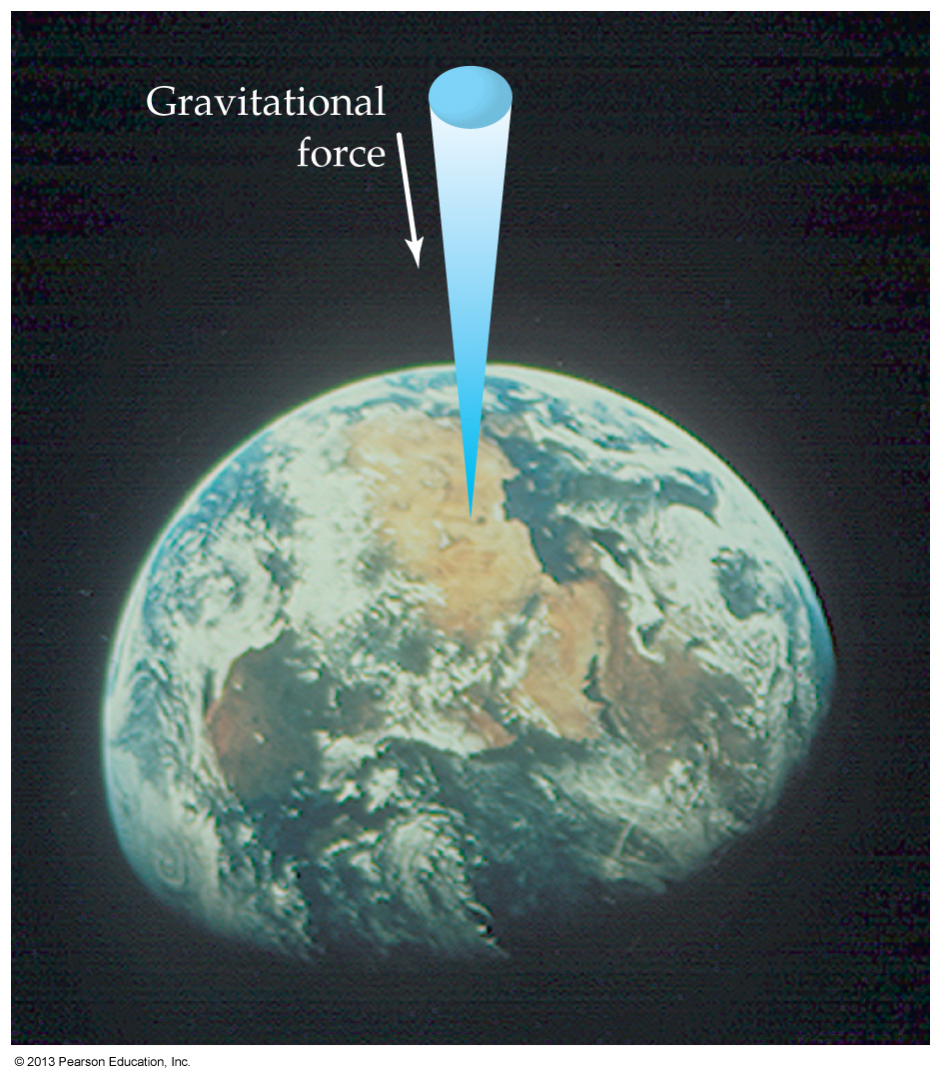
8.4 Pressure
Gravity ‘pulls down’ on the
gas envelope surrounding our
planet, creating pressure
at the surface
= 14.7 pounds per square inch
= 101,325 Pascals
= 1 atmosphere
= 760 mm Hg
= 760 Torr

Slide 77
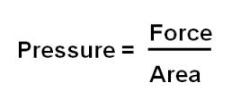
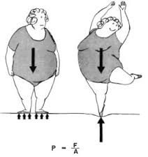
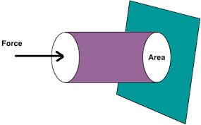

Slide 78
Air Pressure

Slide 79
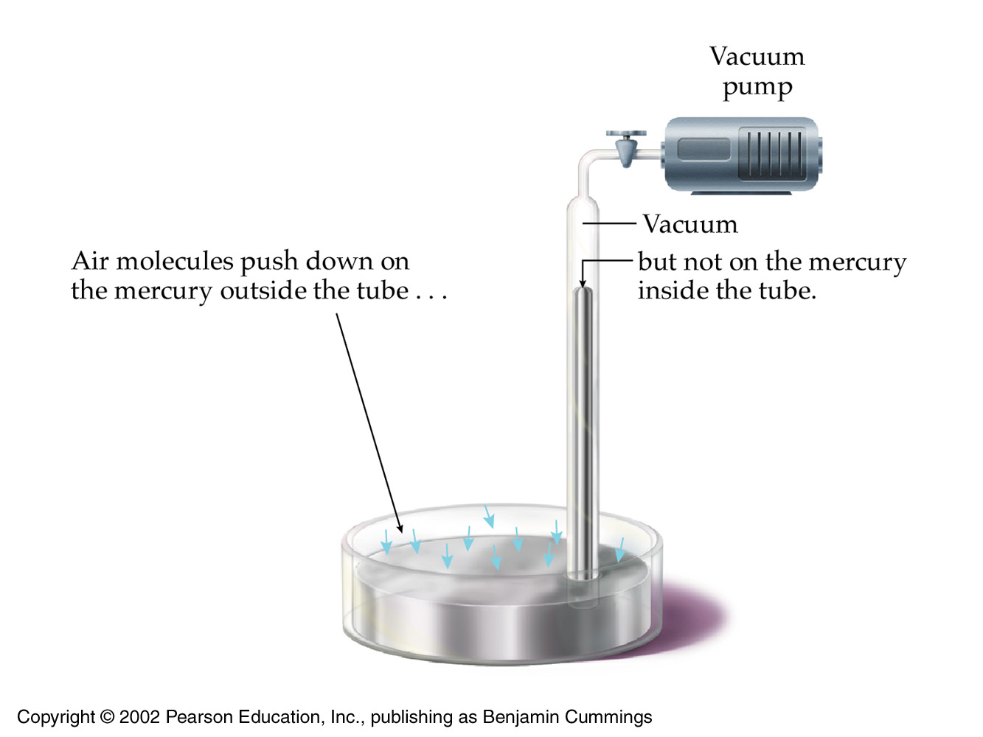
Closed-end mercury barometer
like sucking soda
with a straw

Slide 80
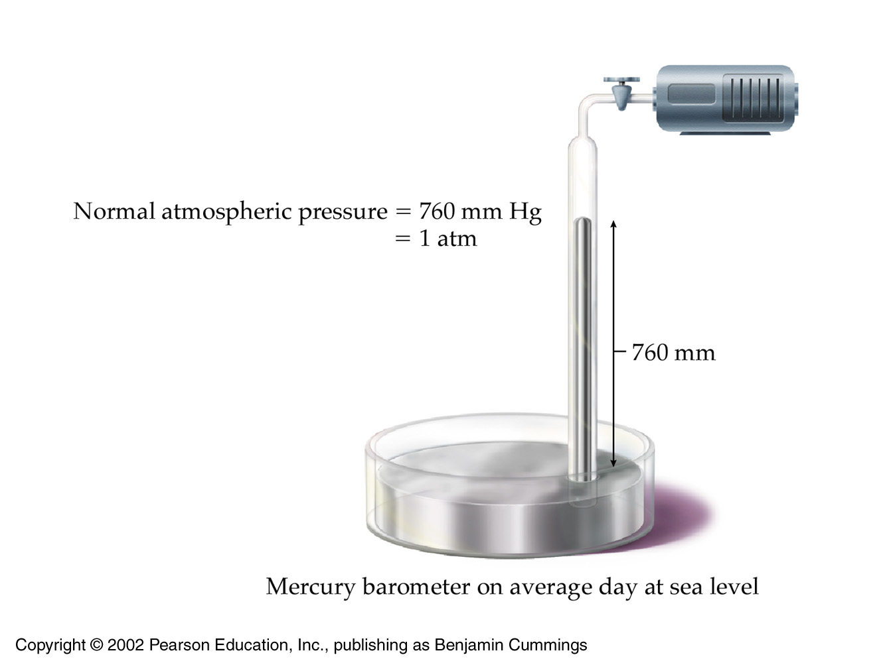

Slide 81
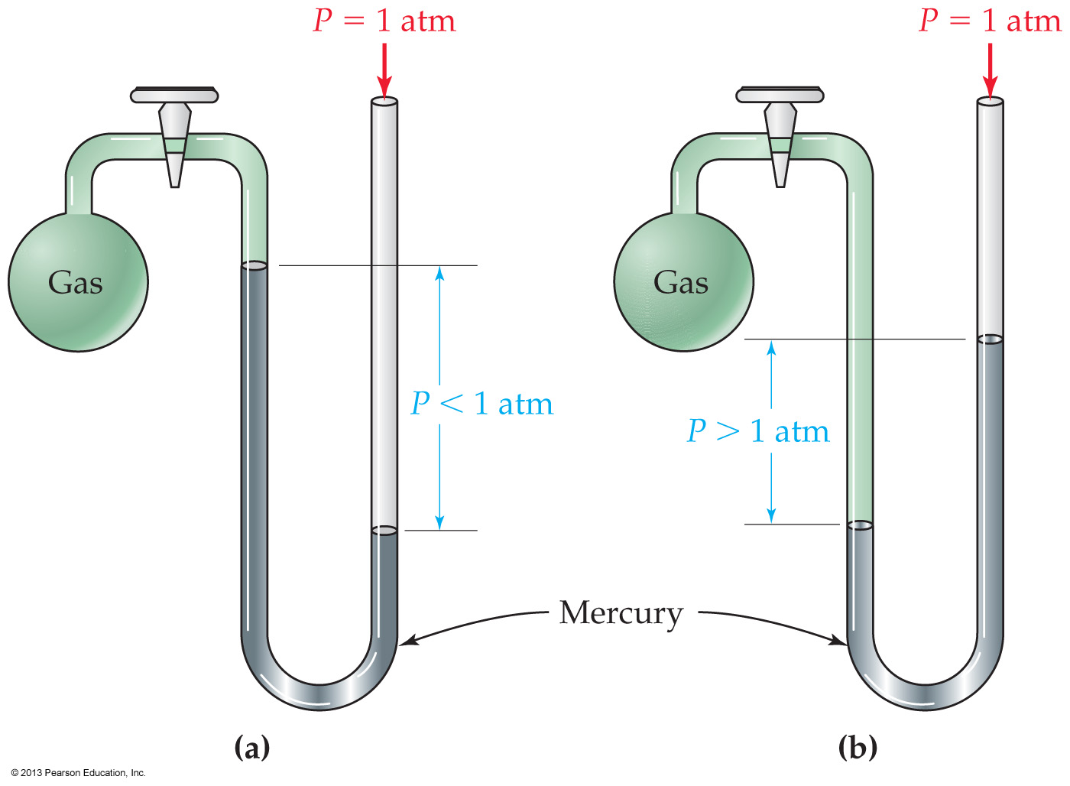
fyi
Gas pressure in a container is measured using a manometer
The difference between the mercury levels indicates the difference between gas pressure and atmospheric pressure
Pressure is given in the SI system by the pascal (Pa)

Slide 82
Conversions
1 atm = 760 mm Hg
we will frequently use: 1 atm = 760 mm Hg
for conversions
1 mm Hg = 1 torr

Slide 83
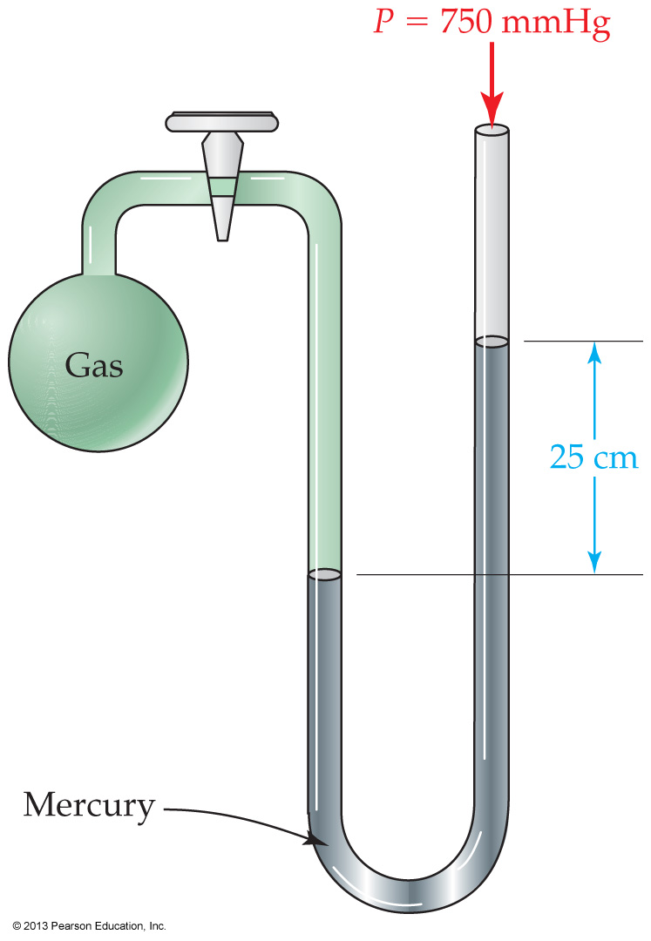
Oxygen gas is contained in the apparatus shown below. What is the pressure of the oxygen in the apparatus?
500 mm Hg
725 mm Hg
775 mm Hg
1000 mm Hg

Slide 84
The Gas Laws

Slide 85
All gas laws can be formulated with four variables
Volume
Pressure
Temperature (Kelvins only!)
n (number of moles of gas)

Slide 86
FYI
V = volume
Conceptually understood since ancient times
P = pressure
Understood since Toricelli in previous section (1643)
T = absolute temperature (Kelvins)
Charles, Lord Kelvin (1724 / 1785)
n = number of moles
Avogadro (1811)

Slide 87
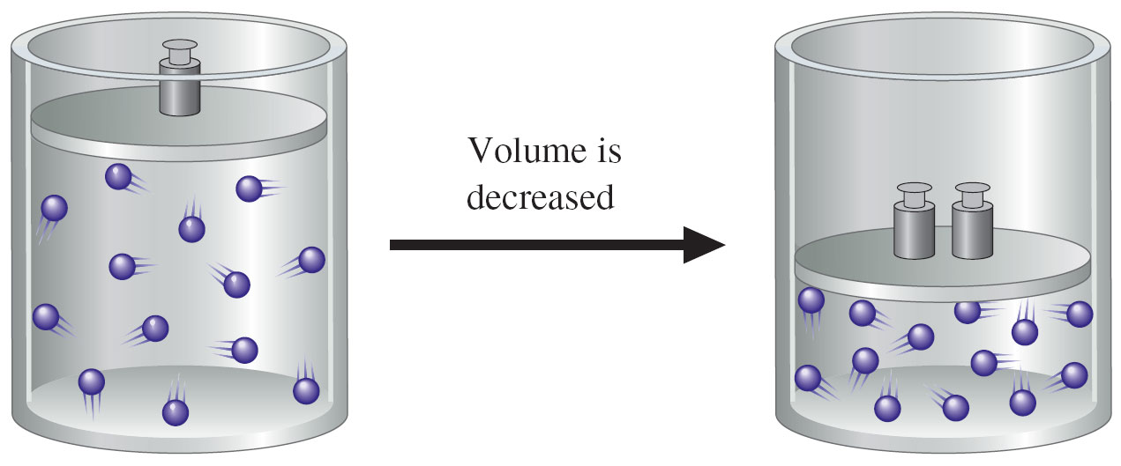
8.5 Boyle’s Law: The Relation between Volume and Pressure
P₁V₁ = P₂V₂

Slide 88
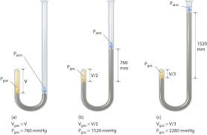
Boyles Apparatus

Slide 89
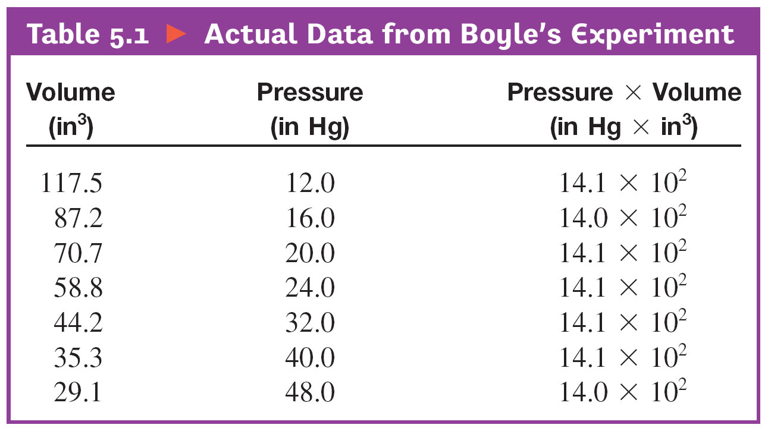
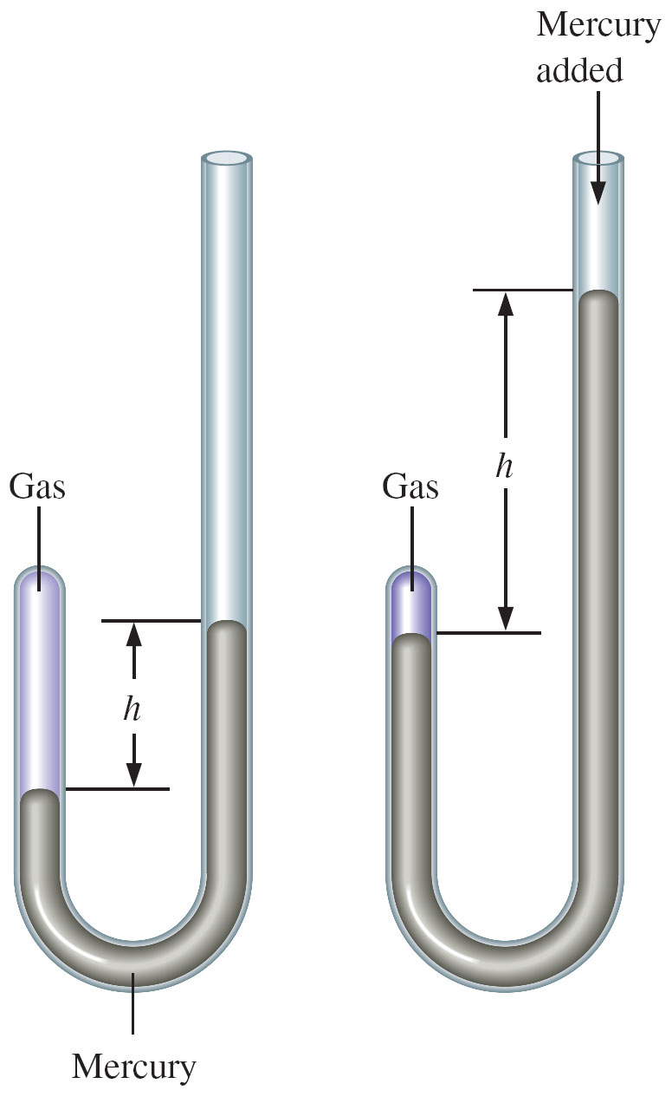
Actual Data From Boyle's Experiment
P₁ x V₁ = P₂ x V₂ = P₃ x V₃ = k

Slide 90
FYI
With Boyle’s results, it is understood for the first time that the ‘chemicals’ around us (such as those contained in air), exhibit a regularity that can be captured by mathematics
Thereby allowing predictions

Slide 91
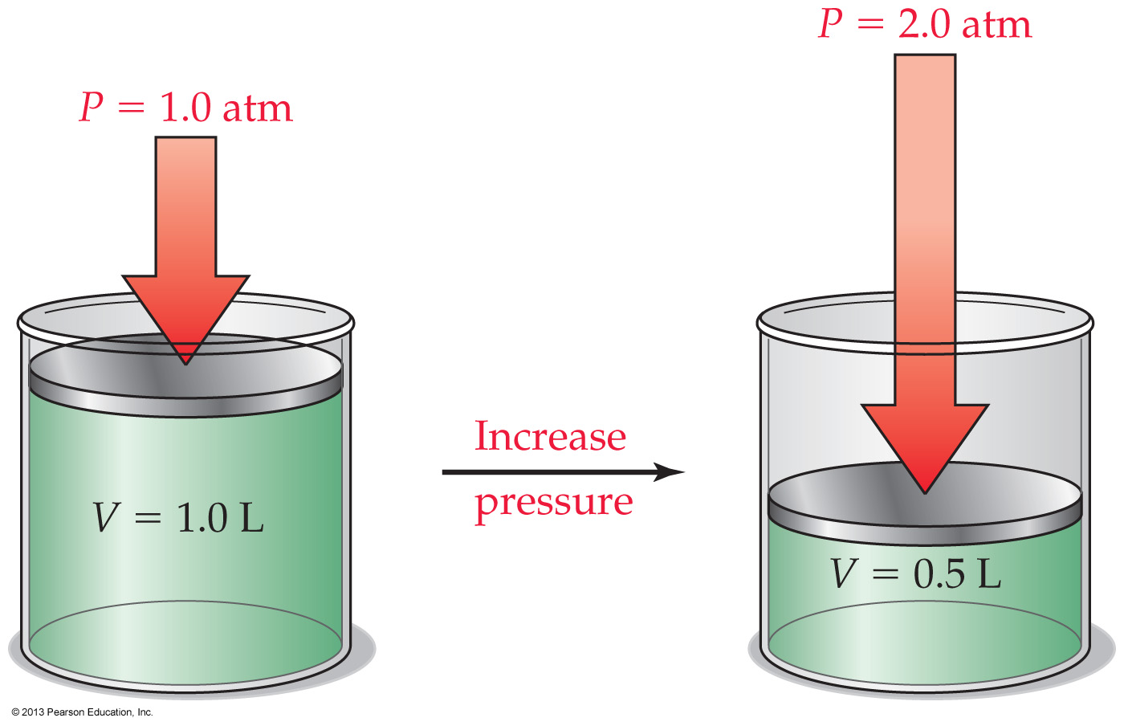
Boyle’s law: The volume of a gas at constant temperature decreases proportionally as its pressure increases
If the pressure of a gas sample is doubled, the volume is halved
P₁V₁ = P₂V₂

Slide 92
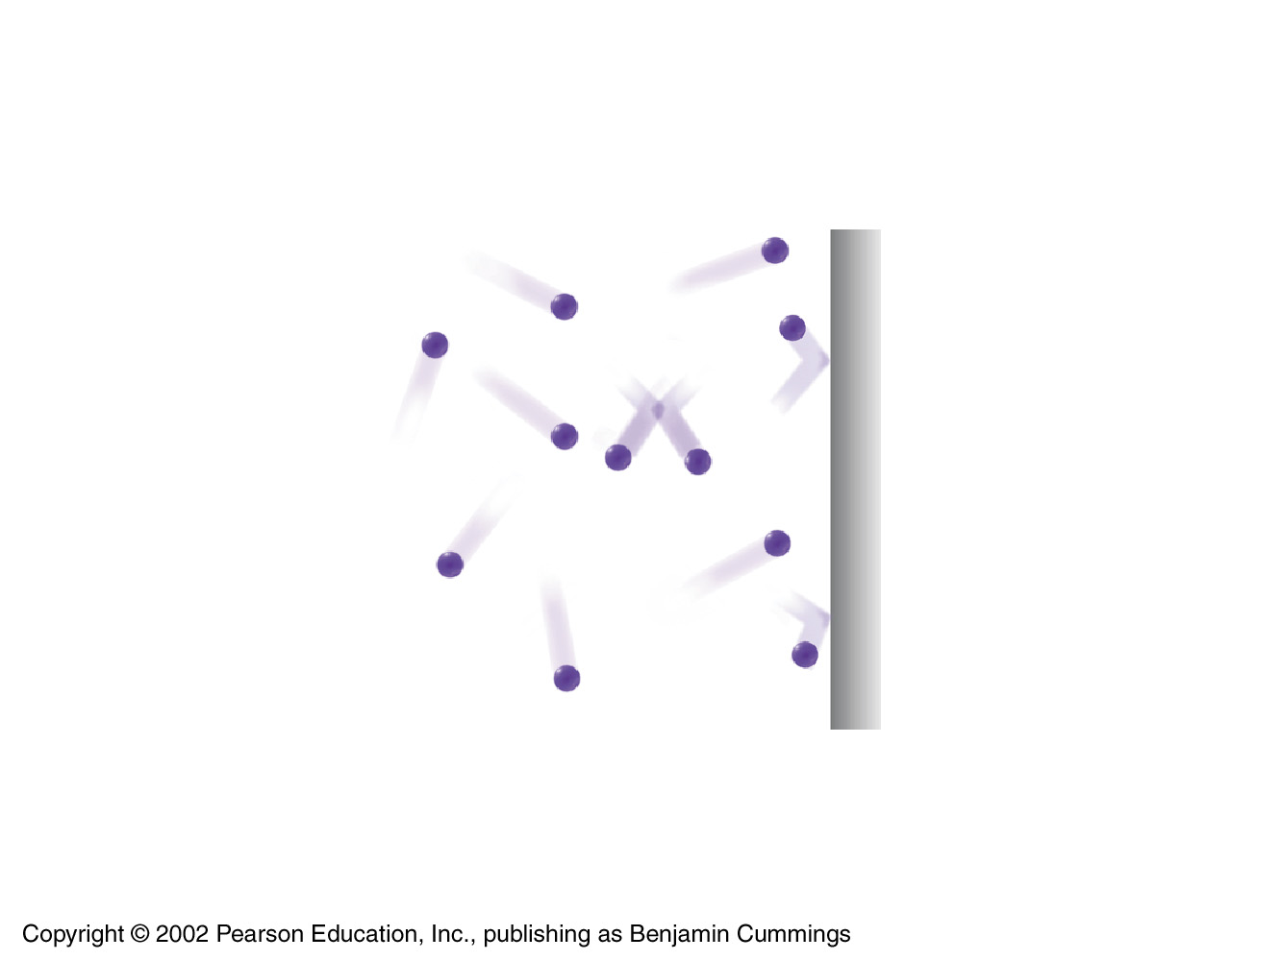
fyi
More molecules striking the surface per unit area per unit of time
This is the kinetic-theory definition of higher pressure

Slide 93
fyi
Notes:
Figure 8.12 Boyle’s law. Pressure and volume are inversely related. Graph (a) demonstrates the decrease in volume as pressure increases, whereas graph (b) shows the linear relationship between V and 1/P.

Slide 94
The volume of a balloon is 2.85 L at a pressure of 763 mm Hg. What will the volume of the balloon be when the pressure is decreased to 755 mm Hg at a constant temperature?
2.82 L
0.355 L
2.88 L
0.347 L

Slide 95
8.6 Charles’s Law: The Relation between Volume and Temperature

Slide 96
fyi: What took so long!
Why did it take 100 years to go from Boyle’s law to Charles’ law
Because the concept of temperature and the construction of thermometers were both in their infancy
And try using Charles’ equation to see what happens to the volume of 1.0 L of a gas as we lower the temperature from 10ºC to -10ºC

Slide 97
Charles’s own graphing data for several gases
Notice they all converge at
@ − 273ºC (aka 0 Kelvins)

Slide 98
Charles’s law: The volume of a gas at constant pressure is directly proportional to its Kelvin temperature
If the Kelvin temperature of the gas is doubled
its volume doubles

Slide 99
Notes:
Figure 8.15 Charles’s law.

Slide 100
8.7 Gay-Lussac’s Law: The Relation between Pressure and Temperature
An exercise for the student

Slide 101
Gay-Lussac’s law: The pressure of a gas at constant volume is directly proportional to its Kelvin temperature
As temperature goes up or down, pressure also goes up or down

Slide 102
fyi
Notes:
Figure 8.16 Gay-Lussac’s law.

Slide 103
8.8 The Combined Gas Law

Slide 104
If any five of the six quantities in this equation are known, the sixth can be calculated
If any of the three variables T, P, or V remains constant, then that variable drops out of the equation
For a fixed amount of gas, the combined gas law is the only equation you need to digest

Slide 105
Where the temperature remains constant, this equation ‘reduces’ to Boyle’s law
Where pressure is constant, it reduces to Charles’ law
Where volume is constant, it reduces to Gay-Lussac’s law

Slide 106
A hot-air balloon has a volume of 960 L at 291 K. The balloon is heated up and the volume increases to 1070 L. What is the final temperature (in °C) of the balloon?
50 °C
80 °C
110 °C
130 °C

Slide 107
8.9 Avogadro’s Law: The Relation between Volume and Molar Amount

Slide 108
Avogadro’s law: the volume of a gas is directly proportional to its molar amount
at a constant pressure and temperature
A sample that contains twice the molar amount has twice the volume

Slide 109
Avogadro’s law
Avogadro postulated that equal volumes of gases at the same temperature and pressure contain the same number of ‘particles’
So what happens if we double the particle count?

Slide 110
The super-duper combined gas law
With Avogadro’s law, we can now formulate
a super-duper combined gas law

Slide 111
1.0 mol of gas at 25 °C and 0.90 atm is contained in an apparatus with a movable piston. Which set of conditions will result in a lower piston position than shown in this drawing?
1.0 mol of gas, 25 °C, and 1.80 atm
1.0 mol of gas, 50 °C, and 0.90 atm
2.0 mol of gas, 25 °C, and 0.45 atm
2.0 mol of gas, 25 °C, and 0.90 atm

Slide 112
If all other variables are held constant, which change will NOT cause a change in the pressure of oxygen in a mixture of oxygen and nitrogen?
Decreasing the moles of oxygen
Decreasing the temperature
Increasing moles of nitrogen
Increasing the volume

Slide 113
At a constant volume, a flask is filled with helium at 25 °C and 1.03 atm pressure, sealed, and then heated to 98 °C. What is the pressure inside the flask?
0.827 atm
1.21 atm
1.28 atm
0.916 atm

Slide 114
8.10 The Ideal Gas Law: PV = nRT
But no gases are truly ideal

Slide 115
The need for a Standard State

Slide 116
Calculations in the previous sections depended on having data from the same sample at two different conditions
initial state and final state
But it would be convenient to be able to do calculations for a gas in a single state
To do this, chemists define Standard State conditions

Slide 117
fyi: PV = nRT
The ideal gas law applies to a gas sample in a single state situation
But not having data available from two distinct states presents a loss of information
To make up for this loss, the ideal gas law invents a standard state condition (STP) to stand in as the ‘second state,’ and thereby fill back this lost data

Slide 118
Standard State conditions
The possibility of an ideal gas law depends on defining an STP
Standard temperature and pressure (STP)
0 °C (273.15 K exactly)
1 atm (760 mmHg by definition)
The question next arises
what is the volume of one mole (standard volume) of ideal gas particles under Standard State conditions

Slide 119
What is the “standard’ volume of one mole of an ideal gas?
Into a ‘high precision’ inflatable ball we charge:
1.0000 mole of an ‘ideal gas’ (a standard amount)
We maintain the temperature at 273.15 K
We maintain the pressure at 1 atm
The volume meter on the balloon reads:
22.414 L

Slide 120
At STP, 22.414 L of an ideal gas would just fit into this precision ball
Photo © Brooks/Cole, Cengage Learning Company. All rights reserved.

Slide 121
The constant R in: PV = nRT
Recall that Boyle’s law involved a constant
next slide
Similarly, all the gas laws of the previous section involved constants
The constant R in the ideal gas law mathematically combines all of these
in order to relate P, V, n & T

Slide 122
FYI: Actual Data From Boyle's Experiment
P₁ x V₁ = P₂ x V₂ = P₃ x V₃ = k

Slide 123
fyi: How is R determined?
We start with the equation
PV = nRT
We solve for R using all our standard inputs
R = (PV) / (nT)
So the defined value for R is:

Slide 124
R = 0.08206 L•atm/mol•K R = 62.40 L•mm Hg/mol•K
PV = nRT
The constant R is called the Universal Gas Constant
Its value depends on the units chosen for pressure

Slide 126
Which of the following condition(s) are NOT considered to be standard temperature or pressure?
760 mm Hg
755 torr
0 °C
Both a and b
None of the above

Slide 127
What is the volume of 3.86 g of nitrogen gas at STP?
3.09 L
86.5 L
4.44 L
6.18 L

Slide 128
8.11 Partial Pressure and Dalton’s Law
Each particle in a gas acts independently
So the identity becomes irrelevant

Slide 129
Mixtures of gases behave the same as a single pure gas and obey the same laws
Dry air is a mixture of 21% O₂, 78% N₂, and 1% Ar by volume
so 21% of atmospheric pressure is caused by O₂, 78% by N₂, and 1% by Ar
The contribution of each gas in a mixture to the total pressure of the mixture is called the partial pressure of that gas.

Slide 130
The contribution of each gas in a mixture to the total pressure of the mixture is called the partial pressure of that gas

Slide 131
For a mixture of ideal gases in a container
P_{Total} = P₁ + P₂ + P₃ + . . .
The total pressure exerted is the sum of the pressures that each gas would exert if it were alone

Slide 132
So for a mixture of ideal gases, it is the total number of ‘particles’ that is important
Not the identity or composition of the involved gases

Slide 133
P_{Total} = P₁ + P₂ + P₃ + P_{n}
Summary
The pressure exerted by each gas depends on the frequency of collisions of its molecules with the walls of the container
This frequency does not change when different gases are employed
Gases are all marble faces to each other

Slide 134
What Intro Chem students can do with Dalton’s law of partial pressure in the lab

Slide 135
Collecting a Gas Over Water
Total pressure is the pressure of the gas plus the vapor pressure of the water

Slide 136
Collecting a Gas Over Water
What is the total pressure of the gas collected over water?

Slide 137
Collecting a Gas Over Water
How can we find the pressure of the ‘dry’ gas collected alone?
We simply subtract the Vapor Pressure of Water from the measured value

Slide 138
8.12 Liquids

Slide 139
Vapor phase
Molecules are in constant motion in the liquid state
If a molecule has enough energy, it can break free of the surface and escape into the gas phase, called a vapor

Slide 140
A liquid’s vapor pressure is its partial pressure in a closed container
It is a partial pressure because these flasks also contain air (N₂, O₂, Ar) in the vapor space

Slide 141
At equilibrium, evaporation and condensation take place at the same rate, and the concentration of vapor in the container remains constant

Slide 142
How do we measure vapor pressure really

Slide 143
How do we measure vapor pressure really

Slide 144
Vapor pressure
and the phenomenon of boiling

Slide 145
Definition
Normal boiling point is the boiling point under a pressure of exactly 1 atmosphere

Slide 146
Vapor pressure always rises with increasing temperature
A liquid’s vapor pressure depends on temperature, atmospheric pressure, and the chemical properties of the liquid itself
eg, is it polar?

Slide 147
Which has the lowest vapor pressure

Slide 148
Which has the highest boiling point

Slide 149
Which has the highest boiling point

Slide 150
All other things being equal, polar molecules have lower vapor pressures, and thus higher boiling points

Slide 151
Which liquid is the most polar?
Which liquid has the highest vapor pressure?
Which liquid has the lowest vapor pressure?

Slide 152
SKIP TO 8.15 Changes of State
We don’t have time to cover the rest of this section in lecture.
study on your own
You may get a multiple choice question
Section 8.13 covers properties of water you definitely are expected to know
Study on your own
We will also be skipping all of Section 8.14

Slide 153
Viscosity
Many familiar properties of liquids can be understood by studying intermolecular forces
Viscosity
some liquids flow easily like gasoline, and some are sluggish like honey
The measure of a liquid’s resistance to flow is called viscosity
Viscosity increases with increasing intermolecular forces

Slide 154
Which would you expect to be more viscous?
nonpolar
polar

Slide 155
Surface tension is caused by the difference between the intermolecular forces experienced by molecules at the surface of the liquid and those experienced by molecules in the interior. p239

Slide 156
A molecule in a liquid prefers being totally surrounded by other molecules of its own kind, in its ‘own’ phase

Slide 157
Molecules at the surface are subject to uneven forces
This makes them ‘unhappy’ – ie, high in energy content

Slide 158
fyi: This explains why gravity can make a puddle grow only just so large If the puddle kept spreading until it was only one molecule thick, none of the molecules would be totally surrounded

Slide 159
8.13 Water: A Unique Liquid
Water covers nearly 71% of the earth’s surface
it accounts for 66% of the mass of an adult human body
it is needed by all living things

Slide 160
All of this section is covered in other sections
We will cover some details in section 8.15 but here are some highlights
Water has the highest specific heat capacity of any liquid (chapter 1)
Water has an unusually high heat of vaporization (540 cal/g)

Slide 161
Liquid water is denser than solid water (ice) – so ice floats on water

Slide 162
8.14 Solids (skip)

Slide 163
Types of Crystalline Solids

Slide 164
A crystalline solid is one whose atoms, molecules, or ions are rigidly held in an ordered arrangement.
Ionic solids are those whose constituent particles are ions. A crystal is composed of alternating + and −ions in a regular three-dimensional arrangement held together by ionic bonds.
Molecular solids constituent particles are molecules held together by intermolecular forces.
Covalent network solids atoms are linked together by covalent bonds into a giant three-dimensional array. In effect, a covalent network solid is one very large molecule
Metallic (to come)

Slide 165
Ionic solids
Ions at the lattice points
so there are two kinds of lattice points
Recall: no intramolecular / intermolecular distinction is possible with ionic solids

Slide 166
Molecular solids
Entire molecules at the lattice points
So there is only one kind of a lattice point
Intermolecular bonding in molecules is directional
Twisting any of these H₂O molecules would disturb the lattice at great cost in energy

Slide 167
Network solids
Perhaps the most confusing of our categories
The lattice points are occupied by covalently bonded atoms
The entire atomic assembly takes on the configuration of a single network solid
A diamond is one huge network-molecule.
Ditto quartz

Slide 168
Network solids
The lattice points are occupied by covalently bonded atoms
The entire atomic assembly takes on the configuration of a single network solid
No inter-intra molecular distinction is logically possible
BUT the reason now is because a diamond is one single, huge molecule

Slide 170
Metallic solids can be viewed as vast three-dimensional arrays of metal cations immersed in a sea of electrons.
The electron sea acts as a glue to hold the cations together and as a mobile carrier of charge to conduct electricity.
Bonding attractions extend uniformly in all directions, so metals are malleable rather than brittle. When a metal crystal receives a sharp blow, the electron sea adjusts to the new distribution of cations.

Slide 171
Metallic: Electron Sea Model

Slide 172
FYI
An amorphous solid is one whose constituent particles are randomly arranged and have no ordered long-range structure
Amorphous solids often result when liquids cool before they can achieve internal order (glass), or when their molecules are large and tangled together (viscosity modifiers in motor oil)
Glass, tar, opal, and some hard candies are amorphous solids
Amorphous solids soften over a wide temperature range and shatter

Slide 173
FYI: Summary

Slide 174
8.15 Changes of State

Slide 175
When a solid is heated
molecules begin to stretch, bend, and vibrate more vigorously
atoms or ions wiggle about with more energy

Slide 176
Heat of Fusion
If enough energy is added and the motions become vigorous enough
particles start to break free from one another and the substance starts to melt
The temperature stops changing until the sample finishes melting

Slide 177
Identify the latent heat of fusion
DEFINITION
The heat required to completely melt one gram of a substance – once it has first reached its melting temperature – is called its (latent) heat of fusion

Slide 178
fyi: Two kinds of heat

Slide 179
FYI water = 79.7 cal per gram ΔH_{fus} water = 1436 cal per mole
→
Once a substance is fully melted
all the added heat resumes going into raising the temperature of the (now liquid) sample

Slide 180
Heat of vaporization

Slide 181
After all the ice melts, the temperature of the liquid rises until the boiling point is achieved

Slide 182
Heat of Vaporization
The heat needed to completely vaporize one gram of a sample at its boiling point is called the (latent) heat of vaporization

Slide 183
Identify the latent heat of vaporization
The temperature of the liquid only rises
until the boiling point is achieved

Slide 184
Heat of Vaporization
ONCE the boiling point comes
all heat goes entirely into loosening molecules from the surface – ejecting them into the gas state

Slide 185
FYI ΔH_{vap} water = 540. cal per gram ΔH_{vap} water = 9730. cal per mole

Slide 186
The transition zones flatline WHILE
the substance emits / absorbs its latent heats

Slide 187
FYI summary
When a substance is above or below its phase change temperature
adding or removing heat will change the temperature of the substance
When a substance is at its phase change temperature
heat is used to overcome the intermolecular forces holding particles in that phase
The temperature remains constant until all particles have been converted

Slide 188
The effect of intermolecular forces
strong vs weak
facts you must know

Slide 189
If intermolecular forces are strong then large amounts of heat must be added to overcome them
so latent heats are large
so boiling points and freezing points are high

Slide 191
If intermolecular forces are weak then less heat need be added to overcome them
so latent heats are small
so boiling points and freezing points are low

Slide 192
A liquid with weak intermolecular forces
has a low heat of vaporization
and is called volatile

Slide 193
What is the boiling point of the substance having the heating curve shown below?
–50 °C
12 °C
75 °C
125 °C

Slide 194
What is the relationship between intermolecular forces (IMF) and the boiling point of a liquid?
As IMF increase, boiling point increases.
As IMF increase, boiling point does not change.
As IMF increase, boiling point decreases.
None of the above

Slide 195
Worked Example 8.13 Heat of Fusion: Calculating Total Heat of Melting
Naphthalene, an organic substance often used in mothballs
heat of fusion = 35.7 cal/g (149 J/g)
molar mass of 128.0 g/mol
How much heat in kilocalories is required to melt 0.300 mol of naphthalene?

Slide 196
How much heat in kilocalories is required to melt 0.300 mol of naphthalene?
molar mass of 128.0 g/mol

Slide 197
fyi:
CO₂ as an Environmentally Friendly Solvent
When it enters an unusual and rarely seen state of matter called the supercritical state, CO₂ becomes a remarkable solvent.
The supercritical state represents a situation that is intermediate between liquid and gas. There is some space between molecules, but not much.
Supercritical CO₂ exists above the critical point, when the pressure is above 72.8 atm and the temperature is above 31.2 °C.
Because open spaces already exist between CO₂ molecules, it is energetically easy for molecules to slip in.
Supercritical CO₂ is used to decaffeinate coffee beans and to obtain spice extracts and fragrant oils. Perhaps the most important future application is the use of carbon dioxide for dry-cleaning clothes, replacing environmentally harmful chlorinated solvents.
Supercritical CO₂ is nontoxic and nonflammable.
Industrial processes using CO₂ are designed as closed systems so that CO₂ is recaptured after use and continually recycled. No organic solvent vapors are released into the atmosphere and no toxic liquids seep into groundwater supplies. The future looks bright for this new technology.

Slide 198
Chapter Summary

Slide 199
What are the major intermolecular forces, and how do they affect the states of matter?
There are three major types of intermolecular forces, which act to hold molecules near one another in solids and liquids.
Dipole–dipole forces are the electrical attractions that occur between polar molecules.
London dispersion forces occur between all molecules as a result of temporary molecular polarities due to unsymmetrical electron distribution. These forces increase in strength with molecular weight and with the surface area of molecules.
Hydrogen bonding, the strongest of the three intermolecular forces, occurs between a hydrogen atom bonded to O, N, or F and a nearby O, N, or F atom.

Slide 200
How do scientists explain the behavior of gases?
According to the kinetic-molecular theory of gases, the physical behavior of gases can be explained by assuming that they consist of particles moving rapidly at random, separated from other particles by great distances, and colliding without loss of energy.
Gas pressure is the result of molecular collisions with a surface.

Slide 201
How do gases respond to changes in temperature, pressure, and volume?
Boyle’s law says that the volume of a fixed amount of gas at constant temperature is inversely proportional to its pressure.
Charles’s law says that the volume of a fixed amount of gas at constant pressure is directly proportional to its Kelvin temperature.
Gay-Lussac’s law says that the pressure of a fixed amount of gas at constant volume is directly proportional to its Kelvin temperature.
Boyle’s law, Charles’s law, and Gay-Lussac’s law together give the combined gas law, which applies to changing conditions for a fixed quantity of gas.
Avogadro’s law says that equal volumes of gases at the same temperature and pressure contain the same number of moles.

Slide 202
What is the ideal gas law?
The four gas laws together give the ideal gas law, which relates the effects of temperature, pressure, volume, and molar amount.
At 0 °C and 1 atm pressure, called standard temperature and pressure (STP), 1 mol of any gas occupies a volume of 22.4 L.
What is partial pressure?
The amount of pressure exerted by an individual gas in a mixture is called the partial pressure of the gas.
According to Dalton’s law, the total pressure exerted by the mixture is equal to the sum of the partial pressures of the individual gases.

Slide 203
What are the various kinds of solids, and how do they differ?
Solids are either crystalline or amorphous.
Crystalline solids are those whose constituent particles have an ordered arrangement; amorphous solids lack internal order and do not have sharp melting points. There are several kinds of crystalline solids: Ionic solids are those like sodium chloride, whose constituent particles are ions.
Molecular solids are those like ice, whose constituent particles are molecules held together by intermolecular forces.
Covalent network solids are those like diamonds, whose atoms are linked together by covalent bonds into a giant three-dimensional array.
Metallic solids, such as silver or iron, also consist of large arrays of atoms, but their crystals have metallic properties, such as electrical conductivity.

Slide 204
What factors affect a change of state?
When a solid is heated, particles begin to move around freely at the melting point, and the substance becomes liquid.
The amount of heat necessary to melt a given amount of solid at its melting point is its heat of fusion.
As a liquid is heated, molecules escape from the surface of a liquid until an equilibrium is reached between liquid and gas, resulting in a vapor pressure of the liquid.
At a liquid’s boiling point, its vapor pressure equals atmospheric pressure, and the entire liquid is converted into gas.
The amount of heat necessary to vaporize a given amount of liquid at its boiling point is called its heat of vaporization.

