Slide 1
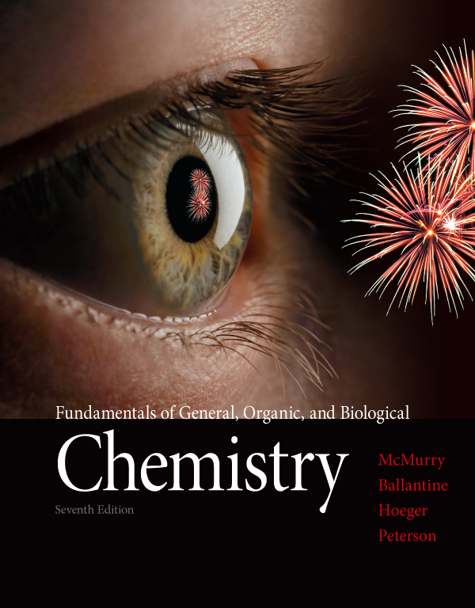
Chapter Nine
Chapter 9 Lecture
Fundamentals of General, Organic, and Biological Chemistry
7th Edition
McMurry, Ballantine, Hoeger, Peterson
Solutions
Julie Klare
Gwinnett Technical College
© 2013 Pearson Education, Inc.

Slide 2
Outline
9.1 Mixtures and Solutions
9.2 The Solution Process
9.3 Solid Hydrates [skip]
9.4 Solubility
9.5 The Effect of Temperature on Solubility
9.6 The Effect of Pressure on Solubility: Henry’s Law
9.7 Units of Concentration
9.8 Dilution
9.9 Ions in Solution: Electrolytes
9.10 Electrolytes in Body Fluids: Equivalents and Milliequivalents
9.11 Properties of Solutions [skip]
9.12 Osmosis and Osmotic Pressure
9.13 Dialysis [skip]

Slide 3
1. What are solutions, and what factors affect solubility?
Be able to define the different kinds of mixtures and explain the influence on solubility of solvent and solute structure, temperature, and pressure.
2. How is the concentration of a solution expressed?
Be able to define, use, and convert between the most common ways of expressing solution concentrations.
3. How are dilutions carried out?
Be able to calculate the concentration of a solution prepared by dilution and explain how to make a desired dilution.

Slide 4
What is an electrolyte?
Be able to recognize strong and weak electrolytes and nonelectrolytes, and express electrolyte concentrations.
How do solutions differ from pure solvents in their behavior?
Be able to explain vapor-pressure lowering, boiling-point elevation, and freezing-point depression for solutions.
6. What is osmosis?
Be able to describe osmosis and some of its applications.

Slide 5
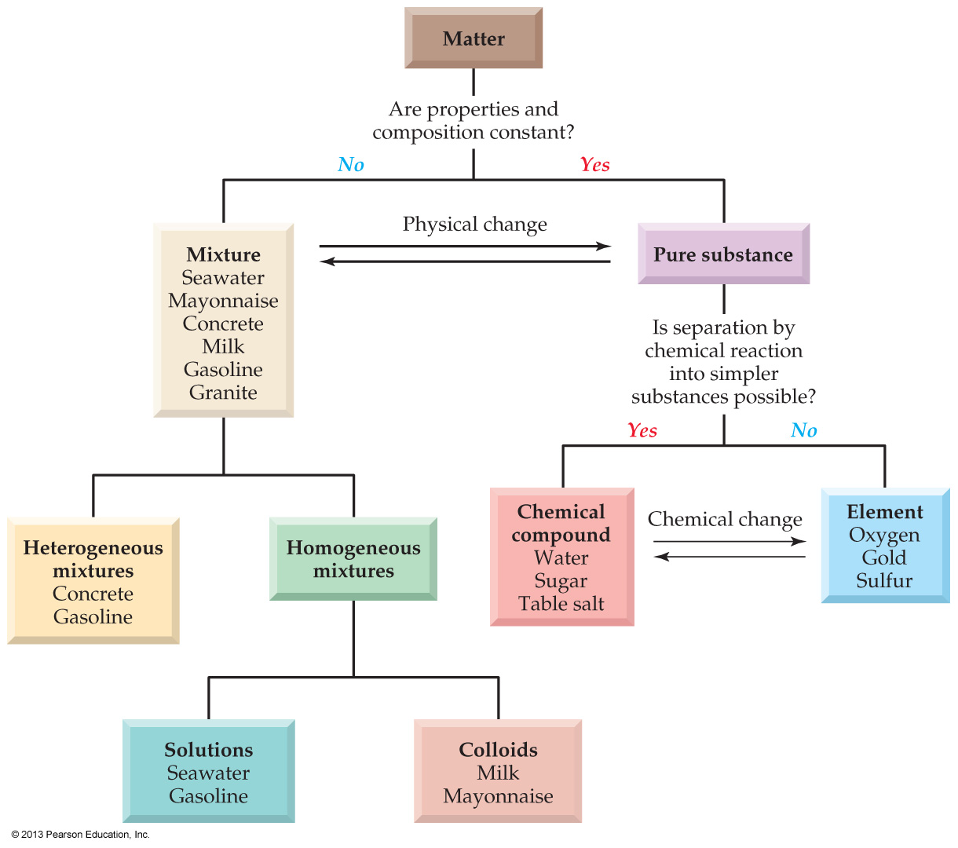
9.1 Mixtures and Solutions

Slide 6
Heterogeneous mixtures are those in which the mixing is not uniform and have regions of different composition
Homogeneous mixtures are those in which the mixing is uniform and have the same composition throughout
Solutions are homogeneous mixtures that contain particles the size of a typical ion or small molecule
Colloids are homogeneous mixtures that contain particles ranging in diameter from 2 to 500 nm
so they scatter (reflect) light

Slide 7
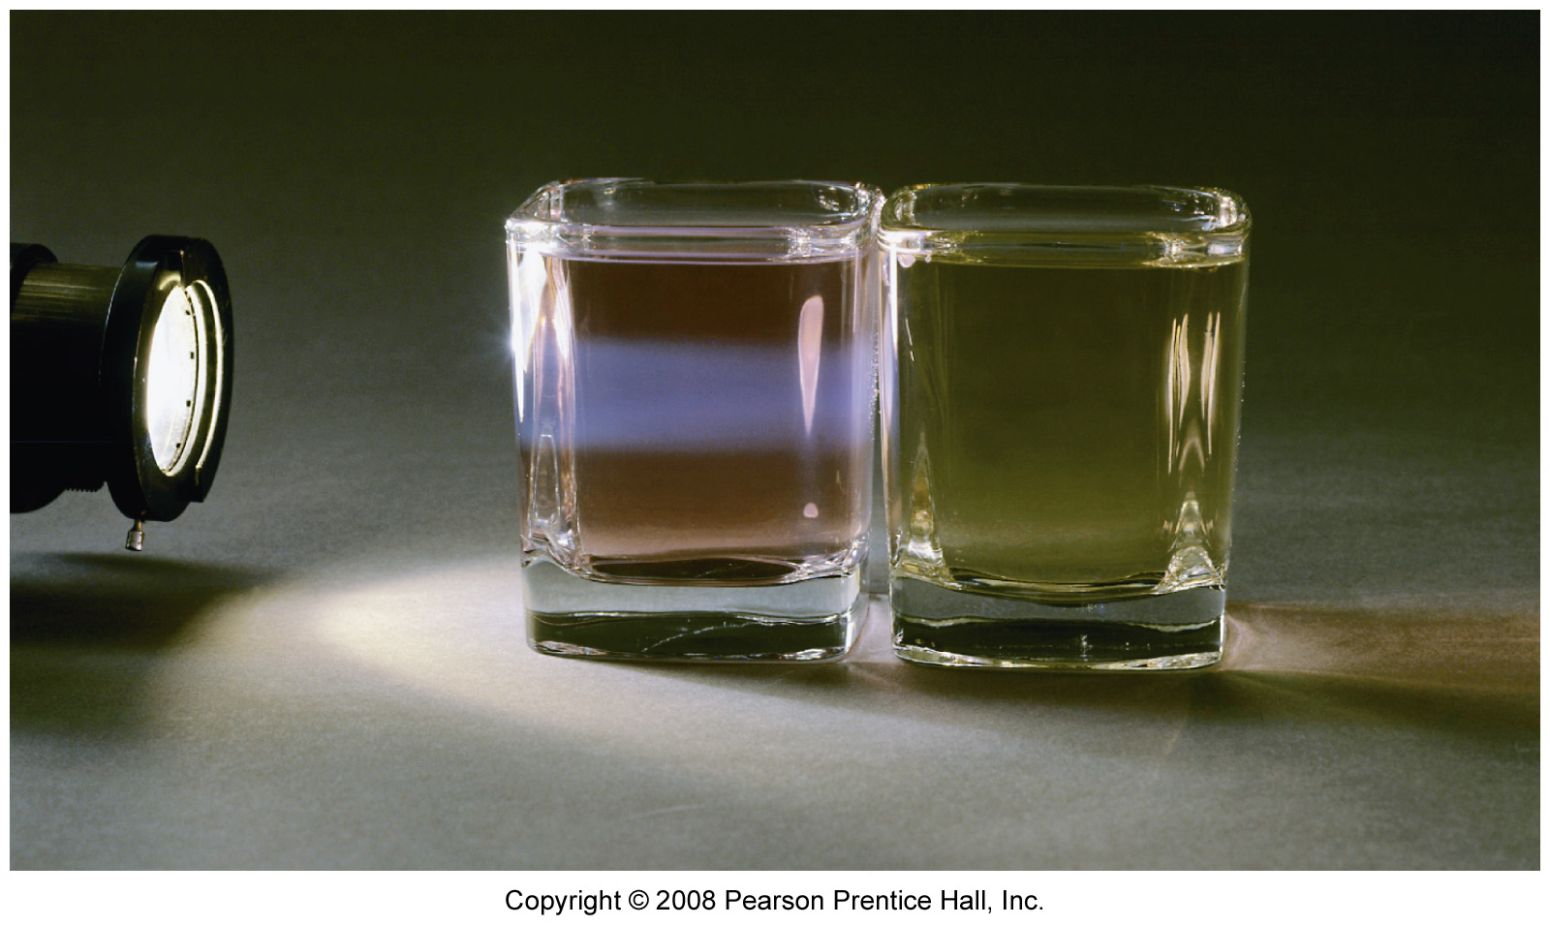

Slide 8
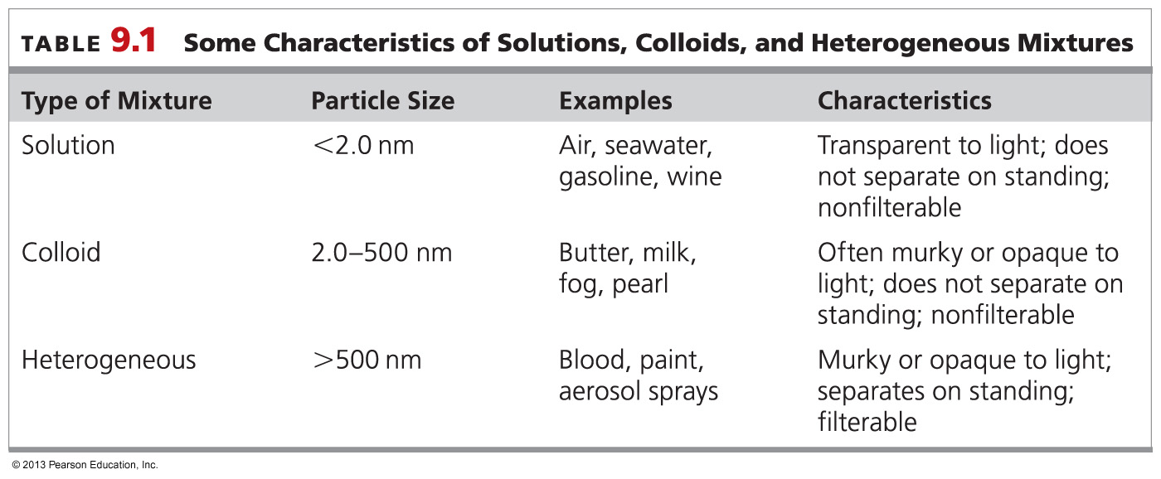
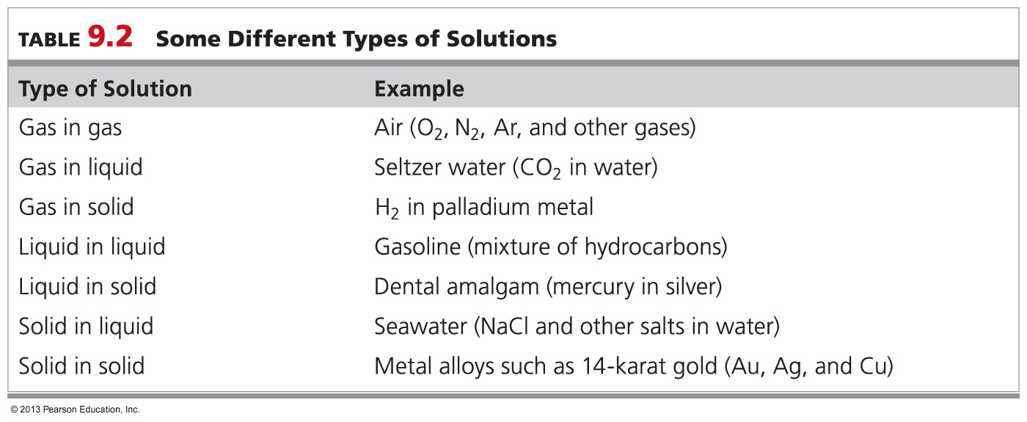
fyi

Slide 9
Which of the following is a solution?
After-shave cream
Blood
Gasoline
A carbonated drink

Slide 10
Which of the following is a homogeneous colloidal mixture?
Air
Milk
Water
Saline solution

Slide 12
Which of the following is a homogeneous colloidal mixture?
Air
Milk
Water
Saline solution

Slide 13
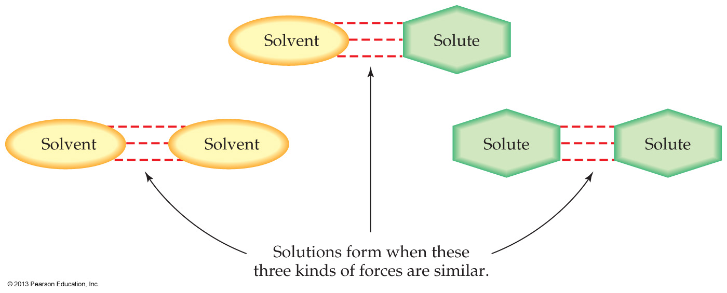
9.2 The Solution Process

Slide 14
Review of molecular polarity
Electronegativities
O = 3.5
H = 2.1
C = 2.5

Slide 15
Polarity: bonds vs molecules
Molecules and their individual bonds have different rules for polarity in Intro
Bonds are polar only where the difference in the electronegativities of the bonded atoms are 0.5 or greater
Molecules are polar whenever their shape is not symmetric

Slide 16
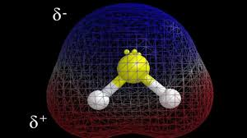
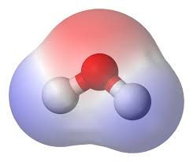
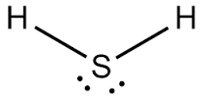
Polarity: bonds vs molecules
Ozone and hydrogen sulfide are both polar molecules – yet both have non-polar bonds
both have ‘bent’ molecular geometry
and so are soluble in water

Slide 17
fyi
Ozone is extremely soluble in water! At 25 deg C, ozone solubility is 109 mg/l. The solubility of oxygen is 8 mg/l. So ozone is 13 times more soluble in water than oxygen
And H₂S is even more soluble in water than is ozone
solulbility of H₂S in water is 4 g dm⁻³ (at 20 °C)
solubility of O₃ in water is only 1.05 g L⁻¹ (at 0 °C)

Slide 18
Polarity: bonds vs molecules
Carbon dioxide, on the other hand, has highly polar bonds (ΔEN = 1.0), but exhibits perfect symmetry in space (linear)
and so is non-polar
and so has low solubility in water

Slide 19
Molecular solubility in water
Any causal relationship between bond polarity and molecular polarity is too advanced a subject for intro chemistry
meaning we will offer you no rules
But chemists have observed that molecular solubility in water tracks molecular polarity
(and thus tracks molecular geometry)
but not bond polarity

Slide 20
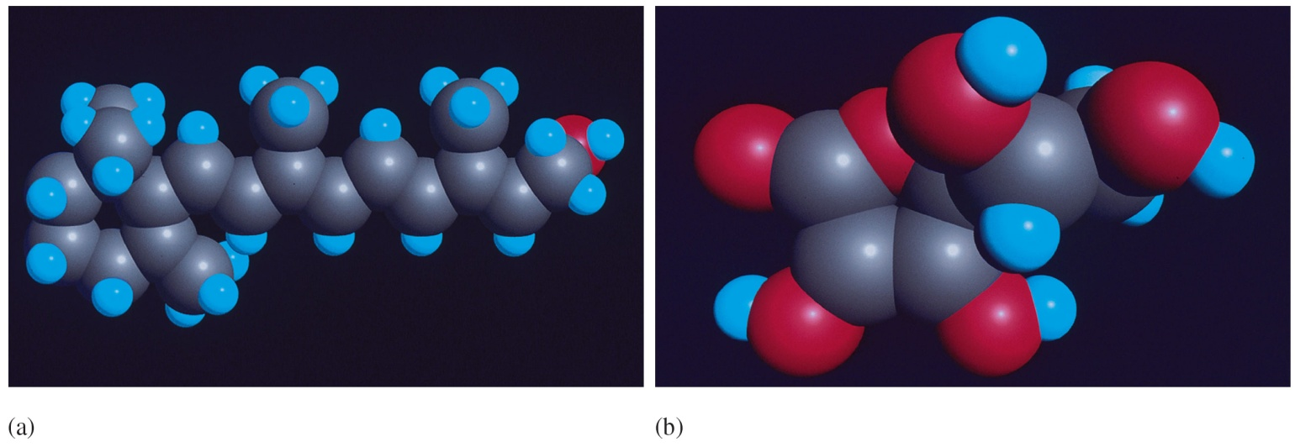
Vitamin A and Vitamin C
Frank Cox
Electronegativities
O = 3.5
H = 2.1
C = 2.5

Slide 21
“Like dissolves like”
Polar solvents (H₂O) dissolve polar and ionic solutes
Nonpolar solvents (hexane) dissolve nonpolar solutes
“Oil and water don’t mix”
Intermolecular forces between water molecules = strong
Intermolecular forces between oil molecules = weak

Slide 22
Between two strong-bonded water molecules, there is no room for an oily weak-bonded wimp

Slide 23
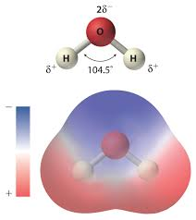
water is a highly polar molecule

Slide 24
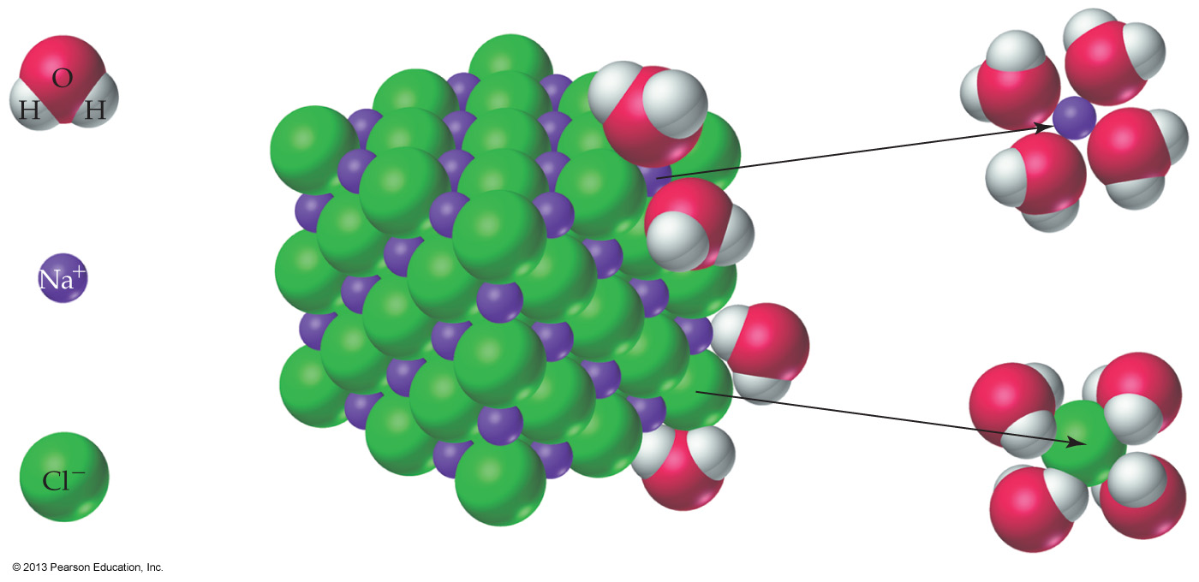
NaCl does
dissolve in water
Positively charged Na⁺ ions are attracted to the negatively polarized oxygen of water
Negatively charged Cl⁻ ions are attracted to the positively polarized hydrogens of water
The forces of attraction between ions and water molecules weakens, then pulls the ions away and into solution

Slide 25
NaCl does
dissolve in water
Once in solution, water molecules form a large electrostatic shell around each ion
a phenomenon called solvation or hydration
The size of this shell is what prevents NaCl fitting through a well-chosen osmotic membrane
thus allowing the desalination of sea water by reverse osmosis

Slide 26
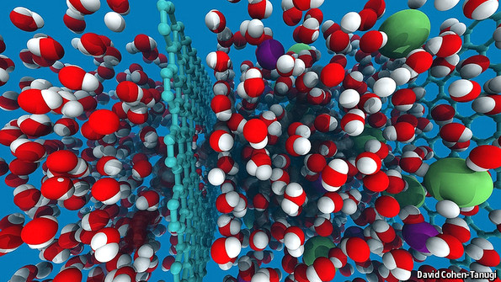

Slide 27
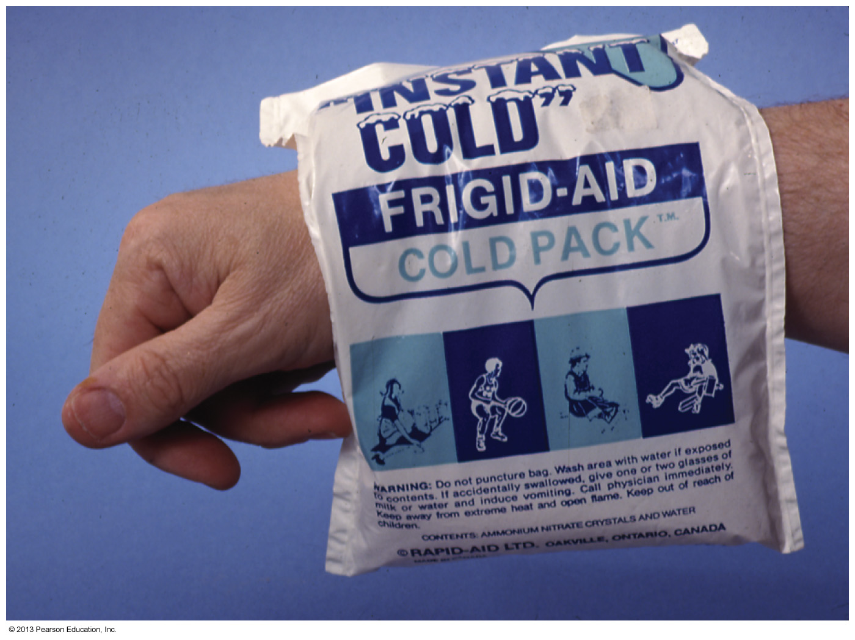
The dissolution (dissolving) of a solute in a solvent is a physical change since the solution components retain their chemical identities
The dissolution of a substance in a solvent always has some enthalpy change associated with it
which is used in making ‘heat packs’

Slide 28
Some substances dissolve exothermically, releasing heat
CaCl₂ in water
Other substances dissolve endothermically, absorbing heat
cooling the resultant solution
NH₄NO₃ in water

Slide 29
Which of the following pairs of substances would you expect to form solutions?
Benzene (C₆H₆) and NaOH
Methyl alcohol (CH₃OH) and NaCl
Octane (C₈H₁₈) and H₂O
CCl₄ and Benzene (C₆H₆)

Slide 30
9.3 Solid Hydrates (SKIP)

Slide 31
Some ionic compounds attract water strongly enough to hold onto water molecules even when crystalline
forming solid hydrates
In the formula of a hydrate, CaSO₄• ½ H₂O for example, the dot between the compound and the water indicates that there is one water for every two units of the ionic compound
Ionic compounds that attract water so strongly that they pull water vapor from humid air to become hydrated are called hygroscopic

Slide 32
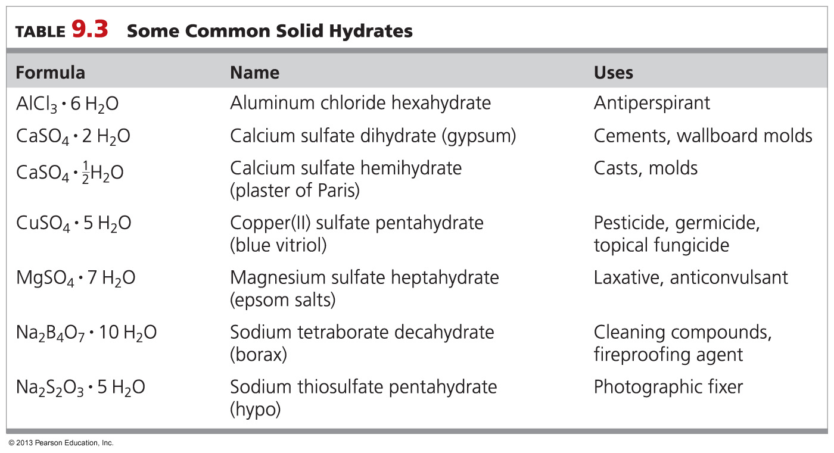
Notes:
Chapter 9, Table 9.3

Slide 33
Epsom salts is a common name of magnesium sulfate heptahydrate. What is the correct formula for magnesium sulfate heptahydrate?
MgSO₃. 6 H₂O
MgSO₄. 6 H₂O
MgSO₃. 7 H₂O
MgSO₄. 7 H₂O

Slide 34
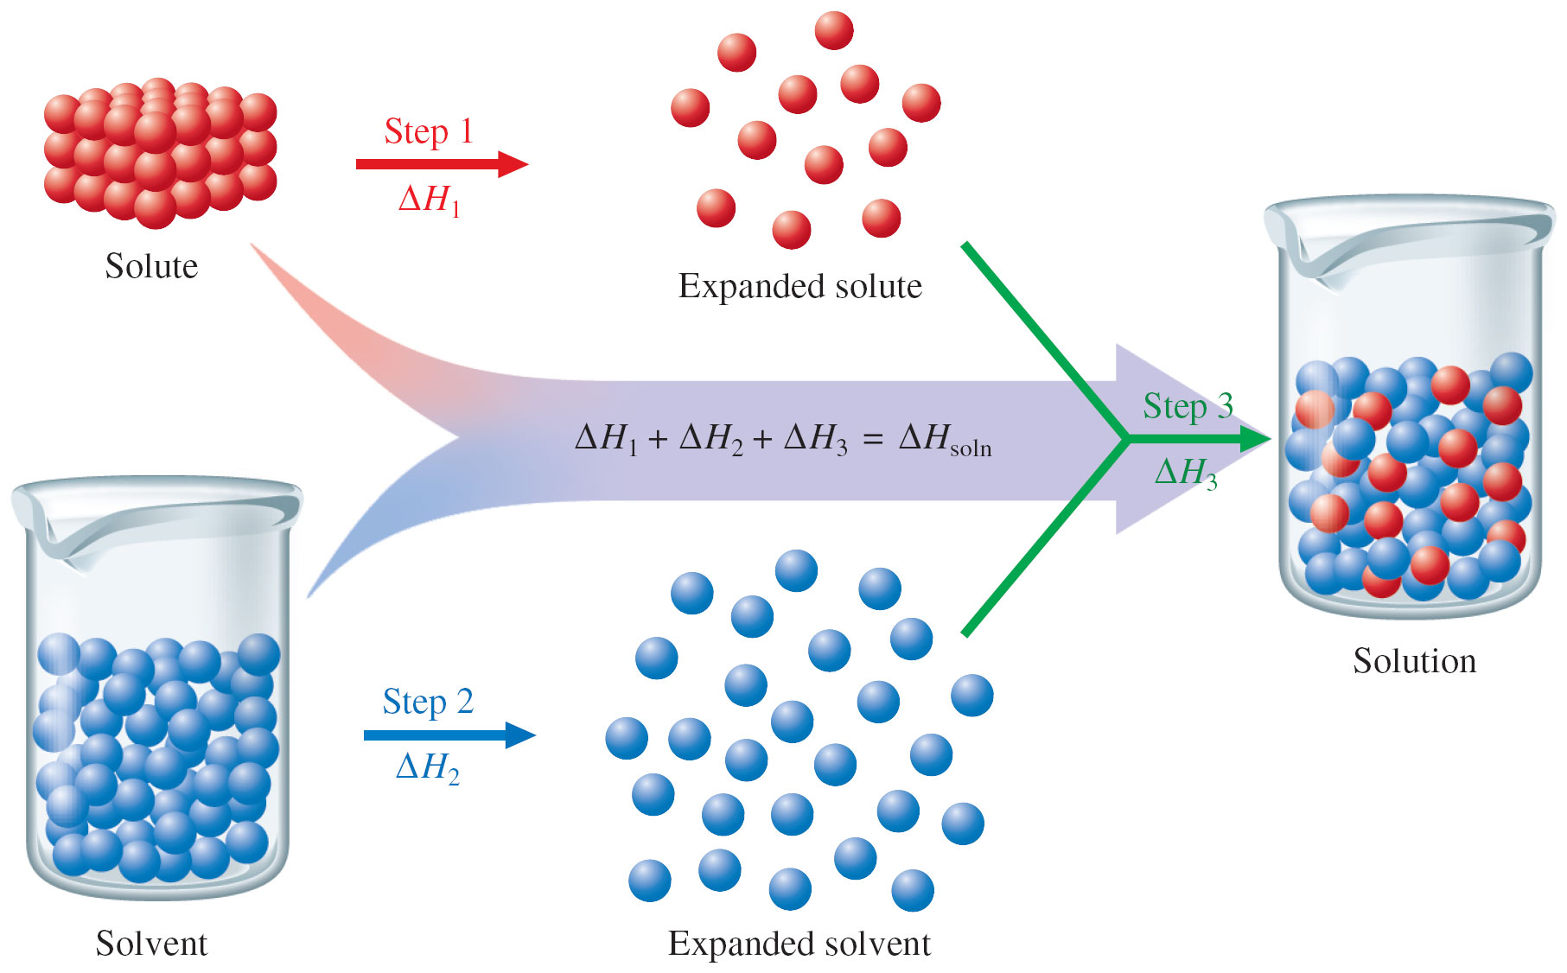
9.4 Solubility

Slide 35
Very little theory
Mostly observation (phenomenology)
We will define useful terms
We will measure and build tables out of data

Slide 36
Miscible: Mutually soluble in all proportions
Ethyl and methyl alcohols will continue to dissolve in water no matter how much are added
But most substances reach a solubility limit beyond which no more will dissolve in water
Solubility: The maximum amount of a substance that will dissolve in a given amount of solvent at a specified temperature

Slide 37
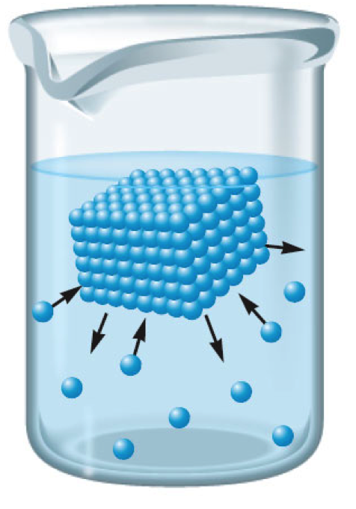
Solubility in water
Only 9.6 g of sodium hydrogen carbonate (baking soda) will dissolve in 100 mL of water at 20 °C, for instance
but 204 g of sucrose will dissolve under the same conditions

Slide 38
Saturated solution: Contains the maximum amount of dissolved solute at equilibrium
No more than 35.8 g of NaCl will dissolve in 100 mL of water at 20 °C
Any amount above this limit sinks to the bottom of the container as a solid
A saturated solution is in a state of dynamic equilibrium:

Slide 39
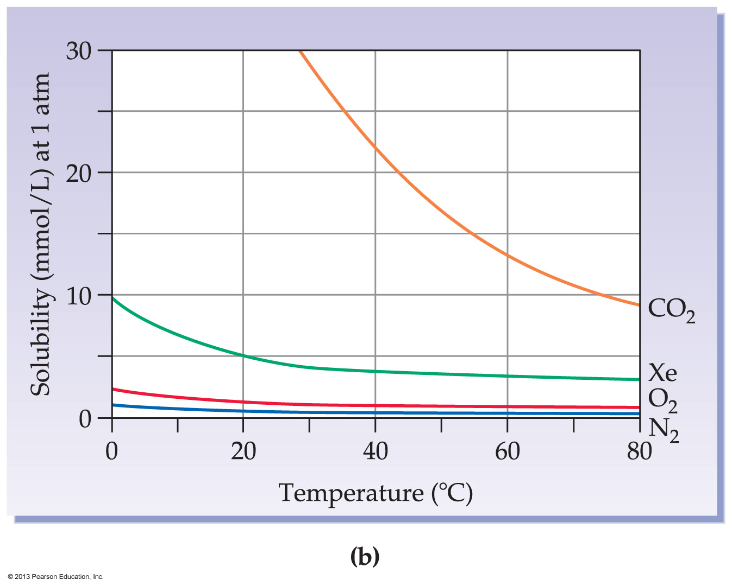
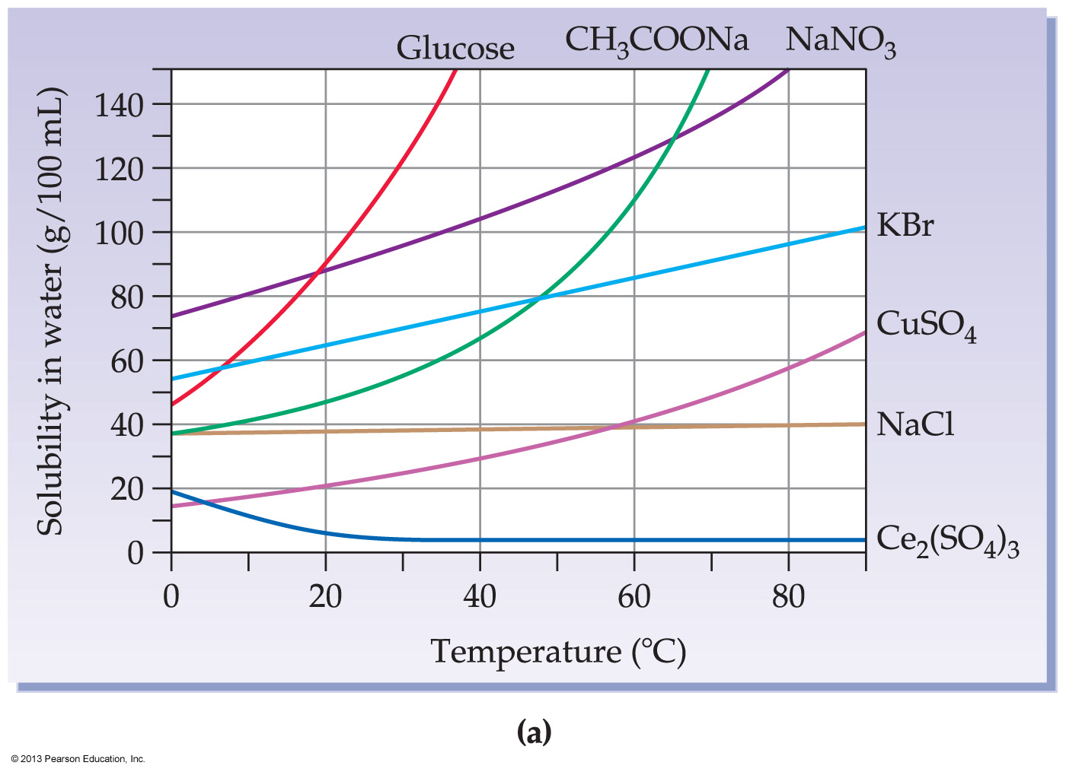
9.5 The Effect of Temperature on Solubility
More phenomenology

Slide 40
Temperature often has a dramatic effect on solubility, but is very unpredictable
In Intro, most solids become more soluble as temperature rises, while the solubility of gases always decreases
but check out NaCl and Ce₂(SO₄)₃

Slide 41
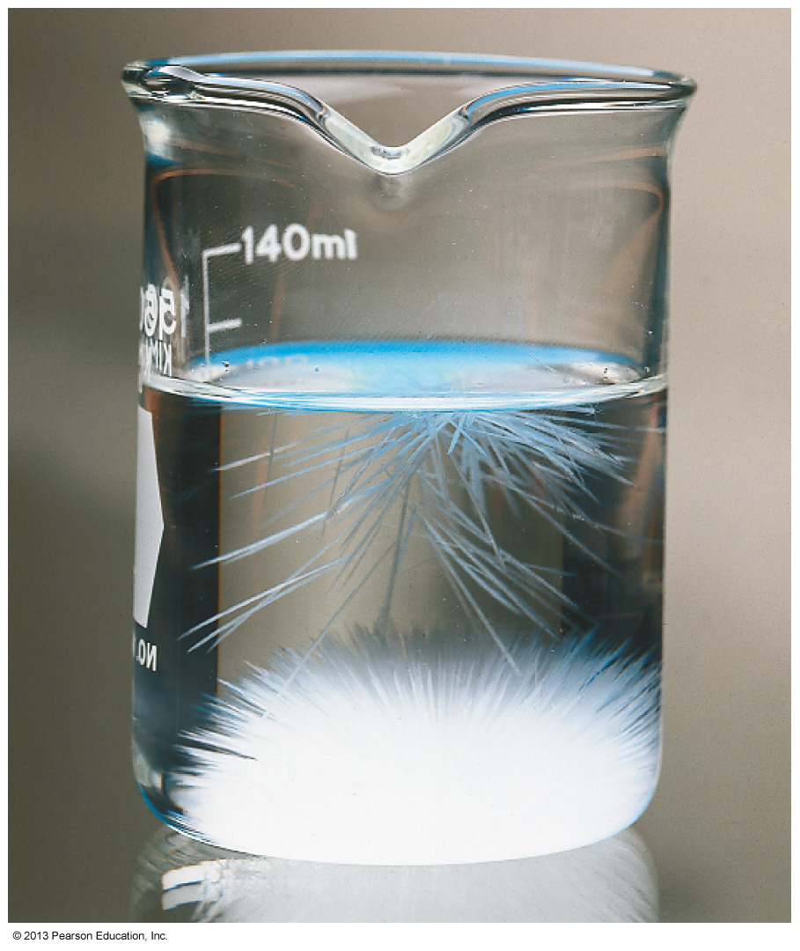
supersaturated solutions
Those solids that are substantially more soluble at high temperature than at low temperature can form supersaturated solutions
Once cooled, these solutions are unstable
and precipitate with dramatic effect when disturbed

Slide 42
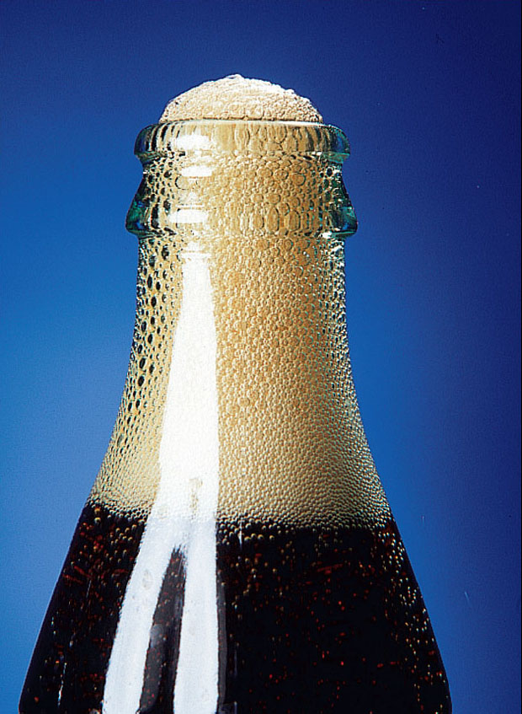
Addition of heat always decreases the solubility of gases in Intro Chem
So as water temperature increases
the concentration of gases like oxygen decrease
killing fish that cannot tolerate low oxygen levels

Slide 43
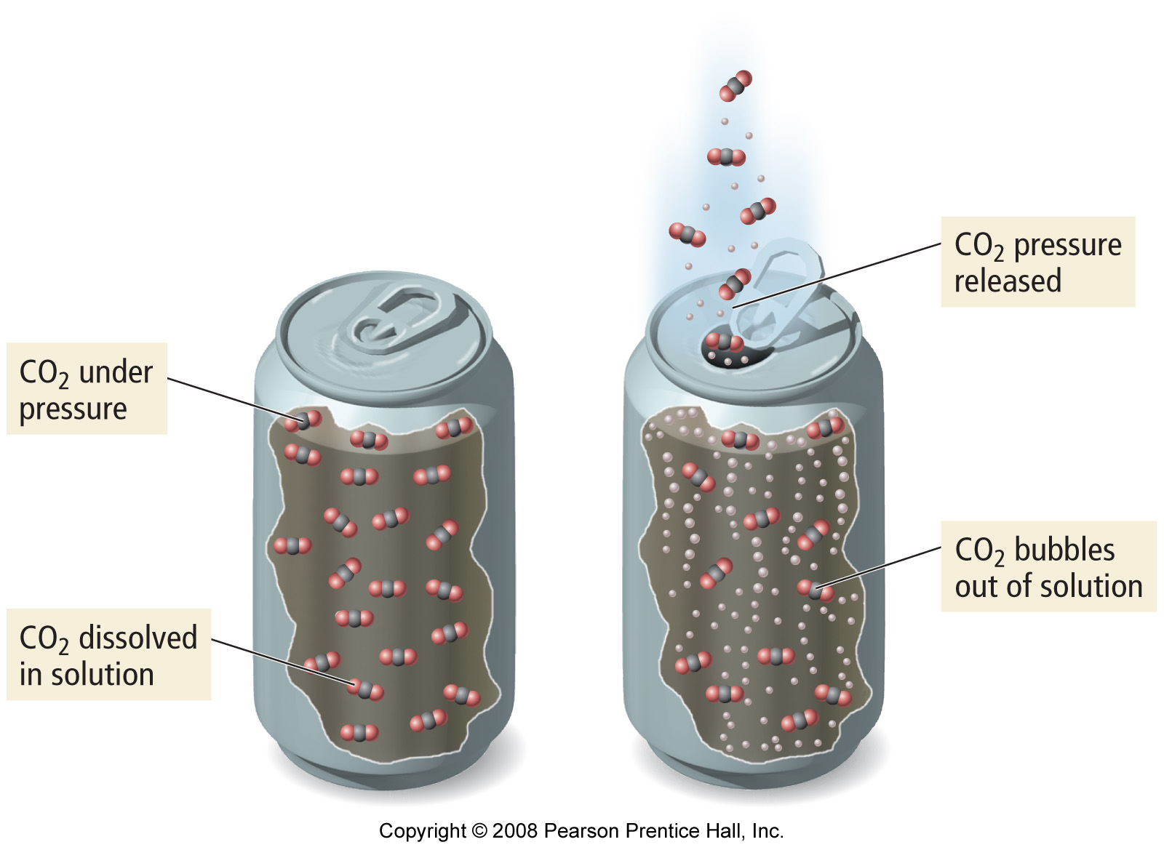
Pop quiz
Heating a can of pop before opening will reduce fizzing:
T or F

Slide 44
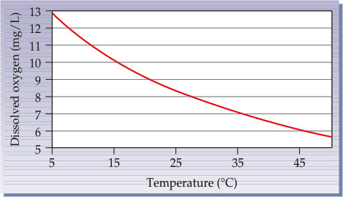
Worked example 9.2
From the following graph of solubility versus temperature for O₂:
Estimate the concentrations of oxygen dissolved in water at 25°C and at 35°C

Slide 45
From the graph we estimate that the solubility of O₂
at 25 °C is approximately 8.3 mg/L
at 35 °C is 7.0 mg/L

Slide 46
By what percentage does the concentration of O₂ change as the temperature rises to 35ºC?

Slide 47
From the graph we estimate that the solubility of O₂
at 25 °C is approximately 8.3 mg/L
at 35 °C is 7.0 mg/L

Slide 48
This has enormous climactical impact!

Slide 49
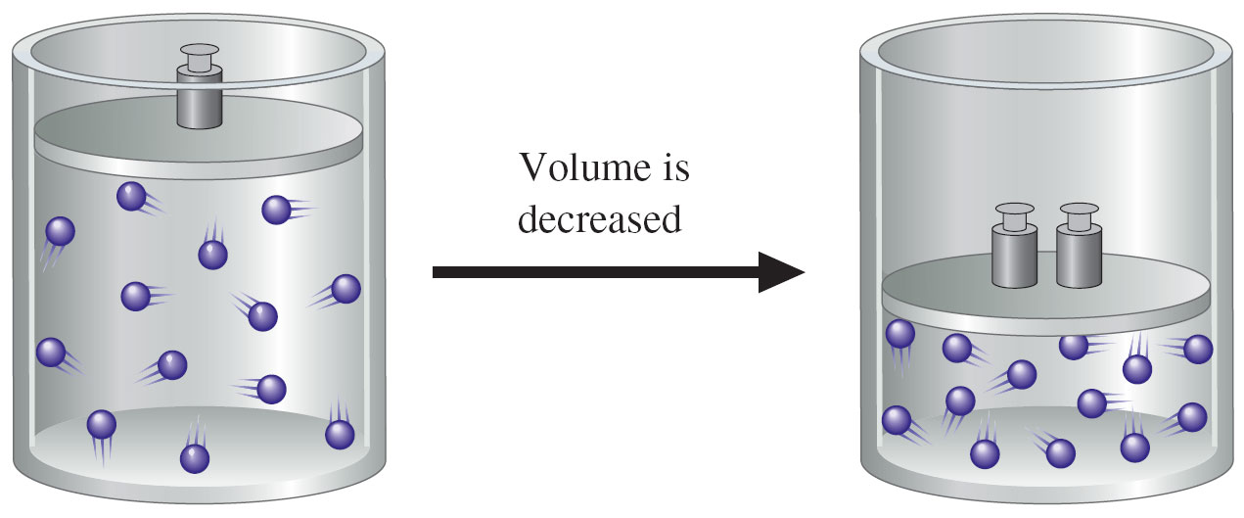
9.6 The Effect of Pressure on Solubility: Henry’s Law
Increasing pressure increases concentration of a gas

Slide 50
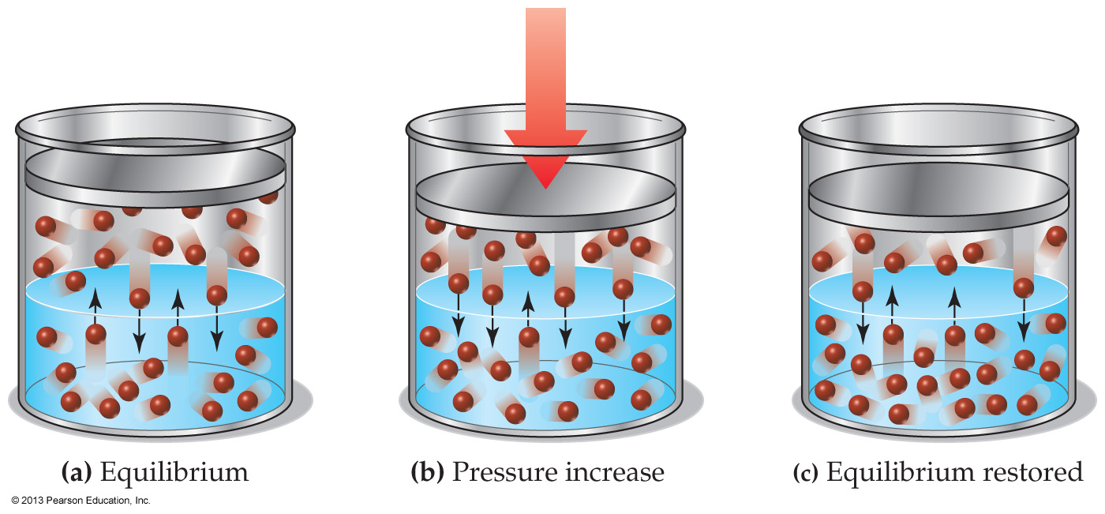
Pressure has no effect on the solubility of solids or liquids in water – because they are not compressible
But pressure has a powerful effect on the solubility of gases
Henry’s law: The solubility of a gas is directly proportional to the partial pressure of the gas – if the temperature is held constant

Slide 51
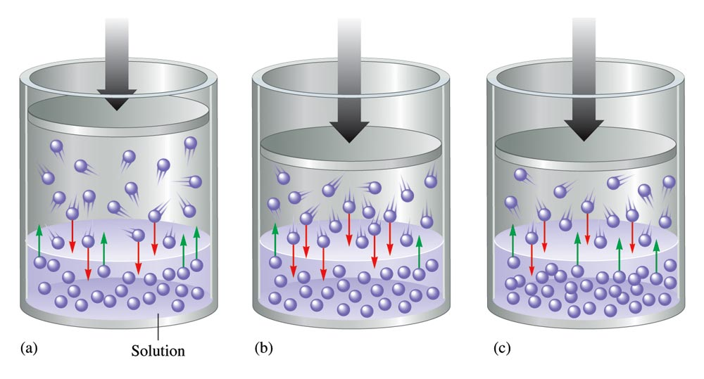
A Gaseous Solute
Increasing pressure on the gas increases the concentration of the gas right above the liquid
This in turn, is what increases the concentration of the gas within the liquid

Slide 52
An exercise for the student
Henry’s law can also be explained using Le Châtelier’s principle
When the system is stressed by increasing the pressure of the gas, more gas molecules go into solution to relieve the increased pressure
When the pressure of the gas is decreased, more gas molecules come out of solution to relieve the decrease

Slide 53
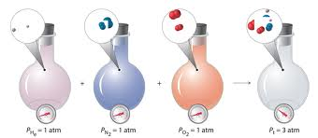
Remember partial pressure
For a mixture of ideal gases in a container
P_{Total} = P₁ + P₂ + P₃ + . . .
The total pressure exerted is the sum of the pressures that each gas would exert if it were alone

Slide 54
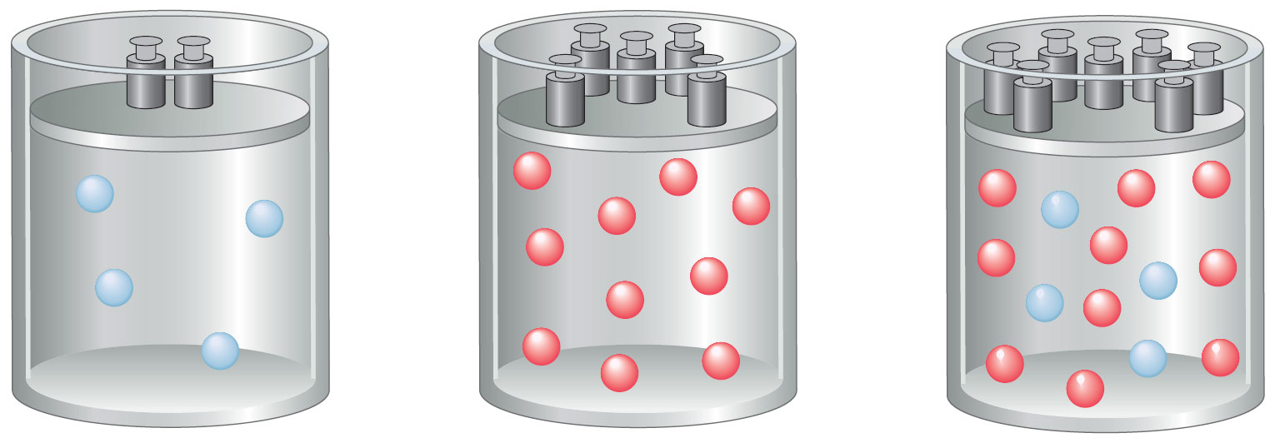
Remember partial pressure

Slide 55
Henry’s law: C_{gas in solution} = kP
C = concentration of dissolved gas in solution
k = constant (find in tables) for a solution
P = partial pressure of gas solute above the solution
Amount of gas dissolved in a solution is directly proportional to the partial pressure of the gas above the solution.

Slide 56
So partial pressure can be used to determine the concentration of gas in a solution
If the partial pressure of a gas over a solution changes while the temperature is constant, the new solubility of the gas can be found easily:

Slide 57
An increase in which of the following will result in an increase in the solubility of oxygen in water?
Partial pressure of oxygen over the solution
Temperature
Total pressure over the solution by the addition of helium
Volume of water

Slide 58
Worked example 9.3
At a partial pressure of oxygen in the atmosphere of 159 mmHg, the solubility of oxygen in blood is 0.44 g/100 mL.
What is the solubility of oxygen in blood at 11,000 ft, where the partial pressure of O₂ is 56 mmHg?
According to Henry’s law, the solubility of the gas divided by its pressure is constant:
Of the four variables in this equation, we know P₁, C₁, and P₂, so we need to find C₂

Slide 59
P₁ = 159 mm Hg
C₁ = 0.44 g/100 mL
P₂ = 56 mm Hg
C₂ = ?

Slide 60
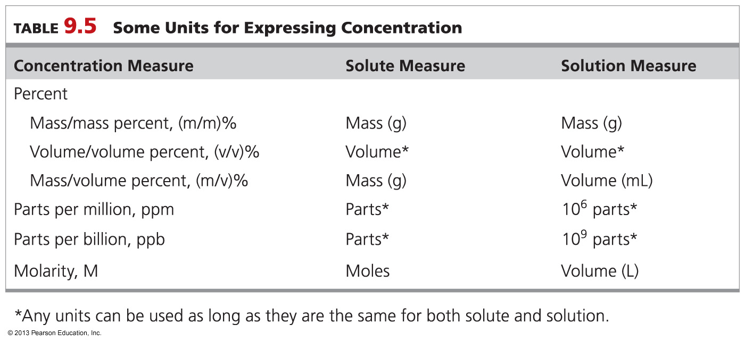
9.7 Units of Concentration

Slide 61
Experiment 23: Concentration of a Sodium Chloride Solution
This lab covers in detail most of this section.

Slide 62
Percent Concentrations
1) For solid solutions (eg, brass) concentrations are typically expressed as mass/mass percent concentration, (m/m)%:
2) For liquid solutions, concentrations are expressed as volume/volume percent concentration, (v/v)%:

Slide 63
What is the mass percent of glucose in a solution that contains 25 g of water and 4.2 g of glucose?
16.8%
17%
14.4%
85.6%

Slide 64
How many milliliters of methanol are needed to prepare 250 mL of a 3.5% (v/v) solution?
83 mL
8.3 mL
88 mL
8.8 mL

Slide 65
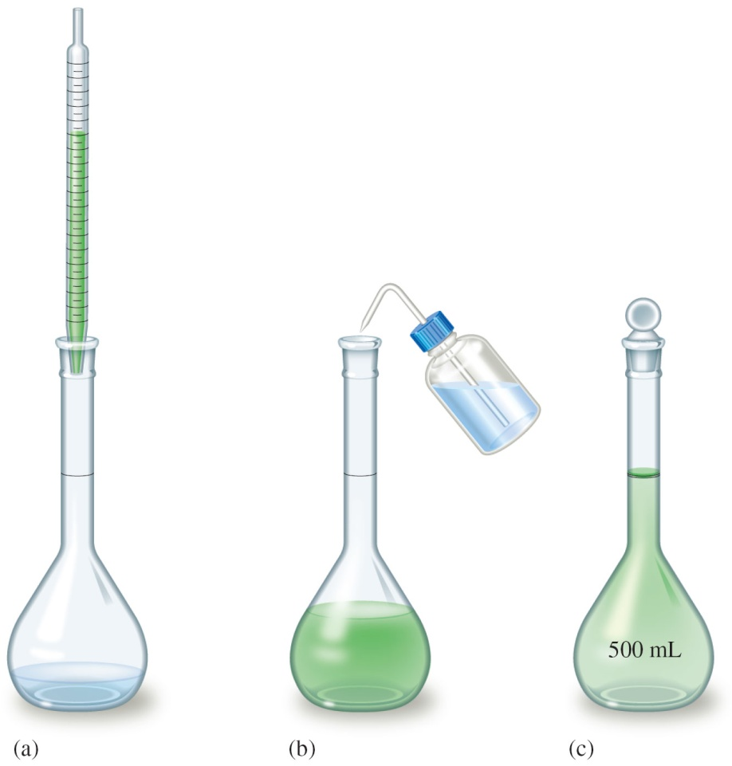
volume/volume percent concentration

Slide 66
Percent Concentrations
3) A third ‘percent’ method is to give the number of grams of solute as a percentage of the number of milliliters
This is mass/volume percent concentration, (m/v)%:

Slide 67
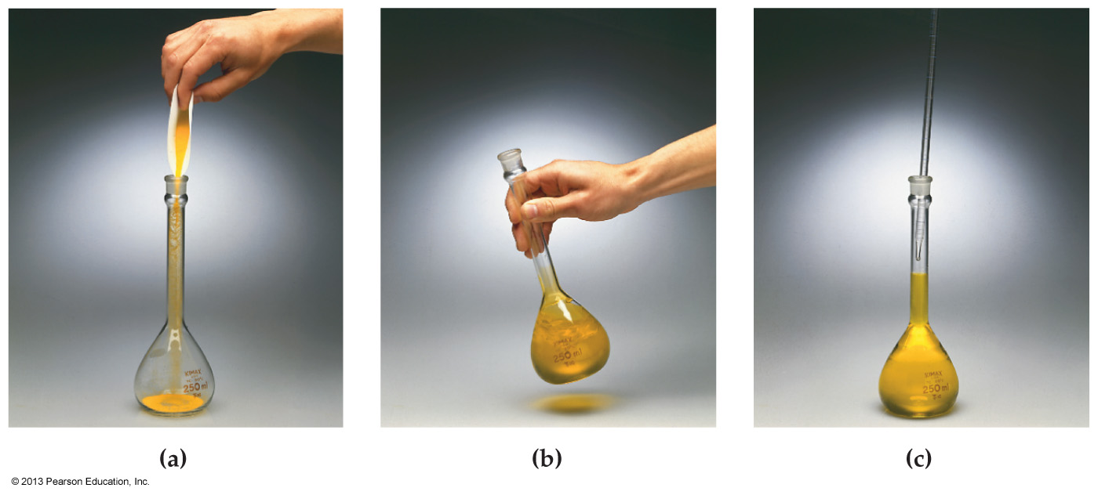
mass/volume percent concentration
12.0 grams of sucrose are added to a volumetric flask.
Enough water is added to bring the final dissolved volume to 500 mL.
What is the mass/volume percent concentration?

Slide 68
The procedure
The appropriate amount of solute is weighed and placed in a volumetric flask
Enough solvent is then added to dissolve the solute
Additional solvent is then added to reach final volume

Slide 69
An exercise for the student
Parts per Million (ppm) or Parts per Billion (ppb)
When concentrations are very small, as often occurs in dealing with trace amounts of pollutants or contaminants, it is more convenient to use parts per million (ppm) or parts per billion (ppb)
The “parts” can be in any unit of either mass or volume as long as the units of both solute and solvent are the same:

Slide 70
Mole/Volume Concentration:
The most generally useful way of expressing concentration in the laboratory is molarity (M), the number of moles of solute dissolved per liter of solution

Slide 71
Definition: A solution of a given molarity is prepared by dissolving the solute in enough solvent to give a final solution volume of 1.00 L
not by dissolving it in an initial volume of 1.00 L
Important: Molarity can be used as a conversion factor to relate the volume of a solution to the moles of solute it contains – we will do a couple of these

Slide 72
fyi
Moles of solute needed for a one liter solution are converted into grams
Here, the weighed solute is added to a 1 liter volumetric
Enough solvent is added to dissolve with swirling
The volumetric is carefully diluted to 1 liter with solvent

Slide 73
Worked Example 9.10 Molarity as Conversion Factor: Molarity to Mass
A blood concentration of 0.065 M ethyl alcohol (EtOH) is sufficient to induce coma
what would be the total mass of alcohol (grams) in 5.6 L of blood (male adult)?
The molar mass of ethyl alcohol is 46.0 g/mol

Slide 75
An exercise for the student
Gastric juice that is about 0.1 M in HCl
How many mLs of gastric juice will react completely with an antacid containing 500 mg of magnesium hydroxide?
The molar mass of Mg(OH)₂ is 58.3 g/mol, and the balanced equation is

Slide 76
HCl = 0.1 M
500 g of MgOH)₂ @ 53.8 g/mol

Slide 77
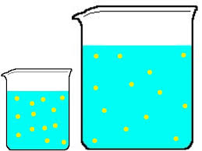
9.8 Dilution
c = concentrated
d = diluted

Slide 78
Many solutions are stored in high concentrations and then prepared for later use by dilution
The amount of solute remains constant; only the volume is changed by adding more solvent
Because the number of moles remains constant, we can set up the following dilution equation for Molarity:

Slide 79
This equation can be rewritten to solve for the concentration of the solution after dilution:
Dilution factor is the ratio of the initial and final solution volumes V_{c} / V_{d}
The dilution equation can be generalized to all other concentration units: C_{c}V_{c} = C_{d}V_{d}

Slide 80
A beaker containing 90 mL of 0.1 M sucrose is represented by drawing (a). Which of the drawings represents the solution that results when 30 mL is withdrawn from (a) and then is diluted by a factor of three?
Drawing (a)
Drawing (b)
Drawing (c)
Drawing (d)

Slide 81
Concentrated ammonia solution is available in a 16.0 M solution. What volume must be used to prepare 750.0 mL of a 2.0 M solution?
94 mL
43 mL
9.4 mL
4.3 mL

Slide 82
in the previous example, how much pure water must be added to finally reach the desired volume of 750 mL.

Slide 83
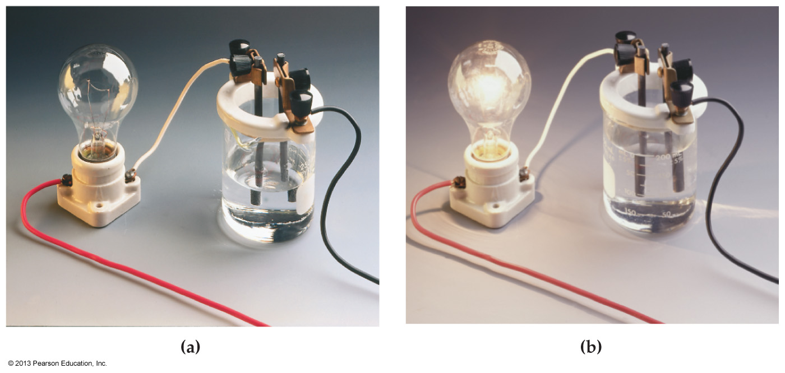
9.9 Ions in Solution: Electrolytes

Slide 84
Ionic compounds, such as NaCl, in aqueous solutions conduct electricity when they dissolve
An electric current results because
negatively charged Cl– anions can migrate through the solution toward the positive terminal of the power source
whereas Na⁺ cations migrate toward the negative terminal

Slide 85
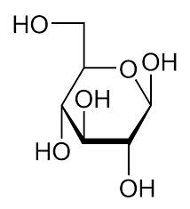
Strong electrolytes are substances that ionize completely when dissolved in water
NaCl, HCl
Weak electrolytes are substances that are only partly ionized in water
CH₃CO₂H (acetic acid)
Nonelectrolytes are substances that do not produce ions when dissolved in water
C₆H₁₂O₆ (Glucose)

Slide 86
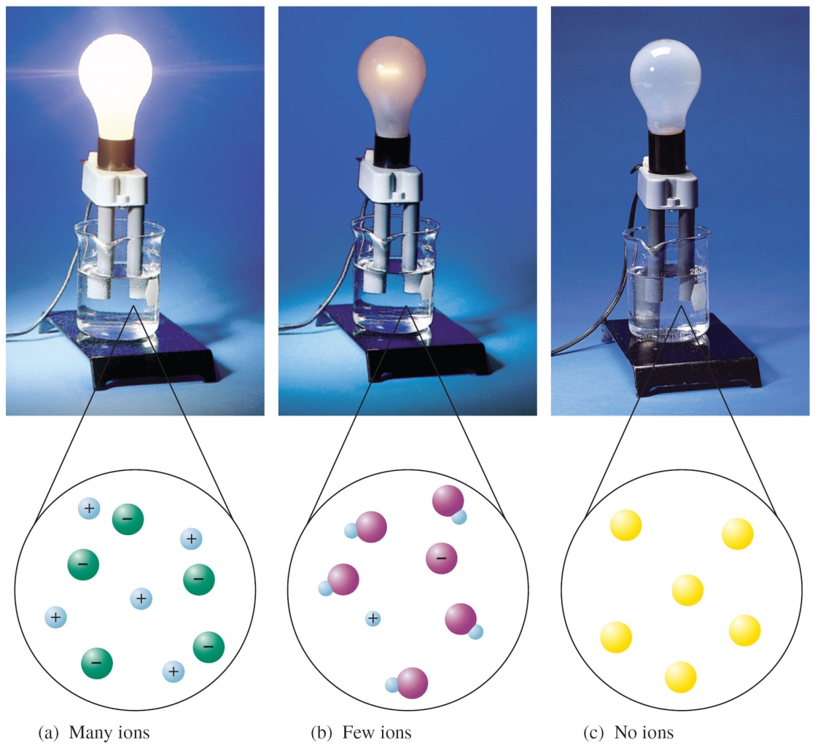
Electrical conductivity of aqueous solutions

Slide 87
The light bulb in the apparatus below glows either brightly, dimly, or remains unlit depending what kind of solution is in the beaker. Which of the following aqueous solutions is in the Figure (b) apparatus?
1.5 mol CaCl₂/kg solution
2.0 mol AgCl/kg solution
3.0 mol glucose/kg solution
4.0 mol methyl alcohol/kg solution

Slide 88
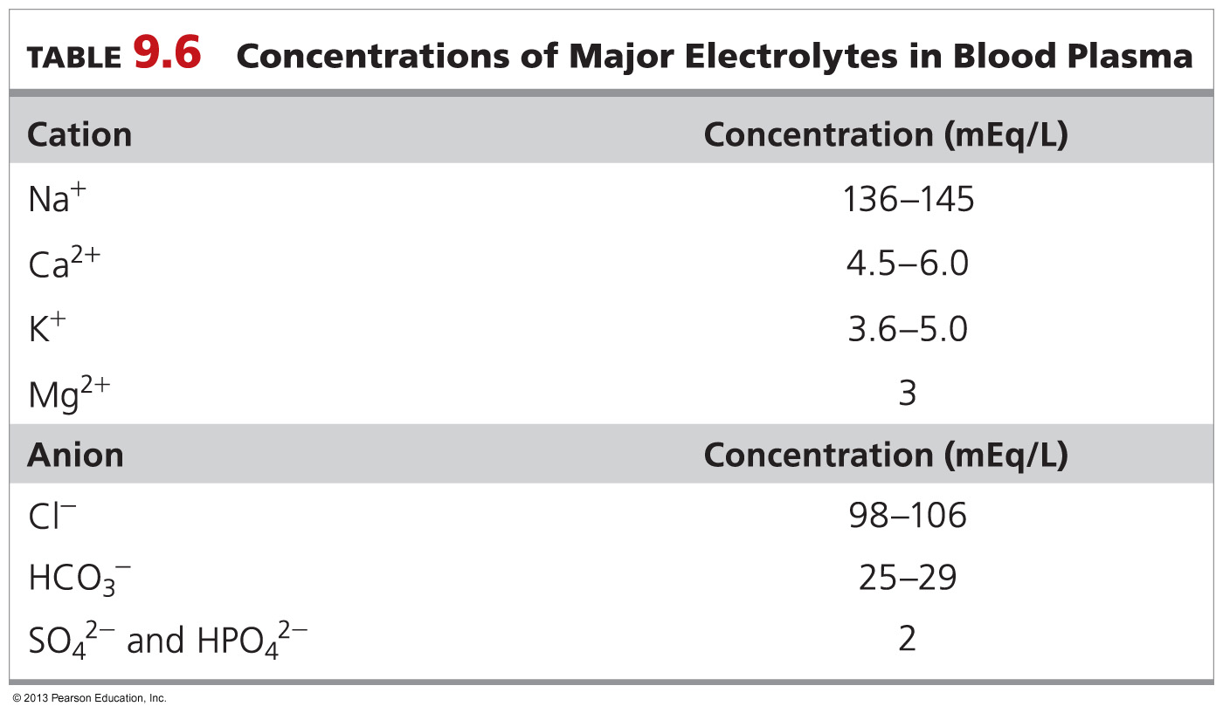
9.10 Electrolytes in Body Fluids

Slide 89
A mélange of electrolytes
Since the body contains these electrolytes in solution all at once …
it makes no sense to talk of NaCl as if it maintained its identity isolated from K₂SO₄
So clinical chemists focus on individual ions (as opposed to compounds of ions) in solution
especially their contribution to the total positive and/or negative charges in solution

Slide 90
The definition of ‘Equivalent’
They utilize the concept ‘Equivalents of ions’
One equivalent (Eq) is equal to the number of ions that carry one mole of charge
For Na⁺ that would be 6.022 x 10²³ ions
For Ca²⁺ that would be 3.011 x 10²³ ions
We can calculate the number of equivalents of a particular ion per liter, simply by multiplying the molarity (M) of the particular ion by its charge

Slide 91
gram-equivalents
Equivalents is a vital concept
it often appears in multiple choice questions
In practice clinical chemists use the more practical unit gram-equivalent (g-Eq)
The amount of ions (in grams) that actually contains that one mole of charge

Slide 92
Examples
Ion(s) that have a +1 or −1 charge
so 1 gram-equivalent of Na⁺ is simply 23.0 g
so 1 gram-equivalent of Cl⁻ is simply 35.4 g
Ion(s) that have a +2 or −2 charge
so 1 gram-equivalent of Mg²⁺ is (24.2/2) = 12.2 g
so 1 gram-equivalent of S²⁻ is (32.1/2) = 16.0 g

Slide 93
Because ion concentrations are so low in the body, clinical chemists use milli-equivalents
So Na⁺ in blood is 0.14 Eq/L or 140 mEq/L
The gram-equivalent (or milligram-milliequivalent) is a useful conversion factor…
…when converting from volume of solution to the mass of its ions
Note:

Slide 94
Worked Example 9.14
The normal concentration of Ca²⁺ in blood is 5.0 mEq/L
How many milligrams of Ca²⁺ are in 1.00 L of blood?

Slide 95
9.11 Properties of Solutions ( SKIP)

Slide 96
Colligative property: A property of a solution that depends only on the number of dissolved particles, not on their identity
Vapor pressure is lower for a solution than for a pure solvent
Boiling point is higher for a solution than for a pure solvent
Freezing point is lower for a solution than for a pure solvent
Osmosis occurs when a solution is separated from a pure solvent by a semipermeable membrane

Slide 97
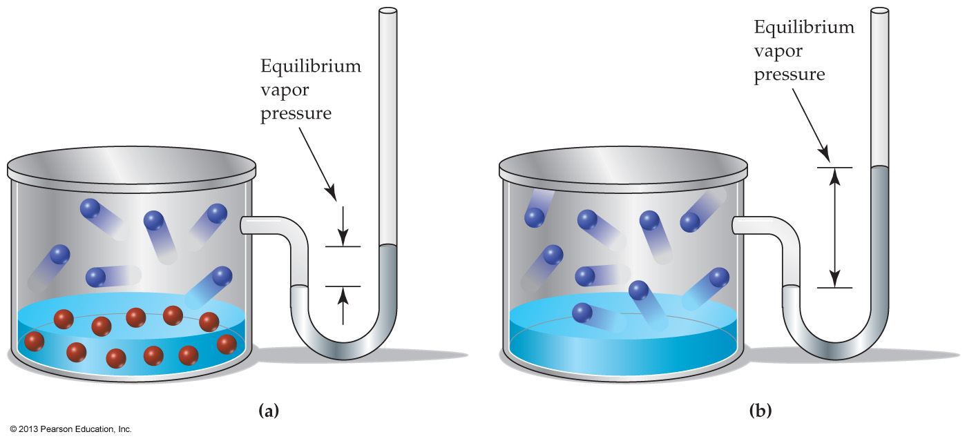
Vapor Pressure Lowering in Solutions
Vapor pressure depends on the equilibrium between molecules entering and leaving the liquid surface
If some solvent molecules are replaced by solute particles, the rate of evaporation decreases
The vapor pressure of a solution is lower than that of the pure solvent
The identity of the solute particles is irrelevant
only their concentration matters

Slide 98
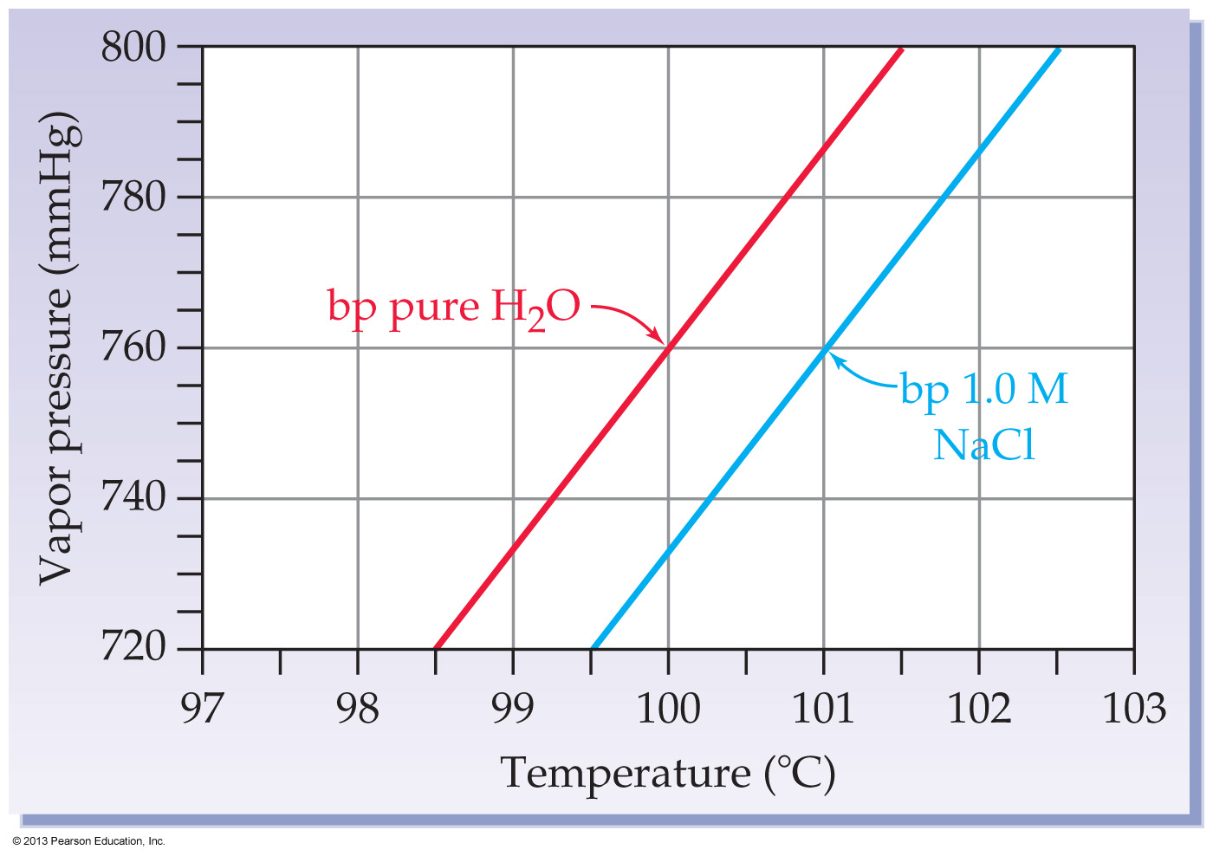
Vapor Pressure Lowering in Solutions

Slide 99
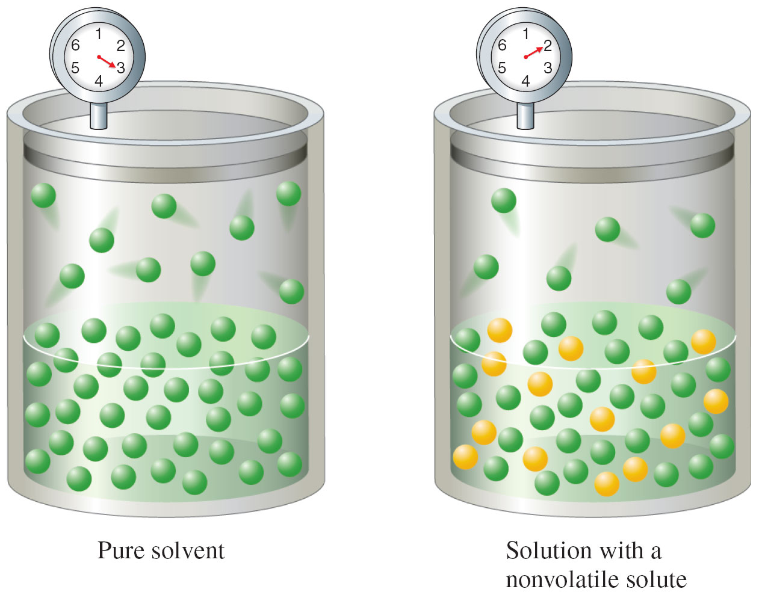
A Nonvolatile Solute Lowers the Vapor Pressure of a Solvent

Slide 100
The diagram below shows plots of vapor pressure versus temperature for water and a 1.0 M solution of NaCl. If a vapor pressure versus temperature plot for a 1.0 M solution of CaCl₂ is superimposed on this diagram, where would the curve occur?
Above the red curve
Below the blue curve
Between the red and blue curves
On top of the blue curve

Slide 101
Boiling Point Elevation in Solutions
The boiling point of the solution is higher than that of the pure solvent
The solution must be heated to a higher temperature for its vapor pressure to reach atmospheric pressure
Each mole of solute particles raises the boiling point of 1 kg of water by 0.51 °C
1 mol of glucose raises the temperature by 0.51 °C
glucose is one particle
1 mol of NaCl by 1.02 °C.
NaCl dissociates into two particles

Slide 102
A nonvolatile solute elevates the boiling point of the solvent
ΔT = K_{b}m_{solute}
ΔT = boiling-point elevation
K_{b} = molal boiling-point elevation constant
m_{solute} = molality of solute

Slide 103
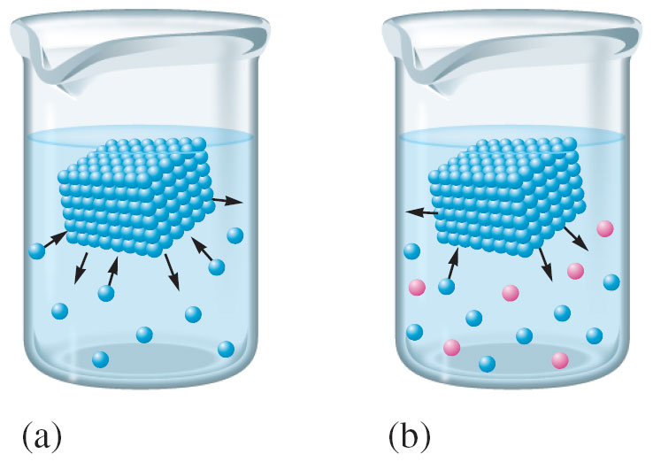
Freezing-Point Depression of Solutions
The freezing point of a solution is lower than that of the pure solvent
Solute molecules are dispersed between solvent molecules, making it more difficult for solvent molecules to organize into ordered crystals

Slide 104
Freezing-Point Depression of Solutions
The freezing point of a solution is lower than that of the pure solvent
Solute molecules are dispersed between solvent molecules, making it more difficult for solvent molecules to organize into ordered crystals
For each mole of nonvolatile solute particles, the freezing point of 1 kg of water is lowered by 1.86 °C
1 mole of glucose lowers the freezing point 1.86ºC
1 mole of NaCl lowers the freezing point 3.72ºC

Slide 105
When a solute is dissolved in a solvent the freezing point of the solution is lower that of pure solvent
ΔT = K_{f}m_{solute}
ΔT = freezing-point depression
K_{f} = molal freezing-point depression constant
m_{solute} = molality of solute

Slide 106
Which aqueous solution has the lowest freezing point?
1.5 mol CaCl₂/kg solution
2.0 mol NaCl/kg solution
3.0 mol glucose/kg solution
4.0 mol methyl alcohol/kg solution

Slide 107
Worked Example 9.15 Properties of Solutions: Boiling Point Elevation
What is the boiling point of a solution of 0.75 mol of KBr in 1.0 kg of water?
Analysis
The boiling point increases 0.51 °C for each mole of solute per kilogram of water. Since KBr is a strong electrolyte, there are 2 moles of ions (K⁺ and Br–) for every 1 mole of KBr that dissolves.
Ballpark Estimate
The boiling point will increase about 0.5 °C for every 1 mol of ions in 1 kg of water. Since 0.75 mol of KBr produce
1.5 mol of ions, the boiling point should increase by (1.5 mol ions) (0.5 °C/mol ions) = 0.75 °C.
Solution
The normal boiling point of pure water is 100 °C, so the boiling point of the solution increases to 100.77 °C.
Ballpark Check
The 0.77 °C increase is consistent with our estimate of 0.75 °C.

Slide 108
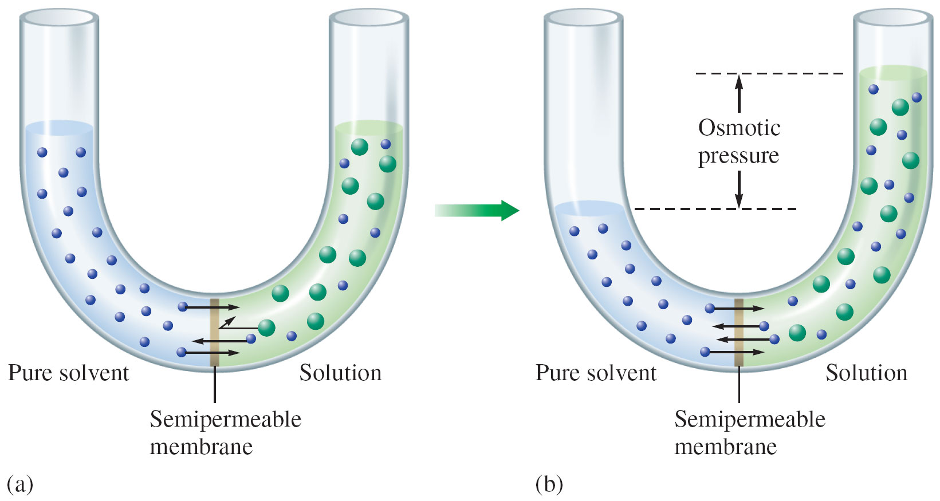
9.12 Osmosis and Osmotic Pressure

Slide 109
Osmosis: The passage of a solvent through a semipermeable membrane separating two solutions of different concentration.

Slide 110
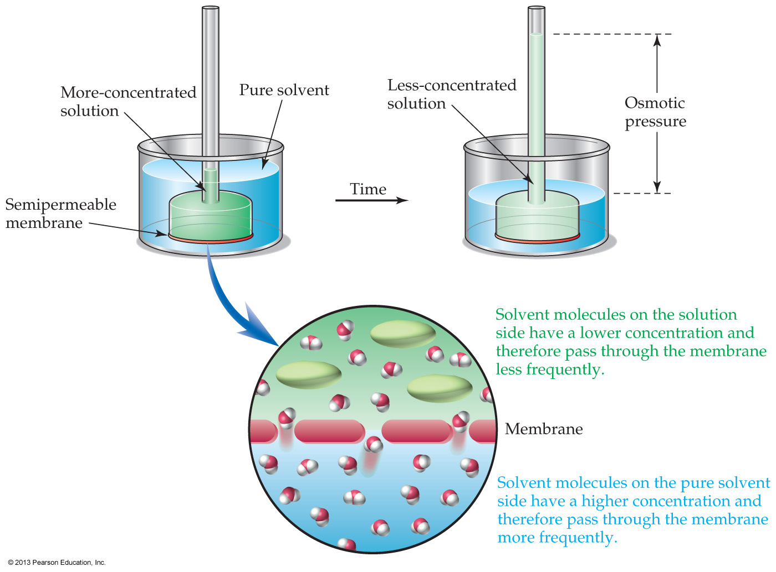

Slide 111
As the liquid in the tube rises (next slide), its gravitational weight creates a pressure that pushes solvent back through the membrane until the rates of forward and reverse passage become equal and the liquid level stops rising
Osmotic pressure is the amount of external pressure that must be applied to a solution to prevent the net movement of solvent molecules across a semipermeable membrane

Slide 112
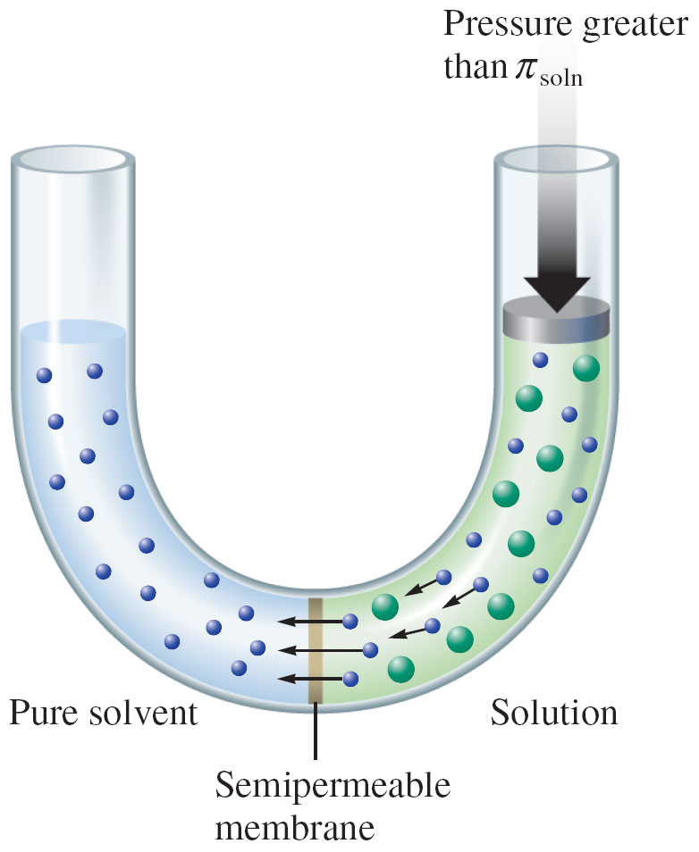
reverse
osmosis

Slide 113
Notice that a ‘bare’ Na⁺ (purple) would probably fit through the pores
But Na⁺ surrounded (hydrated) by six water molecules does not fit through

Slide 114
The osmotic pressure of a 0.15 M NaCl solution at 25 °C is 7.3 atm
Osmotic pressure depends only on the concentration of solute particles
Osmolarity (osmol) is the sum of the molarities of all dissolved particles in a solution

Slide 115
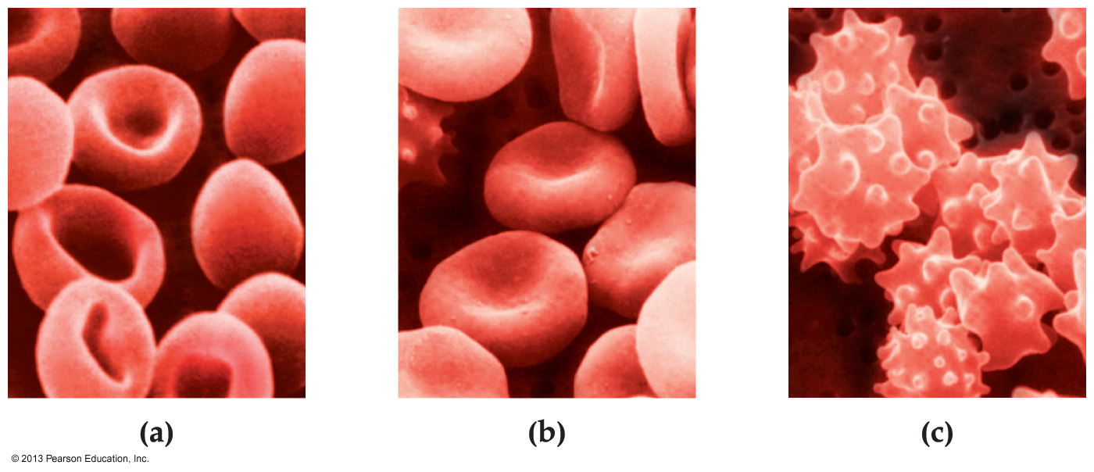
Osmosis is particularly important in living organisms because the membranes around cells are semipermeable.
Isotonic: Having the same osmolarity
Hypotonic: Having an osmolarity less than the surrounding blood plasma or cells.
Hypertonic: Having an osmolarity greater than the surrounding blood plasma or cells.

Slide 116
When dissolved in enough water to make 1.0 liter of solution, which of the following solutes yields the solution with the highest osmolarity?
0.10 mole of CaCl₂
0.15 mole of NaCl
0.30 mole of glucose
All three of the above solutions have the same osmolarity.

Slide 117
9.13 Dialysis (SKIP)

Slide 118
The pores in a dialysis membrane allow both solvent molecules and small solute particles to pass through
Hemodialysis is used to cleanse the blood of patients whose kidneys malfunction
Blood is diverted from the body and pumped through a long cellophane dialysis tube suspended in an isotonic solution
Small waste materials such as urea pass through the dialysis membrane and are washed away

Slide 119
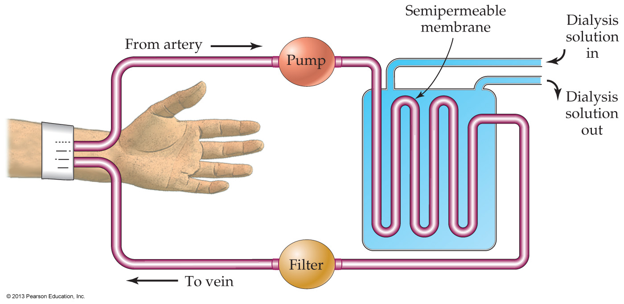
Hemodialysis is used to cleanse the blood of patients whose kidneys malfunction
Notes:
Figure 9.13 Operation of a hemodialysis unit used for purifying blood.

Slide 120
Protein molecules do not cross semipermeable membranes and thus play an essential role in determining the osmolarity of body fluids
The pressure of blood inside the capillary tends to push water out of the plasma (filtration)
The osmotic pressure of colloidal protein molecules tends to draw water into the plasma (reabsorption)

Slide 121
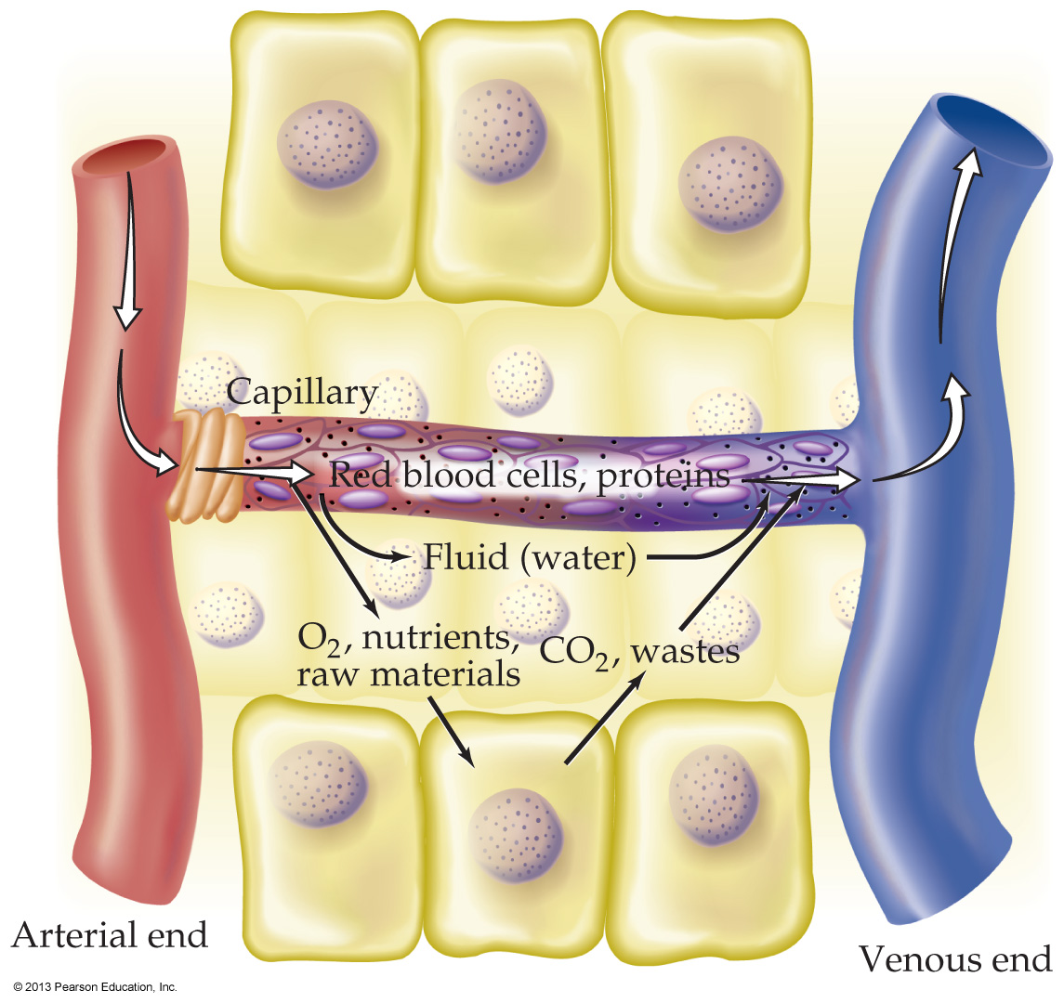
At the arterial end of a capillary, filtration is favored
At the venous end, where blood pressure is lower, reabsorption is favored, and waste products from metabolism enter the bloodstream

Slide 122
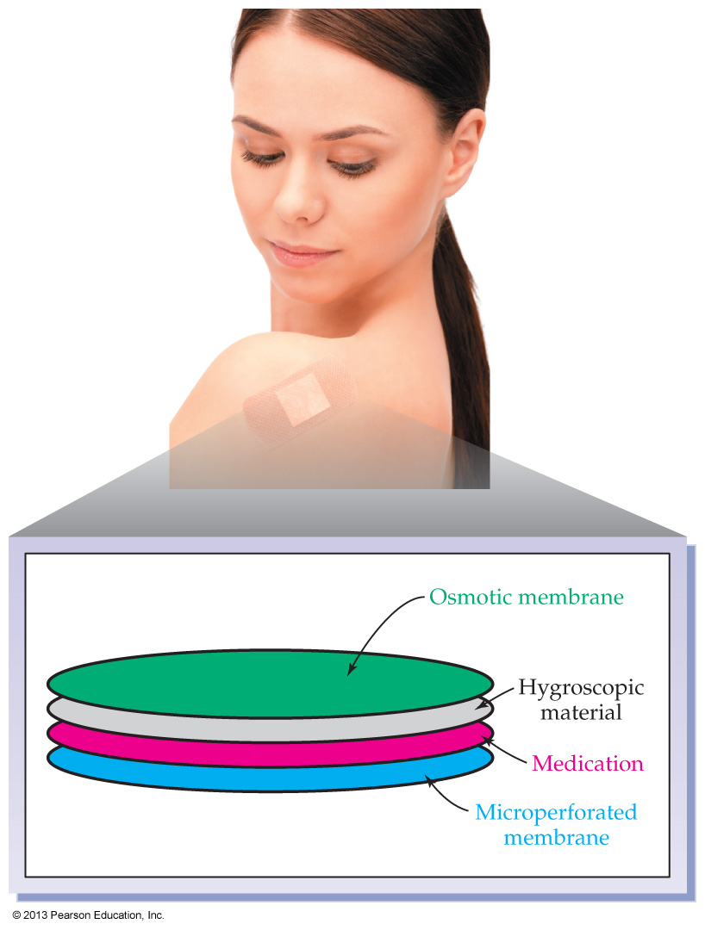
Time released medication
Notes:
Chapter 9, Unnumbered Figure 2, Page 284

