Slide 1
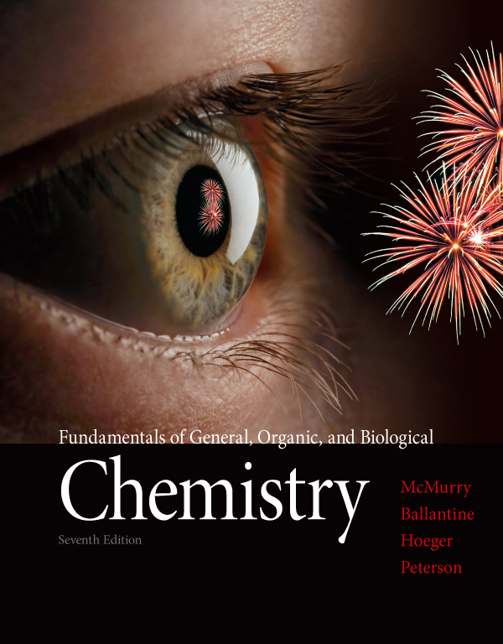
Chapter Eleven
Chapter 11 Lecture
Fundamentals of General, Organic, and Biological Chemistry
7th Edition
McMurry, Ballantine, Hoeger, Peterson
Nuclear Chemistry
Julie Klare
Gwinnett Technical College
© 2013 Pearson Education, Inc.

Slide 2
Outline
11.1 Nuclear Reactions
11.2 The Discovery and Nature of Radioactivity
11.3 Stable and Unstable Isotopes [lightly or skip]
11.4 Nuclear Decay [skip]
11.5 Radioactive Half-Life
11.6 Radioactive Decay Series [skip]
11.7 Ionizing Radiation [skip]
11.8 Detecting Radiation [skip]
11.9 Measuring Radiation [skip]
11.10 Artificial Transmutation [skip]
11.11 Nuclear Fission and Nuclear Fusion [skip]

Slide 3
Goals
What is a nuclear reaction, and how are equations for nuclear reactions balanced?
Be able to write and balance equations for nuclear reactions.
What are the different kinds of radioactivity?
Be able to list the characteristics of three common kinds of radiation—α, β, and γ (alpha, beta, and gamma).
How are the rates of nuclear reactions expressed?
Be able to explain half-life and calculate the quantity of a radioisotope remaining after a given number of half-lives

Slide 4
4. What is ionizing radiation?
Be able to describe the properties of the different types of ionizing radiation and their potential for harm to living tissue.
5. How is radioactivity measured?
Be able to describe the common units for measuring radiation
6. What is transmutation?
Be able to explain nuclear bombardment and balance equations for nuclear bombardment reactions.
7. What are nuclear fission and nuclear fusion?
Be able to explain nuclear fission and nuclear fusion.

Slide 5
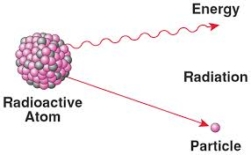
11.1 Nuclear Reactions

Slide 6
Review
An atom is characterized by
its atomic number, Z
and its mass number, A
The mass number gives the total number of nucleons, a general term for total protons (p) plus neutrons (n)
Atoms with identical atomic numbers but different mass numbers are called isotopes
the nucleus of a specific isotope is called a nuclide

Slide 7
A nuclear reaction involves a change in an atom’s nucleus
Different isotopes have the very similar behaviors in chemical reactions but often have completely different behavior in nuclear reactions
The rate of a nuclear reaction is unaffected by a change in temperature or pressure or by the addition of a catalyst
This electron notation
will be explained later

Slide 8
The nuclear reaction of an atom is the same whether it is in a chemical compound or in elemental form
The energy change accompanying a nuclear reaction can be several million times greater than that accompanying a chemical reaction
The nuclear transformation of 1.0 g of uranium-235 releases 3.4 × 10⁸ kcal
The chemical combustion of 1.0 g of methane releases only 12 kcal

Slide 9
Which of the following statements is (are) true of nuclear reactions?
The nucleus of an atom is transformed.
The rate of reaction is not affected by changes in temperature and pressure.
Great amounts of energy can be produced.
All of the above are true.

Slide 10
Which of the following statements is (are) true of nuclear reactions?
The nucleus of an atom is transformed.
The rate of reaction is not affected by changes in temperature and pressure.
Great amounts of energy can be produced.
All of the above are true.

Slide 11
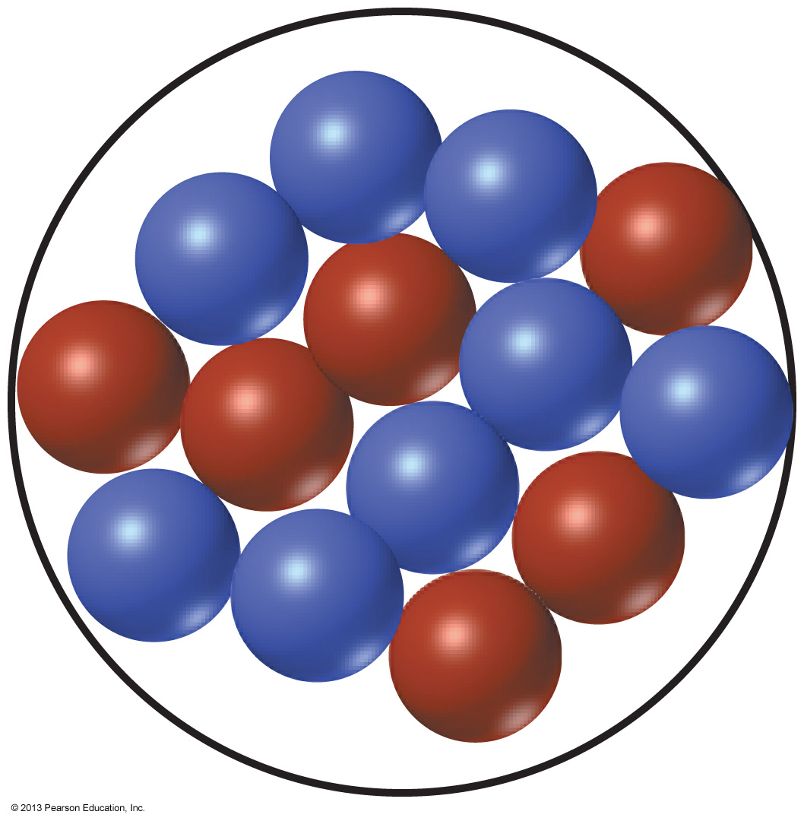
In the drawing below, blue spheres represent protons and red spheres represent neutrons. What is the isotope represented by the drawing?
Carbon-12
Carbon-14
Oxygen-14
Oxygen-16

Slide 12
In the drawing below, blue spheres represent protons and red spheres represent neutrons. What is the isotope represented by the drawing?
Carbon-12
Carbon-14
Oxygen-14
Oxygen-16

Slide 13
11.2 The Discovery and Nature of Radioactivity

Slide 14
In 1896, French physicist Henri Becquerel made a remarkable observation
Becquerel placed a mineral on top of a photographic plate
On developing the plate, Becquerel found a silhouette of the mineral
He concluded that the mineral was producing some kind of unknown radiation

Slide 15
Three types of radiation
Marie Sklodowska Curie and her husband, Pierre found that the source of the radioactivity was the element uranium (U)
Two previously unknown elements, which they named polonium and radium, are also radioactive
Becquerel and the Curies shared the 1903 Nobel Prize in physics
Further work by Ernest Rutherford established that there were two types of radiation, which he named alpha and beta
Soon thereafter, a third type of radiation was found and named for the third Greek letter, gamma

Slide 16
When the three kinds of radiation are passed between plates with opposite electrical charges, each is affected differently
Alpha radiation is deflected toward the negative plate
Beta radiation is deflected toward the positive plate
Gamma radiation is not deflected

Slide 17
When the three kinds of radiation are passed between plates with opposite electrical charges, each is affected differently
Alpha radiation is deflected toward the negative plate
Beta radiation is deflected toward the positive plate
Gamma radiation is not deflected
Another difference is their mass:
Gamma radiation consists of high-energy electromagnetic waves and has no rest mass
A beta particle is an electron
An alpha particle is a helium nucleus

Slide 19
Important!
A third difference is penetrating power:
Alpha particles move slowly (up to about one-tenth the speed of light) and can be stopped by a few sheets of paper or by the top layer of skin
Beta particles move at up to nine-tenths the speed of light and have about 100 times the penetrating power of alpha particles
Gamma rays move at the speed of light and have about 1000 times the penetrating power of alpha particles.
A lead block several inches thick is needed to stop gamma radiation, which can otherwise penetrate and damage the body’s internal organs

Slide 20
Which of the following is true of alpha radiation?
It consists of negatively-charged particles.
It consists of high-energy electromagnetic waves.
It consists of positively-charged particles.
None of the above

Slide 21
Which type of radiation has the greatest penetrating power?
Alpha particles
Beta particles
Gamma rays
All three possess the same penetrating power.

Slide 22
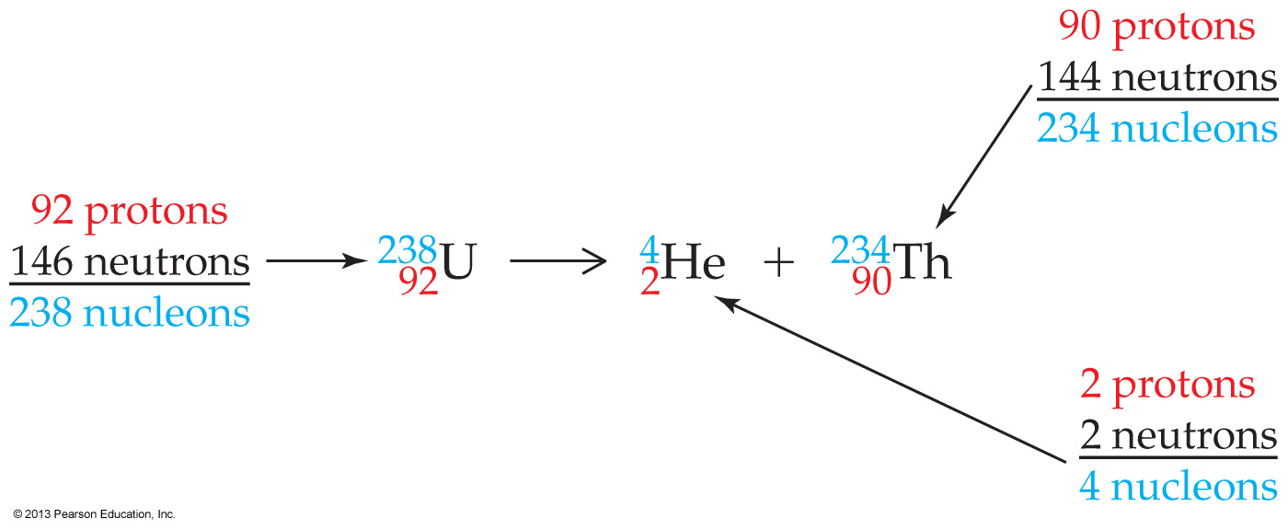
The nuclear reaction shown below is an example of _______.
alpha decay
beta emission
electron capture
positron emission

Slide 23
go to slide 49

Slide 24
11.3 Stable and Unstable Isotopes

Slide 25
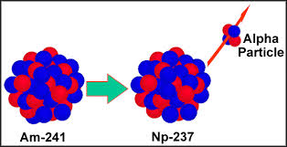
Every element in the periodic table has at least one radioactive isotope
or radioisotope
Radioactivity is the result of unstable nuclei
although the exact causes of this instability are not fully understood
Radiation is emitted when an unstable radionuclide spontaneously changes into a more stable one

Slide 26
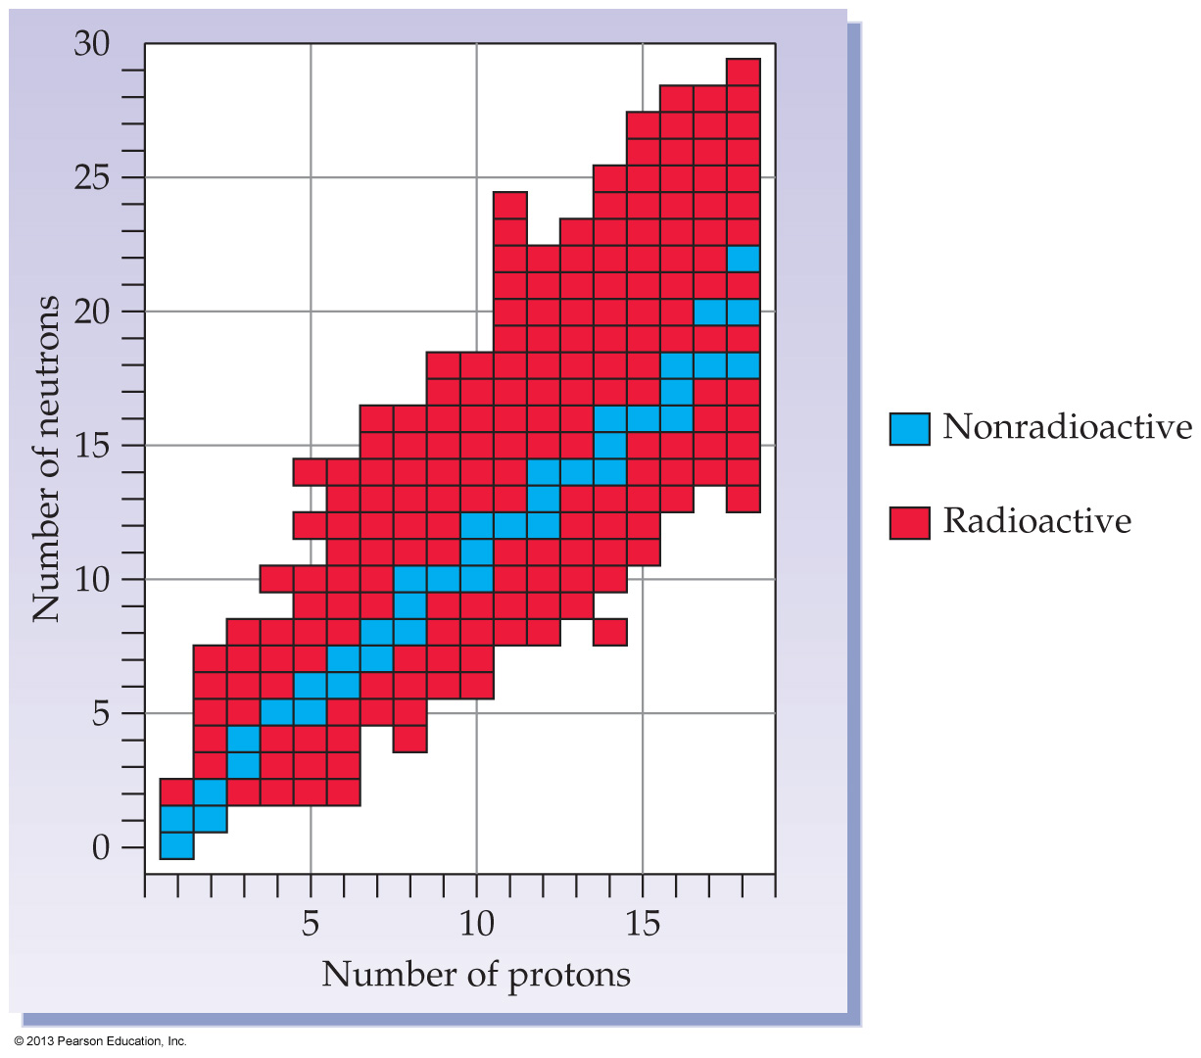
In the first few rows of the periodic table, stability is associated with a roughly equal number of neutrons and protons
As elements get heavier, the number of neutrons relative to protons in stable nuclei increases
Hydrogen has three isotopes
2 are stable
Lead has 35 known isotopes
but only 3 are stable

Slide 27
FYI
Most of the more than 3300 known radioisotopes are made in high-energy particle accelerators
All isotopes of the transuranium elements (those heavier than uranium) are artificial
The much smaller number of radioactive isotopes found in the earth’s crust are called natural radioisotopes
primarliy isotopes of uranium, potassium and thorium
Radioisotopes have the same chemical properties as stable isotopes
which accounts for their great usefulness as tracers

Slide 28
Which of the following is expected to be radioactive?
¹¹B
¹³C
¹⁸F
²²Ne

Slide 29
Which of the following is expected to be radioactive?
¹¹B
¹³C
¹⁸F
²²Ne

Slide 30
11.4 Nuclear Decay

Slide 31
The spontaneous emission of a particle from an unstable nucleus is called nuclear decay or radioactive decay
Radioactive element → New element + Emitted particle(s)
The resulting change of one element into another is called transmutation
The equation for a nuclear reaction is not balanced in the usual sense because the atoms are not the same on both sides
A nuclear equation is balanced when
the number of nucleons is the same on both sides
and when the sums of the charges are the same on both sides

Slide 32
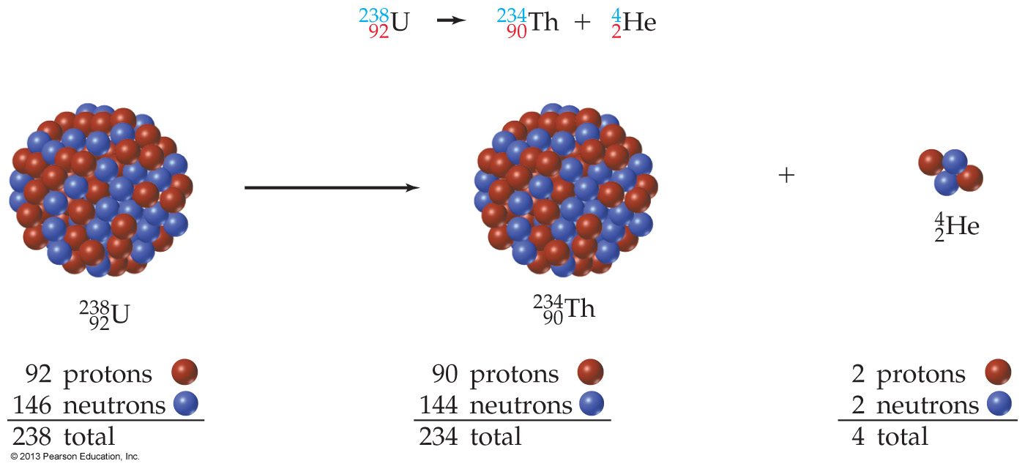
Alpha Emission
When an atom of uranium-238 emits an alpha particle, the nucleus loses two protons and two neutrons
Because the number of protons in the nucleus has now changed from 92 to 90, the identity of the atom has changed from uranium to thorium

Slide 33
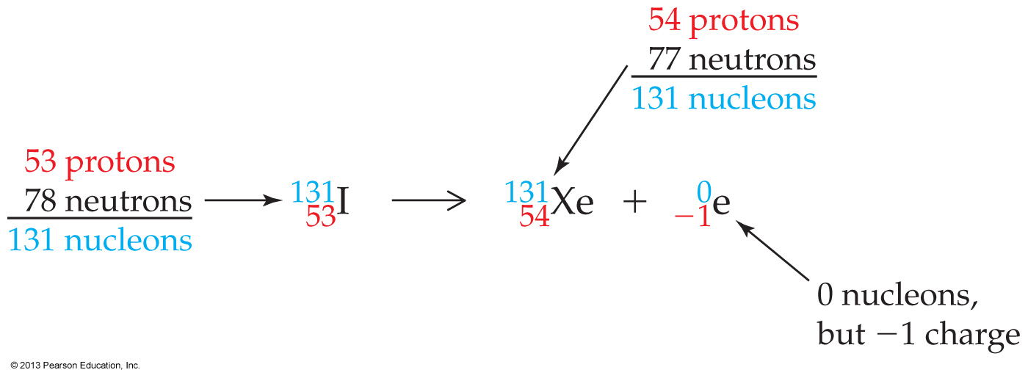
Beta Emission
Beta emission involves the decomposition of a neutron to yield an electron and a proton:
The electron is ejected as a beta particle, and the proton is retained by the nucleus
The atomic number of the atom increases by 1 because there is a new proton
The mass number of the atom remains the same

Slide 34
Charge notation
Notice that the charge on the electron is indicated (-1), but that the charge on the proton (+1) is never indicated

Slide 35
Gamma Emission
Emission of gamma rays themselves causes no change in mass or atomic number because gamma rays are simply high-energy electromagnetic waves:
It usually accompanies transmutation as a mechanism for the new nucleus to get rid of some extra energy
Emission itself affects neither mass number nor atomic number, so is often omitted from nuclear equations
Gamma rays’ penetrating power makes them the most dangerous kind of external radiation and also makes them useful in medical applications

Slide 36
Gamma Emission
Emission of gamma rays causes no change in mass or atomic number because gamma rays are simply high-energy electromagnetic waves:
But notice that one neutron has been converted into a proton in the process
thus changing the identity of the atom by changing its atomic number

Slide 37
fyi
Positron Emission
Positron emission involves the conversion of a proton in the nucleus into a neutron plus an ejected positron
A positron, which can be thought of as a “positive electron”
it has the same mass as an electron but a positive charge
The result of positron emission is a decrease in the atomic number of the product nucleus because a proton has changed into a neutron
but no change in the mass number
Notice the +1 charge
on the positron

Slide 38
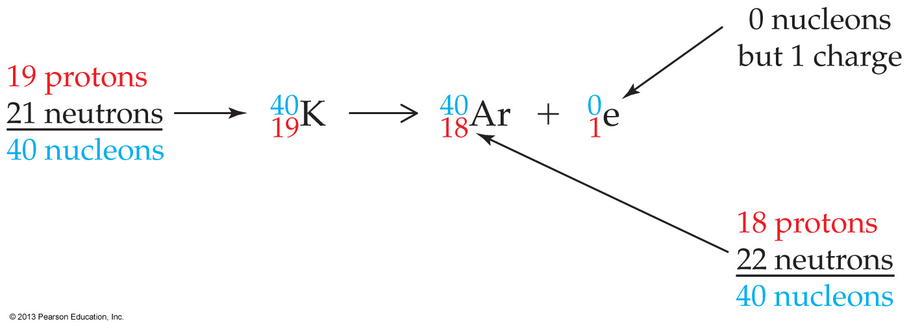
fyi
Notice the +1 charge
on the positron
Notes:
Chapter 11, Unnumbered Figure 1, Page 335

Slide 39
fyi
Electron Capture
Electron capture is a process in which the nucleus captures an inner-shell electron from the surrounding electron cloud
Again, a proton is converted into a neutron
energy is released in the form of gamma rays
The mass number of the product nucleus is unchanged
but the atomic number decreases by 1

Slide 40
Observations
Unstable isotopes that have more protons than neutrons are more likely to undergo β decay to convert a proton to a neutron
Unstable isotopes having more neutrons than protons are more likely to undergo either positron emission or electron capture to convert a neutron to a proton
Very heavy isotopes (Z>83) will most likely undergo α-decay to lose both neutrons and protons to decrease the atomic number

Slide 41
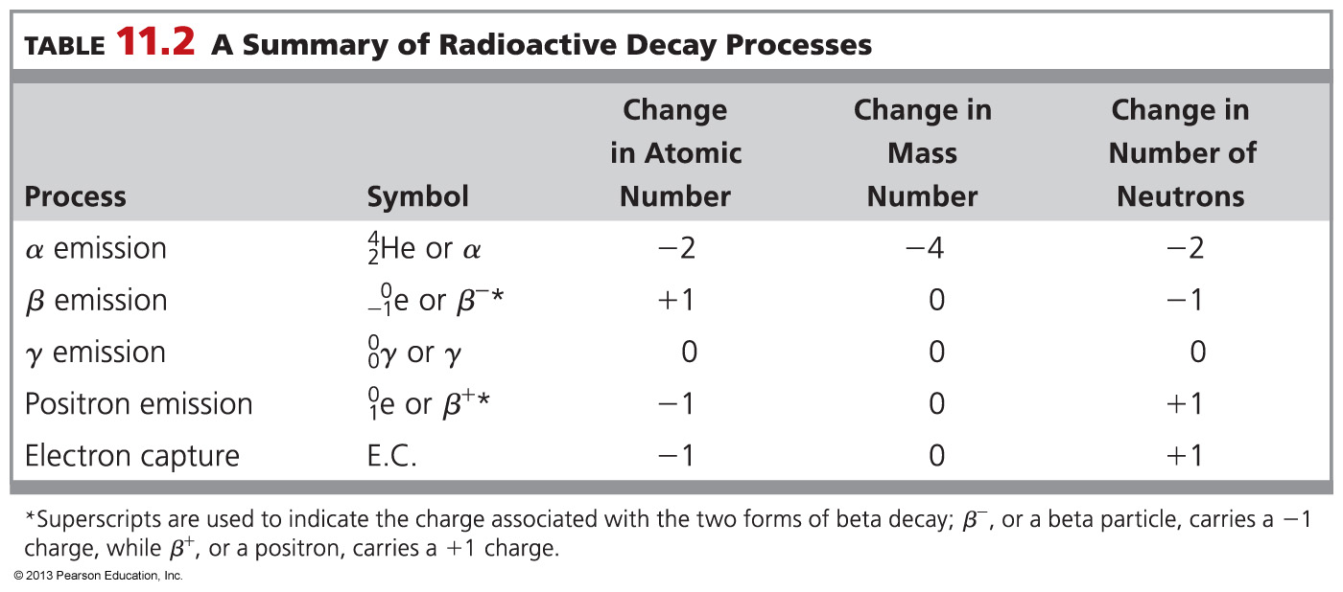

Slide 42
What is the product formed upon electron capture by titanium-44?
Scandium-44
Titanium-43
Titanium-44
Vanadium-44

Slide 43
What is the product formed upon electron capture by titanium-44?
Scandium-44
Titanium-43
Titanium-44
Vanadium-44

Slide 44
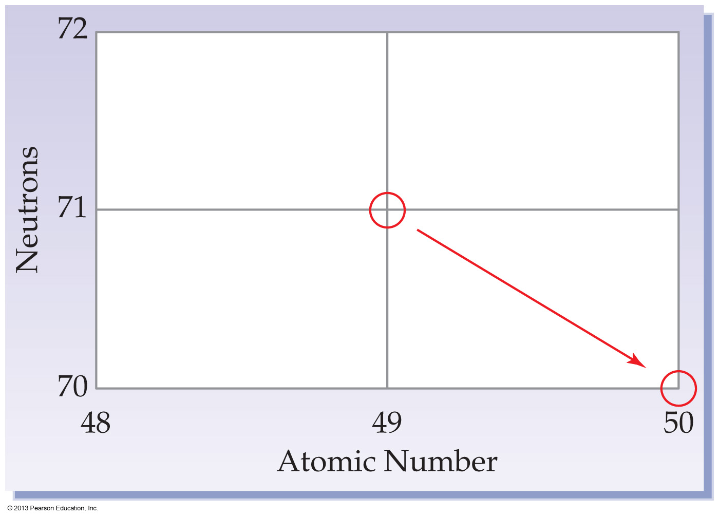
What isotope is the product of the nuclear reaction illustrated below?
Indium-120
Lutetium-120
Tin-120
Ytterbium-120

Slide 45
What isotope is the product of the nuclear reaction illustrated below?
Indium-120
Lutetium-120
Tin-120
Ytterbium-120

Slide 46
Tell the type of decay process occurring in the following nuclear reaction.
α-emission
β-emission
γ-emission
Electron capture or positron emission

Slide 47
Tell the type of decay process occurring in the following nuclear reaction.
α-emission
β-emission
γ-emission
Electron capture or positron emission

Slide 48
Worked Example 11.2 Balancing Nuclear Reactions: Beta Emission
Write a balanced nuclear equation for the decay of chromium-55.
Analysis
Write the known part of the nuclear equation:
Then calculate the mass number and atomic number of the product element, and write the final equation.
Solution
The mass number of the product stays at 55, and the atomic number increases by 1, 24 + 1 = 25, so the product is manganese-55.
Check your answer by making sure that the mass numbers and atomic numbers on the two sides of the equation are balanced:

Slide 49
11.5 Radioactive Half-Life

Slide 50
The rate of radioactive decay varies greatly from one radioisotope to another
Rates of nuclear decay are measured in units of half-life (t_{1/2}) defined as the amount of time required for one-half of a radioactive sample to decay
Fraction remaining = (0.5)^{n} where n is the number of half-lives that have elapsed

Slide 51
The decay of I-131
Notes:
Chapter 11, Unnumbered Figure 2, Page 337

Slide 52
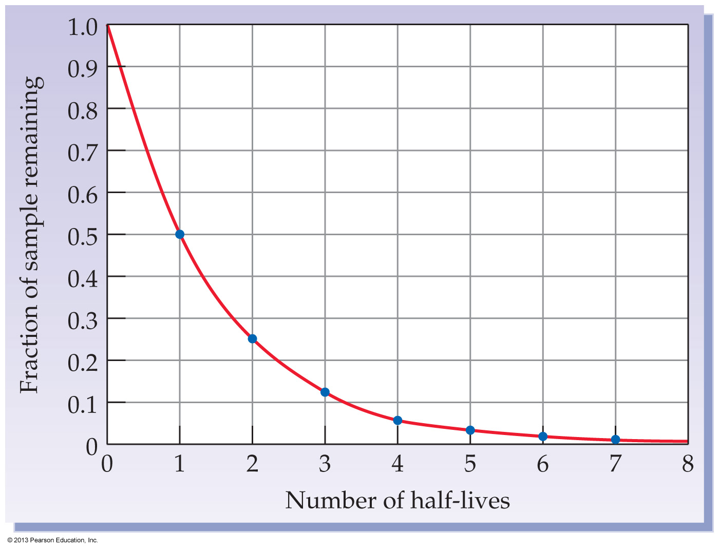
Notes:
Figure 11.4 The decay of a radioactive nucleus over time.

Slide 53
An exercise for the student
Carbon-14 atoms are produced in the upper atmosphere
Carbon-14 is then taken up by plants during photosynthesis
When plants are eaten by animals, carbon-14 enters the food chain
The ratio of C-14 to C-12 in a living organism is the same as that in the atmosphere—about 1 part in 10¹²
When the plant or animal dies
the ratio slowly decreases as C-14 undergoes radioactive decay
At 5730 years (one half-life) after the death of the organism, the ratio has decreased by a factor of 2
By measuring the amount of C-14 remaining in the traces of any once-living organism
archaeologists can determine how long ago the organism died

Slide 54
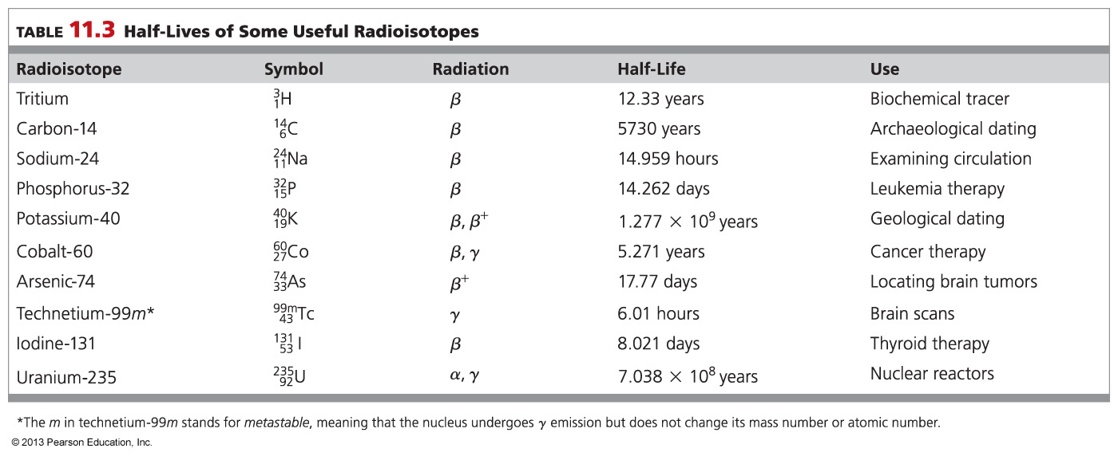
Notes:
Chapter 11, Table 11.3

Slide 55
A radionuclide has a half-life of 3 days. According to its decay curve, how many half-lives have passed after nine days?
one
two
three
four

Slide 56
A radionuclide has a half-life of 3 days. According to its decay curve, how many half-lives have passed after nine days?
one
two
three
four

Slide 57
Curium-242 decays by alpha emission to give plutonium-238. If yellow spheres represent curium-242 and blue spheres represent plutonium-238, how many half-lives have passed in the sample shown below?
0.5
1.0
1.5
2.0

Slide 58
Curium-242 decays by alpha emission to give plutonium-238. If yellow spheres represent curium-242 and blue spheres represent plutonium-238, how many half-lives have passed in the sample shown below?
0.5
1.0
1.5
2.0

Slide 59
Iodine-131 is used in thyroid therapy and has a half-life of about 8 days. What percentage of iodine-131 remains in a patient 32 days after treatment?
50.0%
25.0%
12.5%
6.25%

Slide 60
Iodine-131 is used in thyroid therapy and has a half-life of about 8 days. What percentage of iodine-131 remains in a patient 32 days after treatment?
50.0%
25.0%
12.5%
6.25%

Slide 61
Worked Example 11.4 Nuclear Reactions: Half-Life
Phosphorus-32, a radioisotope used in leukemia therapy, has a half-life of about 14 days. Approximately what
percentage of a sample remains after 8 weeks?
Analysis
Determine how many half-lives have elapsed. For an integral number of half-lives, we can multiply the starting amount (100%) by 1/2 for each half-life that has elapsed.
Solution
Since one half-life of is 14 days (2 weeks), 8 weeks represents four half-lives. The fraction that
remains after 8 weeks is thus

Slide 62
fyi
Medical Uses of Radioactivity
In Vivo Procedures:
In vivo studies take place inside the body and are carried out to assess the functioning of a particular organ or body system. A radiopharmaceutical agent is administered, and its path determined by analysis of blood or urine samples.
Therapeutic Procedures:
External radiation therapy for the treatment of cancer is often carried out with ϒ-rays emanating from a cobalt-60 source.
To treat some tumors a radioactive source is placed physically close to the tumor for a specific amount of time.
In boron neutron-capture therapy (BNCT), boron-containing drugs are administered to a patient and concentrate in the tumor site. The tumor is then irradiated with a neutron beam from a nuclear reactor. The boron absorbs a neutron and undergoes transmutation to produce an alpha particle and a lithium nucleus.

Slide 63
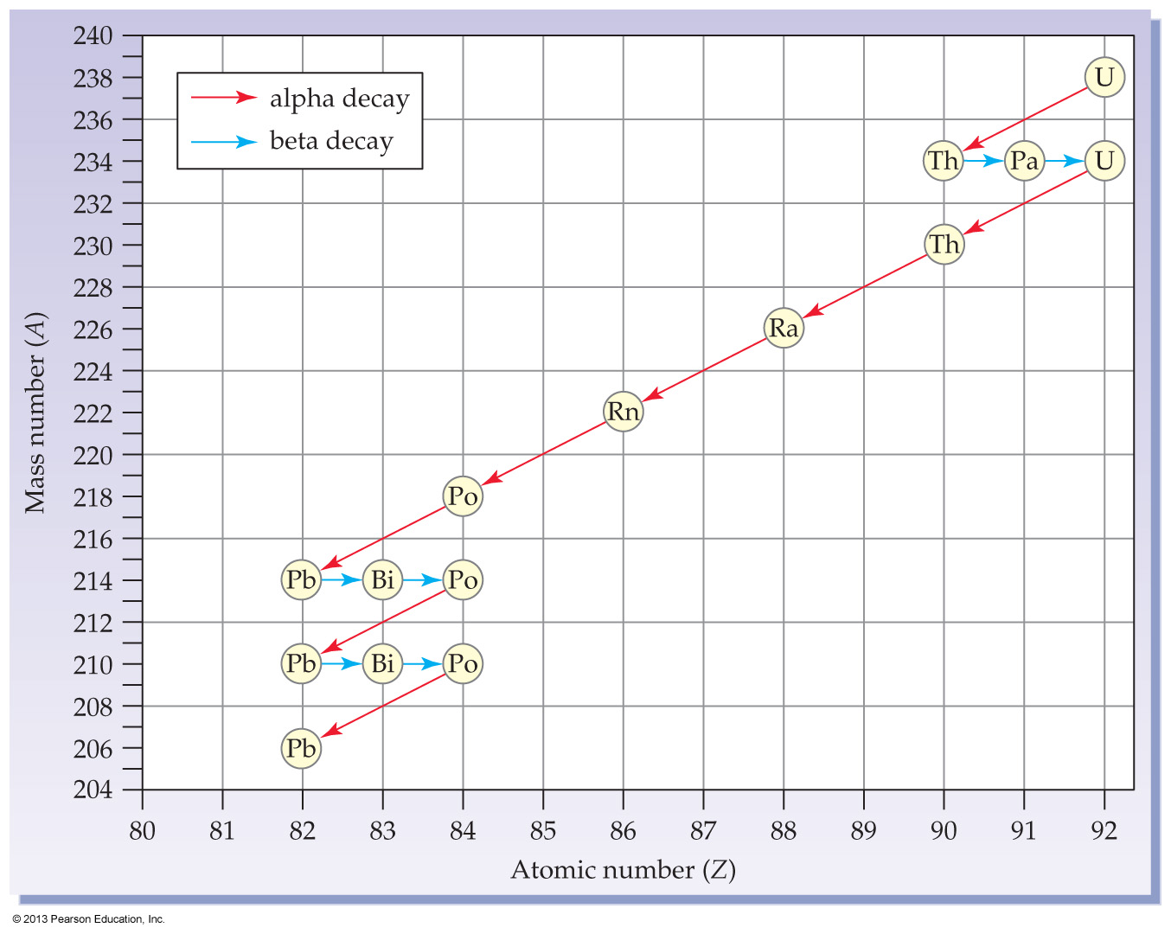
11.6 Radioactive Decay Series [skip]

Slide 64
When a radioactive isotope decays, nuclear change occurs and a different element is formed
Sometimes the product nucleus is radioactive and undergoes further decay
Some radioactive nuclei undergo a whole decay series of nuclear disintegrations
before they ultimately reach a nonradioactive product

Slide 65
One of the intermediate radionuclides in the uranium-238 decay series is radium-226
Radium-226 has a half-life of 1600 years and undergoes decay to produce radon-222, a gas
Radon is a gas that passes in and out of the lungs without being incorporated into body tissue
If a radon-222 atom should decay while in the lungs
the solid decay product polonium-218 results
Further decay emits alpha particles, which can damage lung tissue

Slide 66
11.7 Ionizing Radiation

Slide 67
High-energy radiation of all kinds is also called ionizing radiation
This includes alpha particles, beta particles, gamma rays, and also X rays and cosmic rays
X rays have no rest mass and consist of high-energy electromagnetic radiation
The energy of X rays is less than that of gamma rays
Cosmic rays are a mixture of high-energy particles that shower the earth from outer space
They consist primarily of protons
along with some alpha and beta particles

Slide 68
The interaction of ionizing radiation with a molecule converts the molecule into an extremely reactive ion
The reactive ion can react with other molecules nearby, creating other fragments that can cause further reactions
A large dose of ionizing radiation can destroy the delicate balance of chemical reactions in living cells
ultimately causing the death of an organism

Slide 69
An exercise for the student
A small dose of ionizing radiation can be dangerous if it strikes a cell nucleus and damages the genetic machinery inside
The resultant changes might lead to a genetic mutation, to cancer, or to cell death
The nuclei of rapidly dividing cells, such as those in bone marrow, the lymph system, the lining of the intestinal tract, or an embryo, are the most readily damaged
Because cancer cells are also rapidly dividing, they are highly susceptible to the effects of ionizing radiation
which is why radiation therapy is an effective treatment

Slide 70
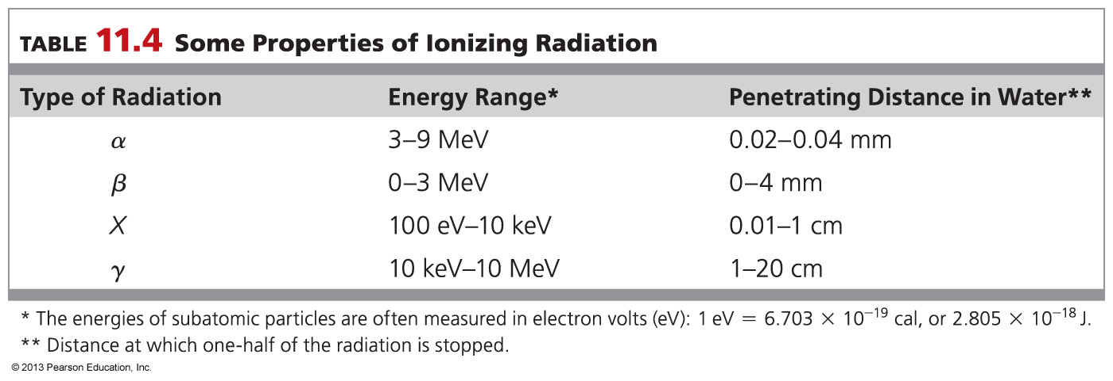

Slide 71
An exercise for the student
The effects of ionizing radiation on the human body vary with
the energy of the radiation
its distance from the body
the length of exposure
and the location of the source
When coming from outside the body, gamma rays and X rays are most harmful because they pass through clothing and skin
Alpha and beta particles are much more dangerous when emitted within the body
because all their radiation energy is given up to the immediately surrounding tissue

Slide 72
Health professionals who work with ionizing radiation protect themselves by surrounding the source with a thick layer of lead or other dense material
Protection from radiation is also afforded by controlling the distance between the worker and the radiation source because radiation intensity (I) decreases with the square of the distance from the source

Slide 73
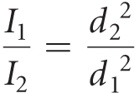
Worked Example 11.6 Ionizing Radiation: Intensity versus Distance from the Source
If a radiation source gives 75 units of radiation at a distance of 2.4 m, at what distance does the source give 25 units of radiation?
Analysis
Radiation intensity (I) decreases with the square of the distance (d) from the source according to the
equation
We know three of the four variables in this equation (I₁, I₂, and d₁) and we need to find d₂.
Ballpark Estimate
In order to decrease the radiation intensity from 75 units to 25 units (a factor of 3), the distance must increase by a factor of Thus, the distance should increase from 2.4 m to about 4 m.

Slide 74
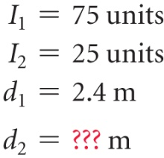
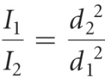
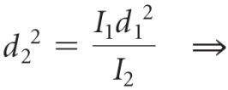
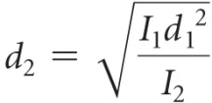
Worked Example 11.6 Ionizing Radiation: Intensity versus Distance from the Source
Continued
Solution
STEP 1: Identify known information. We know three of the four variables.
STEP 2: Identify answer and units.
STEP 3: Identify equation. Rearrange the equation relating intensity and distance to solve for d₂.
STEP 4: Solve. Substitute in known values so that unwanted units cancel.
Ballpark Check
The calculated result is consistent with our estimate of about 4 m.

Slide 75
11.8 Detecting Radiation [skip]

Slide 76
Radiation is invisible, no matter how high the dose
Radiation can be detected by taking advantage of its ionizing properties
The simplest device for detecting exposure to radiation is the photographic film badge
The film is protected from exposure to light, but radiation causes the film to fog

Slide 77
The most versatile method for measuring radiation is the scintillation counter
A phosphor emits a flash of light when struck by radiation. The number of flashes are counted electronically and converted into an electrical signal
A Geiger counter is an argon-filled tube containing two electrodes
Radiation ionizes argon atoms, which briefly conduct a tiny electric current between the walls and the center electrode
The current is detected and used to produce a clicking sound or to register on a meter.

Slide 78
Irradiated Food
In the 1940s, U.S. Army scientists found that irradiation increased the shelf-life of ground beef.
Exposure of contaminated food to ionizing radiation destroys the genetic material of any bacteria or other organisms present.
Irradiation will not kill viruses or prions.
The food itself undergoes little if any change when irradiated and does not become radioactive.
One of the major concerns in the United States is the possible generation of radiolytic products, compounds formed in food by exposure to ionizing radiation
The U.S. Food and Drug Administration has declared that food irradiation is safe and does not appreciably alter the vitamin or other nutritional content of food

Slide 79
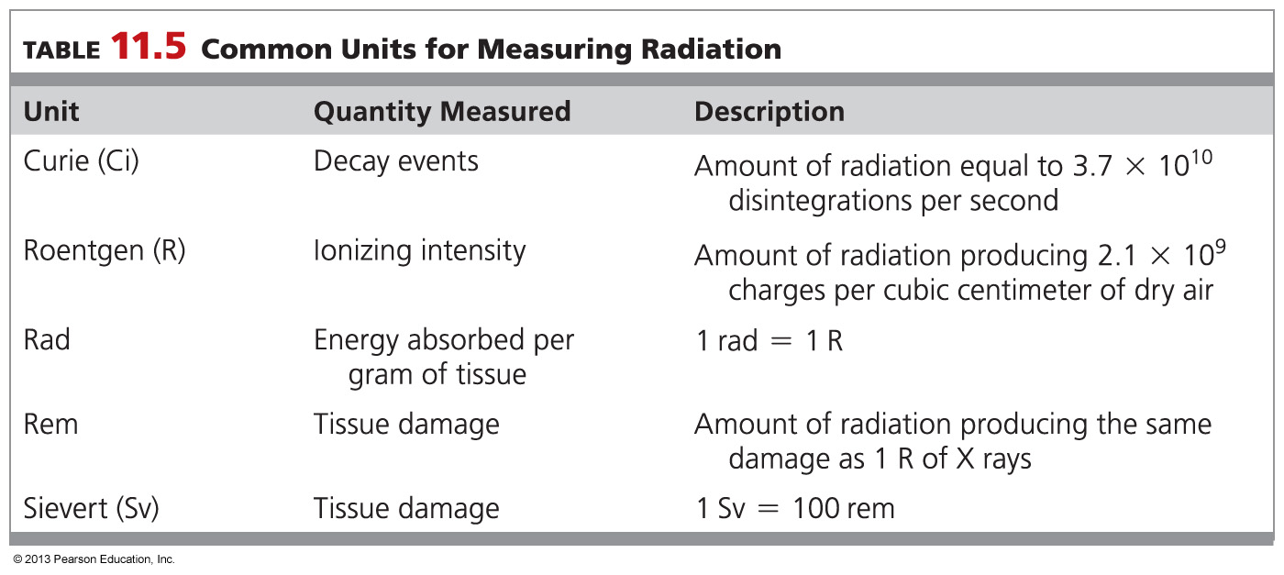
11.9 Measuring Radiation [skip]

Slide 80
Curie: The curie (Ci), the millicurie (mCi), and the microcurie measure the number of radioactive disintegrations occurring each second in a sample
The dosage of a radioactive substance is usually given in millicuries.
Because the emitter concentration is constantly decreasing as it decays…
the activity must be measured immediately before administration

Slide 81
The roentgen (R) is a unit for measuring the ionizing intensity of g or X radiation
the capacity of the radiation for affecting matter
The rad (radiation absorbed dose) is the absorption of 1 × 10⁻⁵ J per gram
The energy absorbed varies with the type of material irradiated and the type of radiation
The roentgen and the rad are so close that they can be considered identical when used for X rays and g rays

Slide 82
The rem (roentgen equivalent for man) measures the amount of tissue damage caused by radiation
Rems are the preferred units for medical purposes because they measure equivalent doses of different kinds of radiation
Rems = rads × RBE
RBE is a relative biological effectiveness factor…
which takes into account the differences in energy and of the different types of radiation

Slide 83
SI Units:
The becquerel (Bq) is defined as one disintegration per second
The SI unit for energy absorbed is the gray (Gy; 1 Gy = 100 rad)
For radiation dose, the SI unit is the sievert (Sv), which is equal to 100 rem
The radiation dose received annually by most people is only about 0.27 rem.
About 80% of this background radiation comes from natural sources
the remaining 20% comes from consumer products and medical procedures

Slide 84
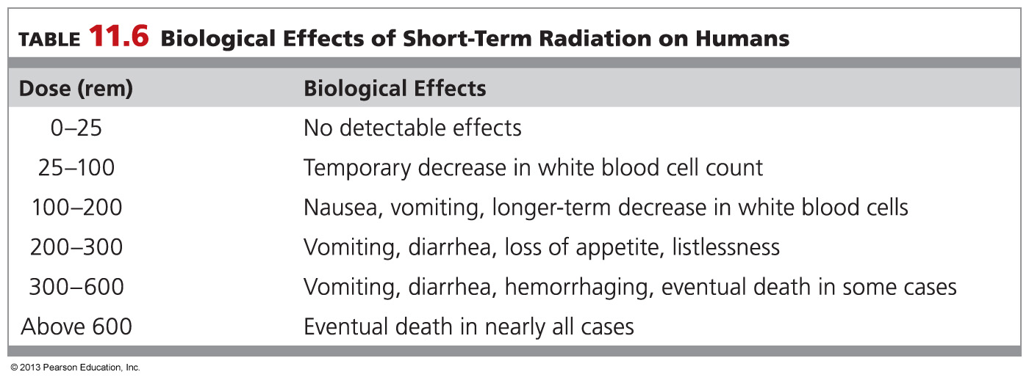

Slide 85
The common unit for measuring the number of disintegrations per second is the _______.
curie
rad
roentgen
sievert

Slide 86
The common unit for measuring the number of disintegrations per second is the _______.
curie
rad
roentgen
sievert

Slide 87
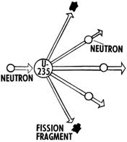
11.10 Artificial Transmutation

Slide 88
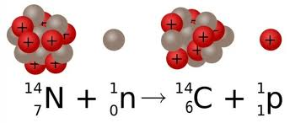
Very few of the approximately 3300 known radioisotopes are naturally occurring
most are made from stable isotopes by artificial transmutation
When a stable atom nucleus is bombarded with a high energy particle
such as a proton, neutron, α particle…
an unstable nucleus is created in the collision
recall the proton,
is a hydrogen
nucleus:

Slide 89
As always, nuclear equations must be balanced
The sum of the mass numbers and the sum of the charges are the same on both sides of the equation

Slide 90
Worked Example 11.7 Balancing Nuclear Reactions: Transmutation
Californium-246 is formed by bombardment of uranium-238 atoms. If 4 neutrons are also formed, what particle is
used for the bombardment?
Analysis
First write an incomplete nuclear equation incorporating the known information:
Then find the numbers of nucleons and charges necessary to balance the equation. In this instance, there are 238 nucleons on the left and 246 + 4 = 250 nucleons on the right, so the bombarding particle must have 250 – 238 = 12 nucleons. Furthermore, there are 92 nuclear charges on the left and 98 on the right, so the bombarding particle must have 98 – 92 = 6 protons.
Solution
The missing particle is .

Slide 91
Body Imaging
An X-ray image is produced when X rays pass through the body and the intensity of the radiation that exits is recorded on film.
Diagnostic information can be obtained by analyzing the distribution pattern of a radioactively tagged substance in the body.
In CT scanning (computerized tomography), an X-ray source and an array of detectors move rapidly in a circle around a patient’s body, collecting up to 90,000 readings. CT scans can detect structural abnormalities without the use of radioactive materials.
Positron emission tomography (PET), combines tomography with radioisotope imaging utilizes radioisotopes that emit positrons and ultimately yield γ rays.
Magnetic resonance imaging (MRI) is a medical imaging technique that uses powerful magnetic and radio-frequency fields to interact with specific nuclei in the body to generate images in which the contrast between soft tissues is much better than that seen with CT.

Slide 92
11.11 Nuclear Fission and Nuclear Fusion

Slide 93
Artificial transmutation usually results in heavier nuclei
Nuclear fusion is the joining together of light nuclei
Nuclear fission is the fragmenting of heavy nuclei
The huge amounts of energy that accompany these processes are the result of mass-to-energy conversions
They are predicted by Einstein’s equation:
E = mc²

Slide 94
NUCLEAR FISSION
Uranium-235 is the only naturally occurring isotope that undergoes nuclear fission
When this isotope is bombarded by a stream of relatively slow-moving neutrons
its nucleus splits to give isotopes of other elements
The split can take place in more than 400 ways
more than 800 different fission products have been identified

Slide 95
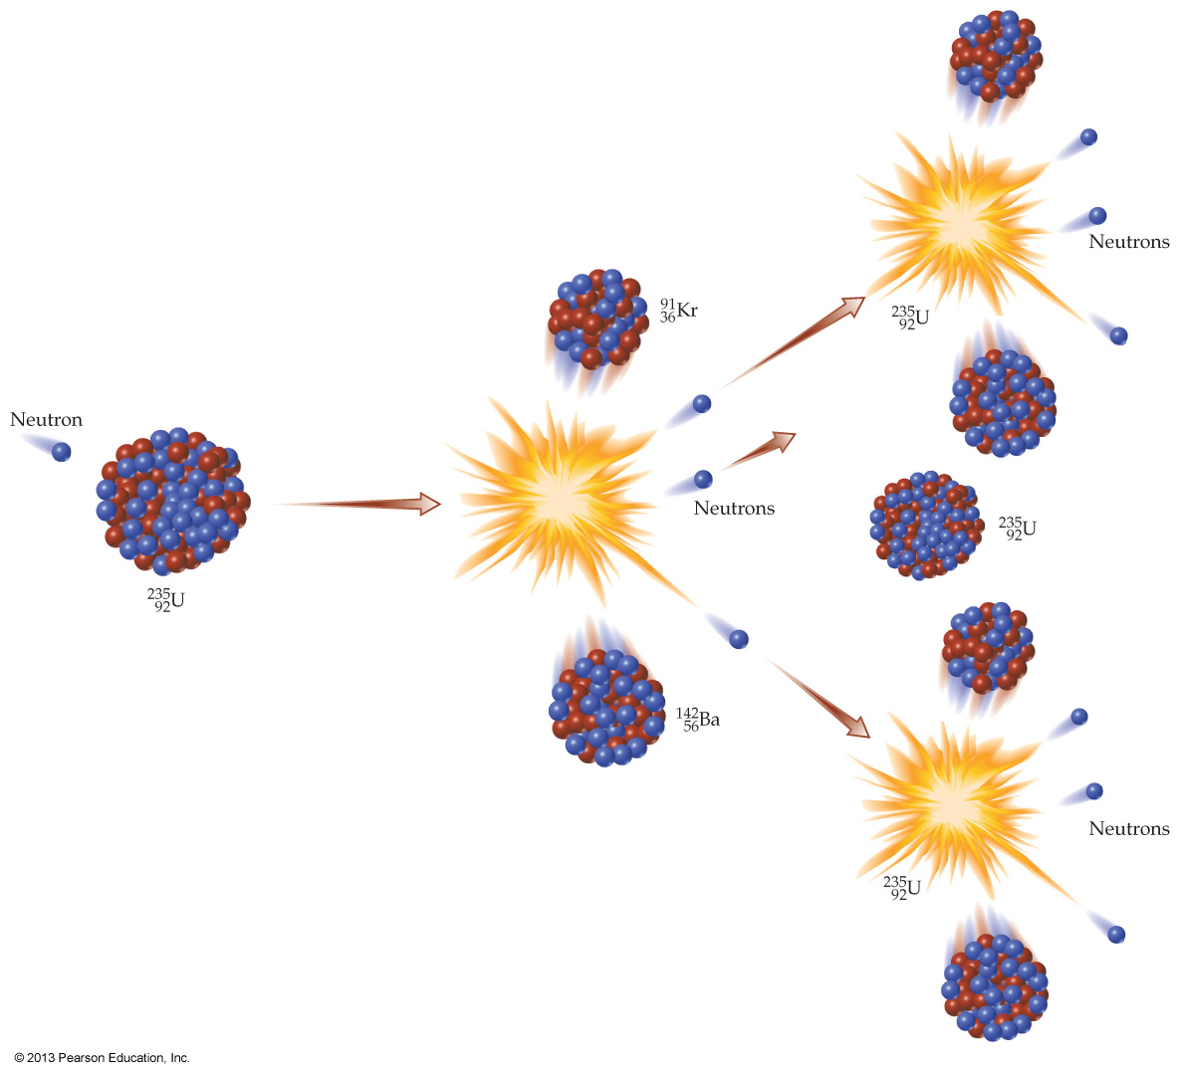
One of the pathways generates barium-142 and krypton-91
along with two additional neutrons
plus the one neutron that initiated the fission

Slide 96
One of the pathways generates barium-142 and krypton-91
along with two additional neutrons
plus the one neutron that initiated the fission
One neutron is used to initiate fission of a ²³⁵U nucleus, but three neutrons are released
Thus, a nuclear chain reaction can be started
If the sample size is small, many of the neutrons escape
and the chain reaction stops
If a critical mass is present then the chain reaction becomes self-sustaining
a nuclear explosion results

Slide 97
The fission of just 1.0 g of uranium-235 produces a whopping 3.4 × 10⁸ kcal (1.4 x 10⁹ kJ) of energy
This heat can be used to convert water to steam
which can be harnessed to generate electricity
Energy release is accompanied by mass loss: E = mc²
Note that combustion of 1.0 g of methane releases only 1.2 x 10¹ kcal (5.2 x 10¹ kJ) of energy
and the mass loss (E = mc²) in a typical exothermic chemical reaction is too small to measure on commercial balances
so we are normally justified is saying that mass is conserved in a typical chemical reaction

Slide 98
Earth today
Nuclear fission continues to power tectonic movement of Earth’s continents and crust
without which, life would not have evolved
and would not continue
Earth’s core is still chock full of radioactive elements
primarily uranium, thorium and potassium
New measurements from boreholes suggest that radioactive decay provides more than half of Earth’s total heat
The rest is leftover from Earth’s formation or other causes yet unknown

Slide 99
fyi: Hazards of commercial fission
There is a potential radiation hazard should an accident rupture the containment vessel.
Many of the wastes from power generation have such long half-lives that hundreds or even thousands of years must elapse before they will be safe for humans to approach.

Slide 100
NUCLEAR FUSION
Very light nuclei such as the isotopes of hydrogen release enormous amounts of energy when they undergo fusion
It is a fusion reaction of hydrogen nuclei to produce helium that powers our sun and other stars
In stars, where the temperature is 2 × 10⁷ K and pressures approach 10⁵ atmospheres
nuclei are stripped of their electrons
and have enough kinetic energy that fusion readily occurs
On earth, however, the necessary conditions for nuclear fusion are not easily created
and have never occurred naturally

Slide 101
Which of the following is true of nuclear fission reactions?
It is the joining together of light nuclei.
A chain reaction is initiated by neutrons.
These reactions take place on the sun.
No waste products are created.

Slide 102
Which of the following is true of nuclear fission reactions?
It is the joining together of light nuclei.
A chain reaction is initiated by neutrons.
These reactions take place on the sun.
No waste products are created.

Slide 103
Which of the following is true of nuclear fusion reactions?
It is the joining together of light nuclei.
It is the breaking apart of heavy nuclei.
Uranium-235 is used in fusion reactions.
A critical mass of uranium can keep the reaction going.

Slide 104
Which of the following is true of nuclear fusion reactions?
It is the joining together of light nuclei.
It is the breaking apart of heavy nuclei.
Uranium-235 is used in fusion reactions.
A critical mass of uranium can keep the reaction going.

Slide 105
Chapter Summary

Slide 106
What is a nuclear reaction, and how are equations for nuclear reactions balanced?
A nuclear reaction is one that changes an atomic nucleus, causing the change of one element into another. Loss of an α particle leads to a new atom whose atomic number is 2 less than that of the starting atom. Loss of a b particle leads to an atom whose atomic number is 1 greater than that of the starting atom.
A nuclear reaction is balanced when the sum of the nucleons (protons and neutrons) is the same on both sides of the reaction arrow and when the sum of the charges on the nuclei plus any ejected subatomic particles is the same.

Slide 107
What are the different kinds of radioactivity?
Radioactivity is the spontaneous emission of radiation from the nucleus of an unstable atom. The three major kinds of radiation are called alpha (a), beta (b), and gamma (g).
Alpha radiation consists of helium nuclei, small particles containing two protons and two neutrons; beta radiation consists of electrons; and gamma radiation consists of high-energy light waves. Every element in the periodic table has at least one radioactive isotope, or radioisotope.
How are the rates of nuclear reactions expressed?
The rate of a nuclear reaction is expressed in units of half-life where one half-life is the amount of time necessary for one half of the radioactive sample to decay.

Slide 108
What is ionizing radiation?
High-energy radiation of all types—a particles, b particles, g rays, and X rays—is called ionizing radiation. When any of these kinds of radiation strikes an atom, it dislodges an electron and gives a reactive ion that can be lethal to living cells.
Gamma rays and X rays are the most penetrating and most harmful types of external radiation, and a particles are the most dangerous types of internal radiation because of their high energy and the resulting damage to surrounding tissue.

Slide 109
How is radioactivity measured?
Radiation intensity is expressed in different ways according to the property being measured.
The curie (Ci) measures the number of radioactive disintegrations per second in a sample; the roentgen (R) measures the ionizing ability of radiation; the rad measures the amount of radiation energy absorbed per gram of tissue; and the rem measures the amount of tissue damage caused by radiation.
Radiation effects become noticeable with a human exposure of 25 rem and become lethal at an exposure above 600 rem.

Slide 110
What is transmutation?
Transmutation is the change of one element into another brought about by a nuclear reaction.
Most known radioisotopes do not occur naturally but are made by bombardment of an atom with a high-energy particle. In the ensuing collision between particle and atom, a nuclear change occurs and a new element is produced by artificial transmutation.
What are nuclear fission and nuclear fusion?
With a very few isotopes, including , the nucleus is split apart by neutron bombardment to give smaller fragments. A large amount of energy is released during this nuclear fission, leading to use of the reaction for generating electric power.
Nuclear fusion results when small nuclei such as those of tritium and deuterium combine to give a heavier nucleus.

