Slide 1
Chapter Four
Chapter 4 Lecture
Fundamentals of General, Organic, and Biological Chemistry
7th Edition
McMurry, Ballantine, Hoeger, Peterson
Molecular Compounds
Julie Klare
Gwinnett Technical College
© 2013 Pearson Education, Inc.

Slide 2
4.1 Covalent Bonds
4.2 Covalent Bonds and the Periodic Table
4.3 Multiple Covalent Bonds
4.4 Coordinate Covalent Bonds [skip]
4.5 Characteristics of Molecular Compounds
4.6 Molecular Formulas and Lewis Structures
4.7 Drawing Lewis Structures
4.8 The Shapes of Molecules
4.9 Polar Covalent Bonds and Electronegativity
4.10 Polar Molecules
4.11 Naming Binary Molecular Compounds

Slide 3
Goals
1. What is a covalent bond?
Be able to describe the nature of covalent bonds and how they are formed.
2. How does the octet rule apply to covalent bond formation?
Be able to use the octet rule to predict the numbers of covalent bonds formed by common main group elements.
3. What are the major differences between ionic and molecular compounds?
Be able to compare the structures, compositions, and properties of ionic and molecular compounds.

Slide 4
How are molecular compounds represented?
Be able to interpret molecular formulas and draw Lewis structures for molecules.
What is the influence of valence-shell electrons on molecular shape?
Be able to use Lewis structures to predict molecular geometry.
When are bonds and molecules polar?
Be able to use electronegativity and molecular geometry to predict bond and molecular polarity.

Slide 5
4.1 Covalent Bonds

Slide 6
Covalent bond—A bond formed by sharing electrons between nonmetal atoms
Molecule—A group of (nonmetal) atoms held together by covalent bonds

Slide 7
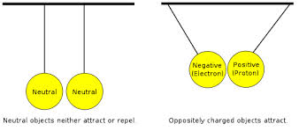
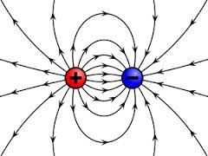
FYI
Contrast the electron-sharing covalent bond with the ionic bond which holds ions together in a salt

Slide 8
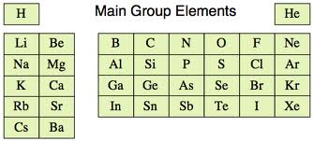
Main group elements are predisposed to chemical reactions that leave them with 8 valence electrons (octet; duet for hydrogen)
In order to achieve a noble gas configuration
True for making both salts (ionics) and molecules

Slide 9
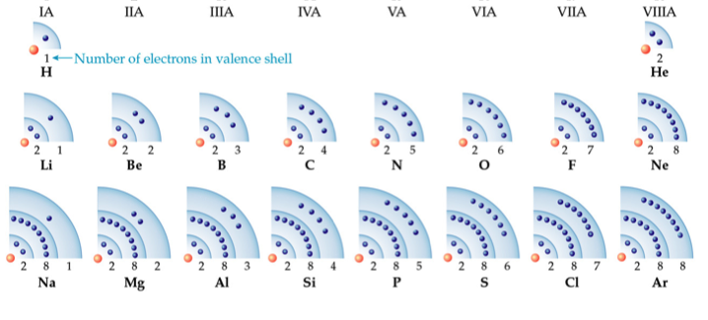
Molecules (nonmetals bonded to nonmetals) achieve their octet by sharing an appropriate number of electrons in covalent bonds
Unlike salts which exchange electrons

Slide 10
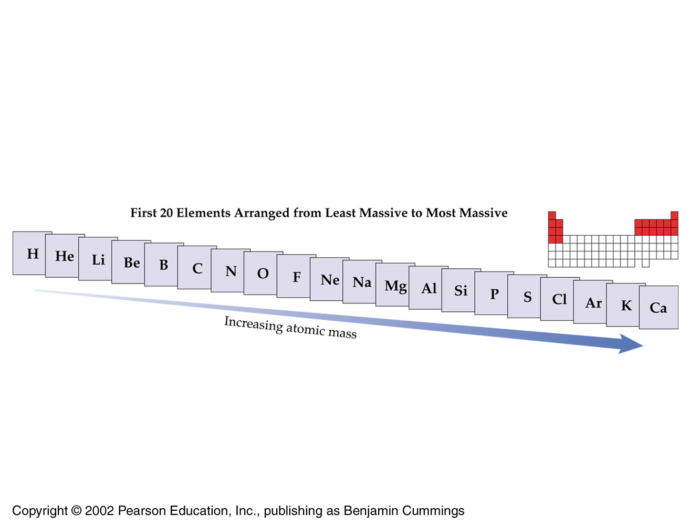
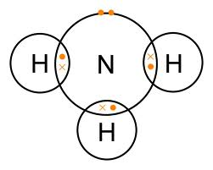
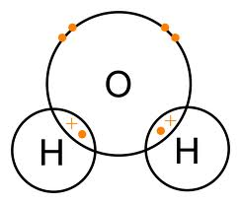
Get ready for Lewis Structures
So all nonmetals want to have the same number of valence electrons to play with as their bigger noble gas neighbor

Slide 11
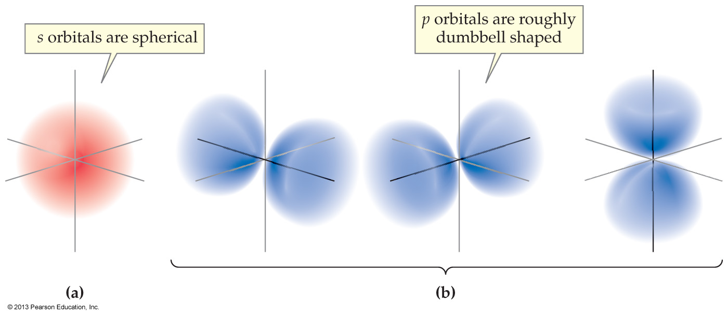
fyi: Review
Recall from Ch 2 what the atomic s and p orbitals look like
The s are spherical
the p are dumbbell shaped

Slide 12
Electron sharing in
Covalent Bonds
We begin with the hydrogen molecule (H₂)

Slide 13
Two atomic 1s orbitals from hydrogen overlap to give one bonding orbital: an egg-shaped region
called a bonding electron charge cloud
The two electrons between the nuclei mimic the 1s² configuration of helium – which H₂ craves
a bonding electron charge cloud

Slide 14
Bond length is the optimum distance between nuclei in a covalent bond.
If atoms are too far apart, attractive forces are small and no bond exists.
If atoms are too close, the repulsive interaction between nuclei is so strong that it pushes the atoms apart.
In the H₂ molecule, the optimum distance between nuclei is 74 pm.

Slide 15
Chlorine exists as a diatomic molecule due to the overlap of a 3p orbital from each bonding atom
to give a bonding orbital
containing an electron pair in a bonding electron charge cloud
a bonding electron charge cloud

Slide 16
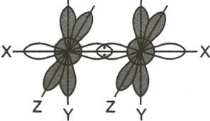
The bonding electron charge cloud
The Lewis structure
of Cl₂

Slide 17
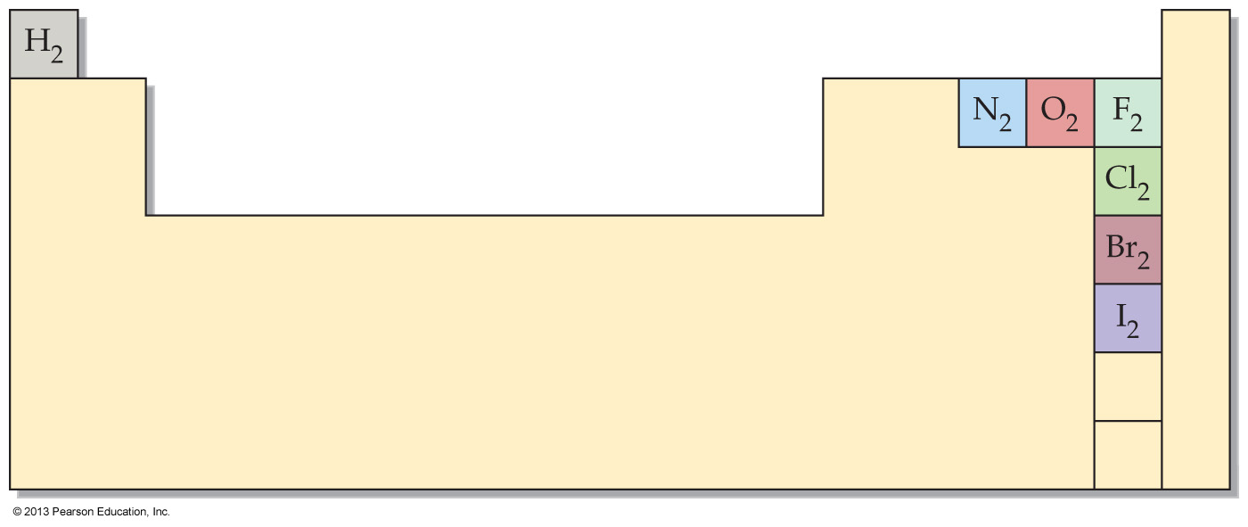
Pop reminder
There are seven diatomic elements: nitrogen, oxygen, hydrogen, fluorine, chlorine, bromine, and iodine

Slide 18
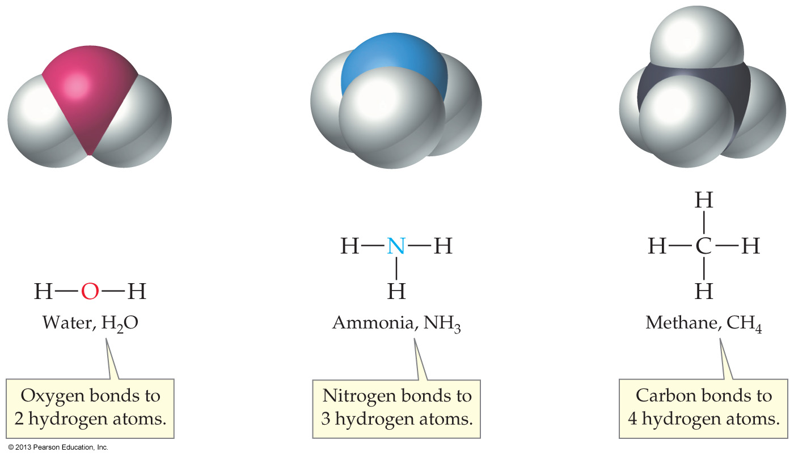
4.2 Covalent Bonds and the Periodic Table

Slide 19
So a molecular compound is a compound that consists of molecules – no ions are involved
In molecules, atoms share electrons to achieve a noble gas configuration.
Like salts, molecules are electrically neutral overall

Slide 20
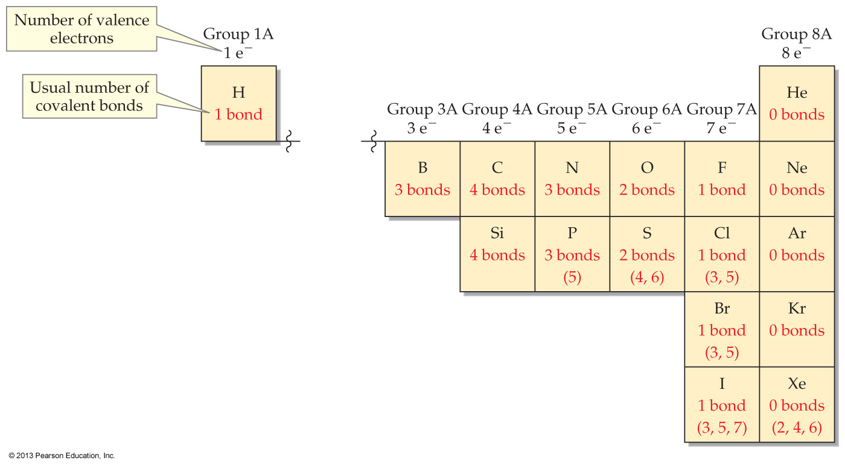
FIGURE 4.3 Numbers of covalent bonds typically formed by main group elements to achieve octet configurations

Slide 21
Exceptions to the Octet Rule:
Hydrogen wants a duet (to be like helium)
Boron only has three electrons to share, and so can only bond to three other atoms
We will cover the octet exceptions in greater detail in section 4.6

Slide 22
Which of the following is NOT true of molecular compounds?
Their smallest components are molecules.
They are composed of all nonmetals.
They possess high melting points.
They are usually soluble in organic liquids.

Slide 23
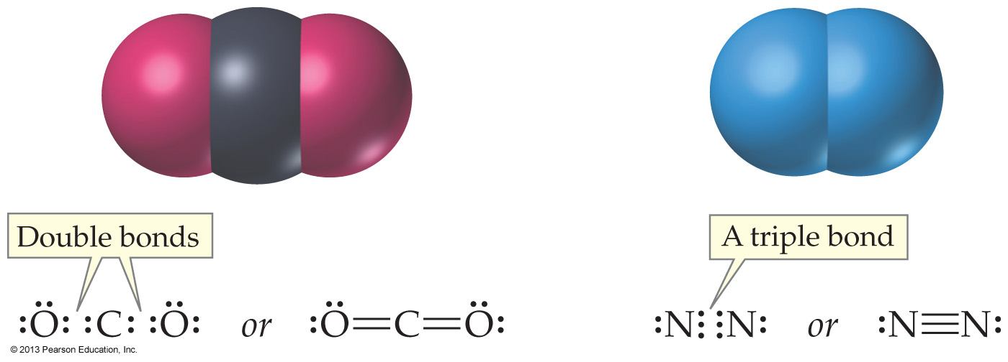
4.3 Multiple Covalent Bonds

Slide 24
atomic & bonding orbitals
All orbitals can hold a maximum of 2 electrons
A covalent bonding orbital must contain 2 electrons to form a bond
At least in Intro

Slide 25
FYI
This picture
shows all the
valence orbitals
of Cl₂

Slide 26
The electron charge cloud concept
A single bond is: One bonding electron charge cloud that contains one molecular bonding orbital
Cl—Cl
But a bonding electron charge cloud can enclose multiple covalent bonding orbitals

Slide 27
FYI: Names
Sometimes I will refer to bonding electron charge clouds as bonding electron clouds for short
and maybe even cloud for shorter

Slide 28
Double and triple bonds cannot be explained by sharing one electron pair in one bonding orbital
Compare
CO₂ to CH₄
The only way the atoms can achieve an octet – is by sharing multiple bonding orbitals
all enclosed within the same bonding electron cloud

Slide 29
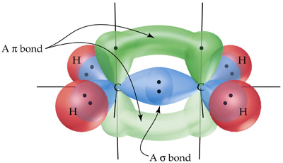
An attempt to show a double bond within a single bonding electron charge cloud in ethylene
C₂H₄

Slide 30
Bonds and bonding electron clouds
a single bond is: one bonding electron cloud that contains one molecular bonding orbital
N—N
a double bond is: one bonding electron cloud that contains two molecular bonding orbitals
N=N
a triple bond is: one bonding electron cloud that contains three molecular bonding orbitals
N≡N

Slide 31
Who forms multiple bonds?
Carbon, nitrogen, and oxygen are the elements most often present in multiple bonds
Carbon and nitrogen will form double and triple bonds
Oxygen normally forms only double bonds
Halogens never involve multiple bonds (in Intro)
Multiple covalent bonding is particularly common in organic molecules, which predominantly consist of the element carbon

Slide 32
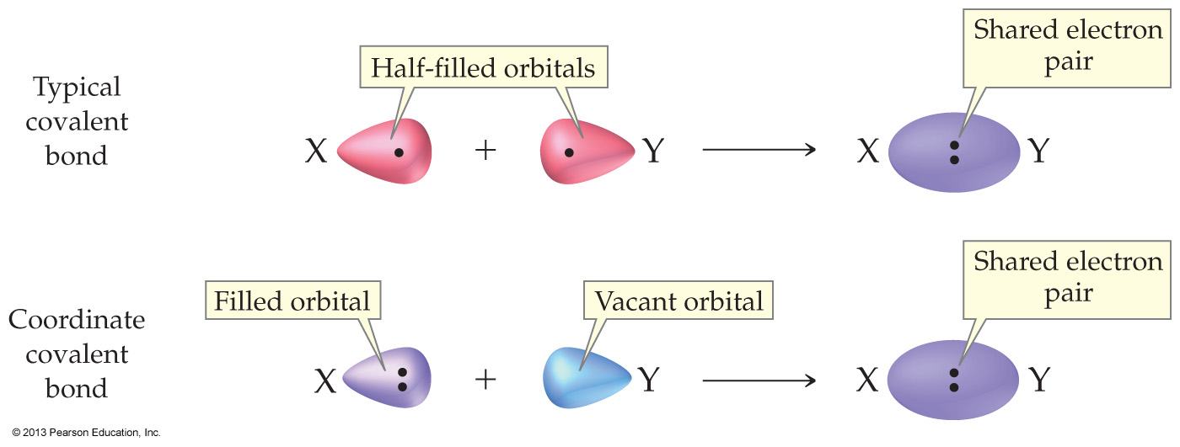
4.4 Coordinate Covalent Bonds

Slide 33
A coordinate covalent bond is the covalent bond that forms when both electrons are donated by the same atom

Slide 34
Once formed, a coordinate covalent bond is no different from any other covalent bond
Coordinate covalent bonds often result in unusual bonding patterns, such as nitrogen with four covalent bonds, or oxygen with three bonds (H₃O⁺)

Slide 35
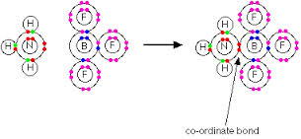
Ammonia and BF₃
Remember that empty orbital in boron!

Slide 36
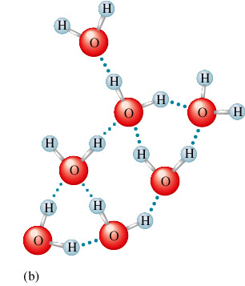
4.5 Characteristics of Molecular Compounds
Section vocabulary
intramolecular force
Bonds within molecules
Covalent
intermolecular force
“Bonds” between molecules
Hydrogen bonding

Slide 37
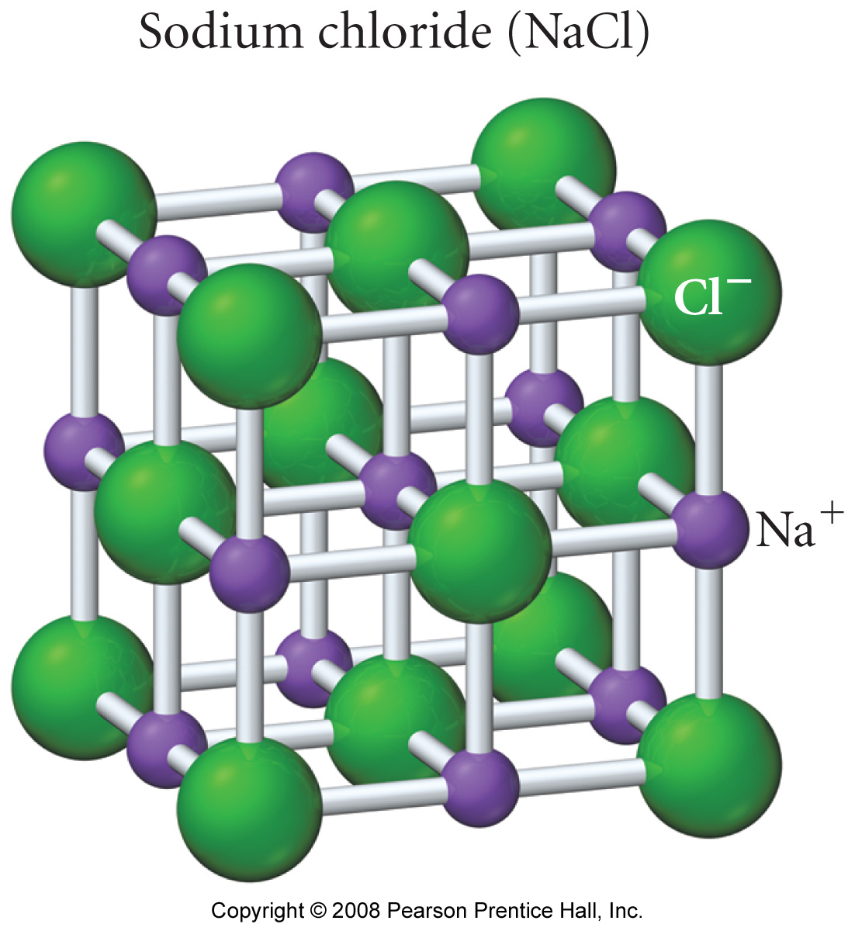
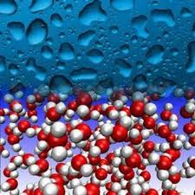
what is the smallest component in
a salt
in a collection of molecules

Slide 38
Collections of ionic compounds have high melting and boiling points because the attractive forces between particles (oppositely charged ions) are so strong
But collections of molecules are not composed of oppositely charged particles

Slide 39
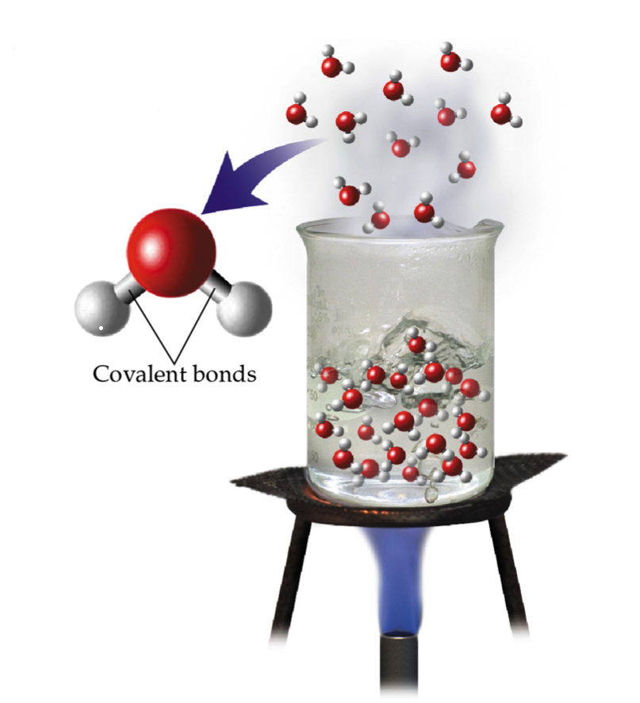
Molecules have:
strong intramolecular bonds (covalent), but weak intermolecular bonds
So melting and boiling points
tend to be low

Slide 40
So molecules have no positive & negative components to provide a strong electrostatic attraction as do salts
But there are weak forces between molecules, called intermolecular forces

Slide 41
Intermolecular forces
Unlike ionic compounds, molecular compounds
have low melting and boiling points
are rarely soluble in water
do not conduct electricity when melted

Slide 42
STUDY THIS!!!

Slide 43
4.6 Molecular Formulas and Lewis Structures

Slide 44
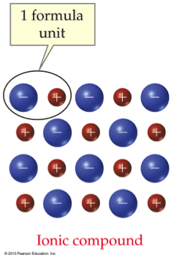
A molecular formula gives the number of atoms that are combined into one molecule
The formula “Cl₂” says the chlorine molecule is made of two atoms bonded together
An ionic formula gives only a ratio of ion
So it’s: NaCl not Na₂Cl₂

Slide 45
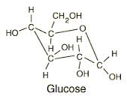
Formulas: Molecules vs salts
Glucose really has:
6 carbons
12 hydrogens
6 oxygens
C₆H₁₂O₆
All even numbers

Slide 46
fyi
Molecular formula—Any formula that makes explicit the numbers and kinds of atoms in one molecule of a compound
Structural formula—A molecular representation that shows the actual connections among atoms by using lines to represent the covalent bonds
Condensed formula—Larger organic molecules are often written as condensed structures in which the bonds are not specifically shown

Slide 47
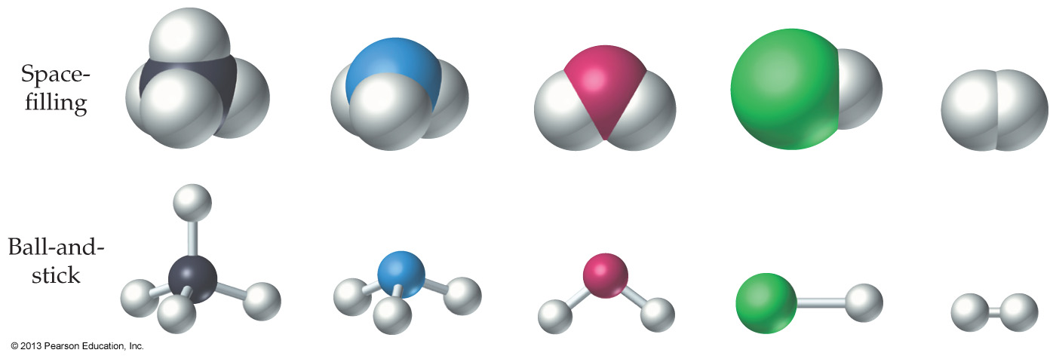
fyi
For clarity, ball-and-stick representations are sometimes used
These are generally color-coded as follows:
C is black, H is white, O is red, N is blue, S is yellow, P is dark blue, F is light green, Cl is green, Br is brownish red, and I is purple

Slide 48
Lewis structure—A molecular representation that shows atomic bonds and lone-pair valence electrons
Lone pair—A pair of valence electrons not available for bonding
Lewis structures are normally drawn for molecules

Slide 50
FIGURE 4.3 Numbers of covalent bonds typically formed by main group elements to achieve octet configurations

Slide 51
Exceptions to the octet rule
A summary of exceptions

Slide 52
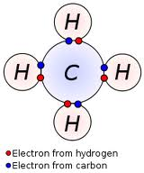
Exceptions to the octet rule
Hydrogen follows the duet rule
Hydrogen forms stable molecules where it shares two electrons
giving the electron configuration of Helium

Slide 53
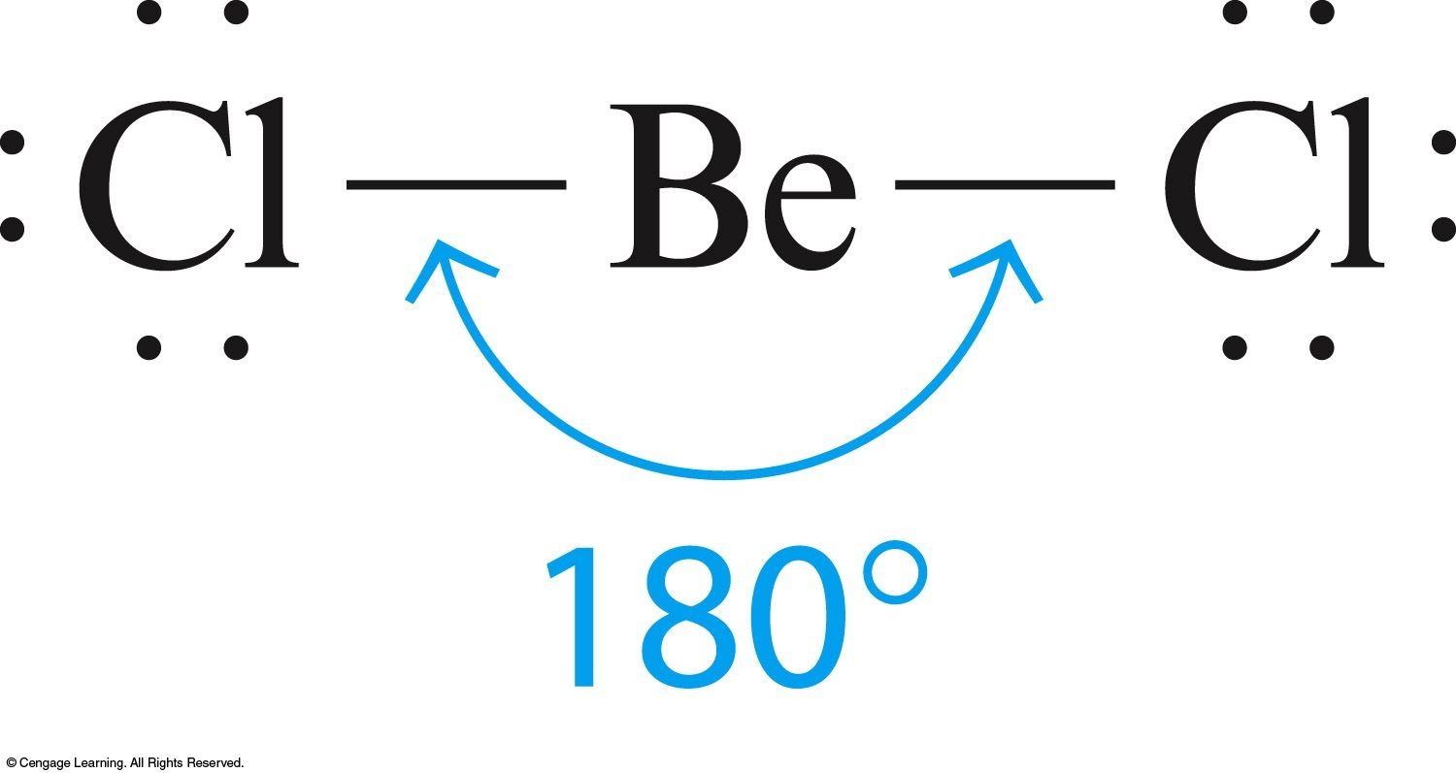
Exceptions to the octet rule
Beryllium is happy with only 4 valence electrons

Slide 54
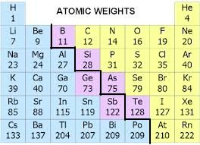
FYI
Beryllium lies on the ‘metalloid line,’ so we shouldn't be surprised that some of its compounds have ‘nonmetal properties’

Slide 55
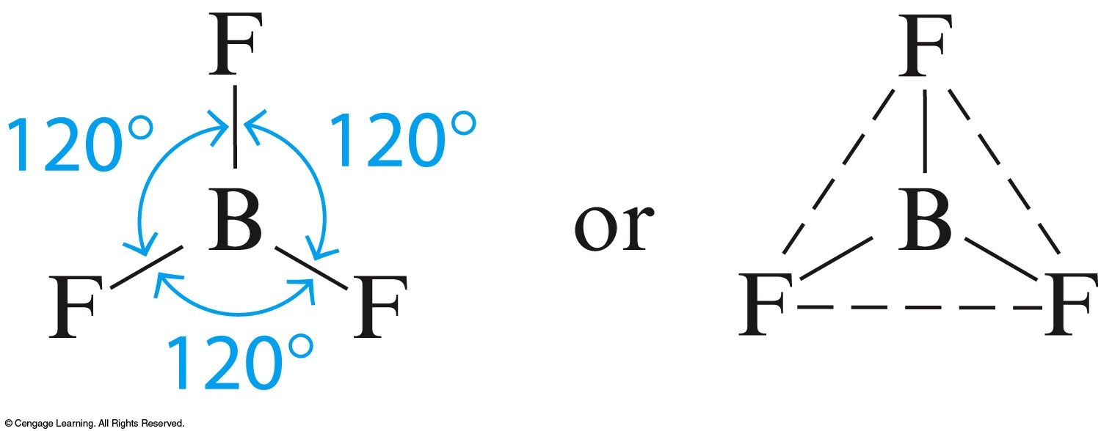
Exceptions to the octet rule
Boron is happy with only 6 valence electrons

Slide 56
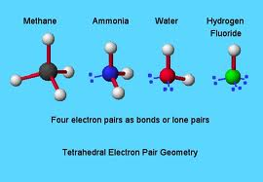
The rest want an octet
Carbon, nitrogen, oxygen, fluorine, Neon
all want an octet

Slide 57
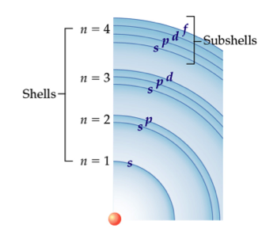
FYI: Exceeding the octet rule
In Gen Chem you will learn that period 3 and higher elements can exceed the octet rule due to the availability of d electrons

Slide 58
Which of the following molecules is NOT likely to exist?
BCl₂
CH₂Cl₂
NH₂Cl
H₂Se

Slide 59
What is the most likely value of x in the molecule CHCl_{x}?
1
2
3
4

Slide 60
4.7 Drawing Lewis Structures

Slide 61
FYI: A General Method for Drawing Lewis Structures
Find the total number of valence electrons of all atoms in the molecule or ion. For an ion, add one electron for each negative charge or subtract one for each positive charge.
Draw a line between each pair of connected atoms to represent the two electrons in a covalent bond.
Using the remaining electrons, add lone pairs so that each atom connected to the central atom (except H) gets an octet.
Place any remaining electrons in lone pairs on the central atom.
If the central atom does not have an octet after all electrons have been assigned, take a lone pair from a neighboring atom and form a multiple bond to the central atom.

Slide 62
let’s do the Lewis structure for water, H₂O

Slide 64
FYI: Always ask if your answer makes sense:
Lewis Structures for Molecules Containing C, N, O, X (Halogen), and H
C forms four covalent bonds and often bonds to other carbon atoms
N forms three covalent bonds and has one lone pair of electrons
O forms two covalent bonds and has two lone pairs of electrons
Halogens (X) form one covalent bond and have three lone pairs of electrons
H forms one covalent bond

Slide 65
Let’s do the Lewis Structure for PF₃

Slide 66
How many valence electrons are in PF₃?
12
24
26
42

Slide 67
How many lone pairs of electrons are in the total Lewis structure of PF₃?
0
8
9
10

Slide 68
How many lone pairs are on the central atom?
0
1
2
3

Slide 69
In the molecule formaldehyde, CH₂O, a double bond is found between _______.
carbon and oxygen
carbon and hydrogen
oxygen and hydrogen
There are no double bonds in the molecule.

Slide 70
The case for resonance

Slide 71
Fact
Single bonds are longer than double bonds
You will study the details of this in Gen Chem
N—N
N=N
N≡N

Slide 72
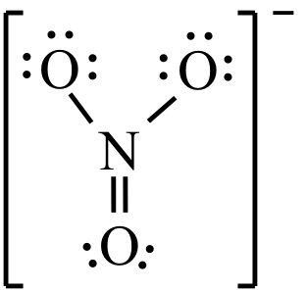
But the Lewis structure you will draw for NO₃⁻ implies that it has two long (single) bonds, and one short (double) bond
In fact, studies show that all the bonds in NO₃⁻ are the same length
a length somewhere between a single and double bond
So its valence electrons must be delocalized

Slide 73
‘Resonance’ is always used…
… when more than one Lewis structure can be written

Slide 75
Brackets to denote charge
And finally, note that when the species is charged, as in all polyatomic ions, brackets must be used for clarity

Slide 76
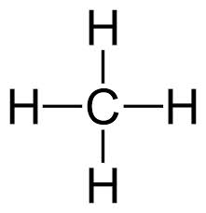
4.8 The Shapes of Molecules
true
false

Slide 77
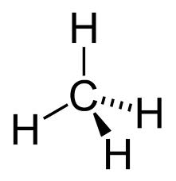
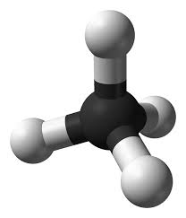
Valence-shell electron-pair repulsion (VSEPR)
Constantly-moving valence electrons in bonds and lone pairs make up negatively charged ‘clouds’ of electrons which repel one another like tightly held balloons surrounding a central atom

Slide 78
VSEPR is a method for predicting shape by counting the number of electron charge clouds surrounding a central atom
BOTTOM LINE: These negatively charged electron clouds repel each other, causing molecules to assume predictable shapes
This
Not this

Slide 79
Four electron charge clouds always take the tetrahedral shape
Not crowded:
happy electron clouds
Crowded:
not happy electron clouds
Tetrahedral
Square planar

Slide 80
Electron Charge Clouds
Each Electron Charge Cloud contains one of the following:
a single lone pair
a non-bonding electron charge cloud
a single bond
a double bond
a triple bond

Slide 81
Note that one kind of electron charge cloud is not bonding
those that contain a lone pair
Carbon (0),Nitrogen (1), Oxygen (2), Fluorine (3), Neon(4)

Slide 82
FYI: Electron charge clouds: Disambiguation
Other names for the Electron Charge Cloud:
Electron region
Electron cloud
Charge cloud
Negatively charged cloud
Valence electron cloud
Electron pair ( not recommended)

Slide 83
Using VSPER to predict Molecular Geometry
STEP 1: Identify the central atom, and draw a Lewis structure
STEP 2: Count the total number of atoms bonded to this central atom – plus any lone pair clouds
This is the total number of electron charge clouds

Slide 85
STEP 1: Identify the central atom, and draw a Lewis structure
STEP 2: Count the total number of atoms bonded to this central atom – plus any lone pair clouds
This is the total number of electron charge clouds
STEP 3: To predict molecular geometry, assume that all the electron charge clouds orient in space as far away from one another as possible, then…
Ignore any lone pair electron clouds
Focus on those electron clouds bonded to atoms only

Slide 86
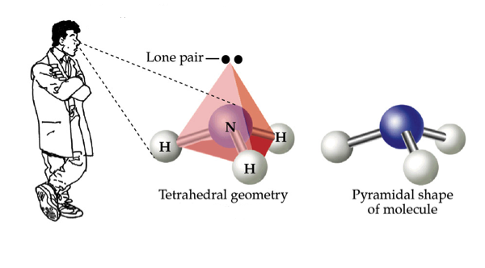
Using VSPER to predict Molecular Geometry
Determine first, the total electron charge cloud arrangement
ie, bonding plus non-bonding (lone pair) clouds
Only then can we establish the molecular geometry
of all the electron clouds

Slide 87
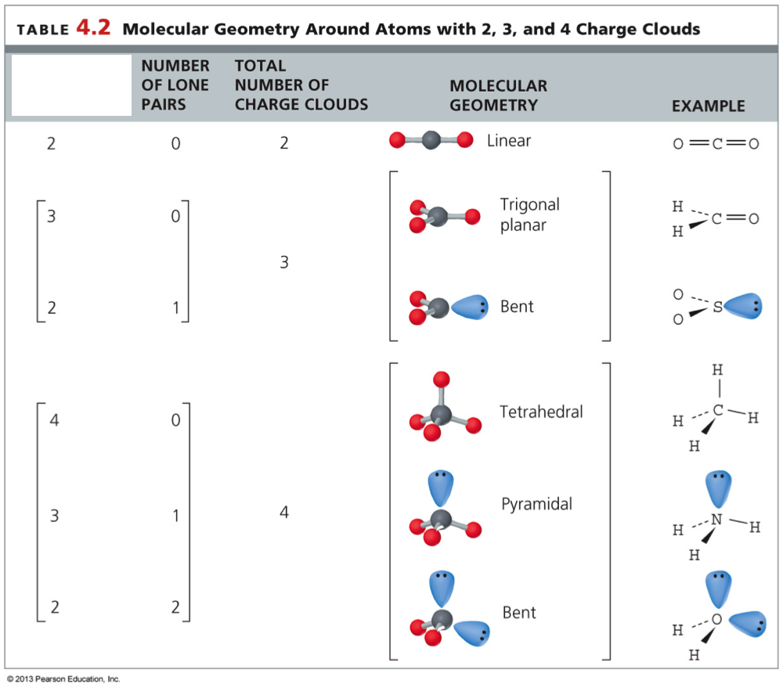
Note the MOLECULAR GEOMETRY heading
NUMBER OF ATOMS ON CENTRAL
NUMBER OF ATOMS
ON CENTRAL =
the number of bonding
clouds
NUMBER OF LONE
PAIRS = the number of
lone pair clouds
"Fundamentals of General, Organic, and Biological Chemistry” by McMurry, John E.;
Hoeger, Carl A.; Peterson, Virginia E.; Ballantine, David S. 7th edition.

Slide 88
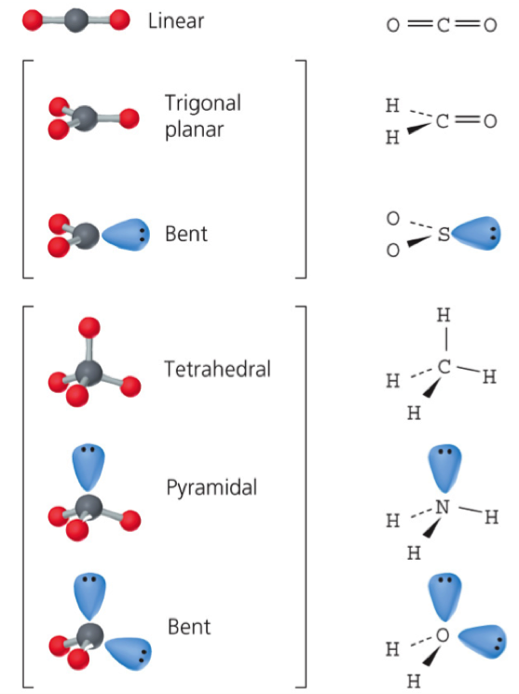
You must memorize the names of these common shapes
and their bond angles
180º
120º
120º
109.5º
109.5º
109.5º
"Fundamentals of General, Organic, and Biological Chemistry” by McMurry, John E.;
Hoeger, Carl A.; Peterson, Virginia E.; Ballantine, David S. 7th edition.

Slide 89
Note the column ‘Bond angle’

Slide 90
fyi: Two electron charge clouds
BeCl₂
180°
Linear

Slide 91
fyi: Two electron charge clouds
Two electron charge clouds are farthest apart when they point in opposite directions. Linear molecules result with bond angles of 180°
each has two electron
clouds but four bonds

Slide 92
fyi: Three electron charge clouds
BF₃
120°
Trigonal planar

Slide 93
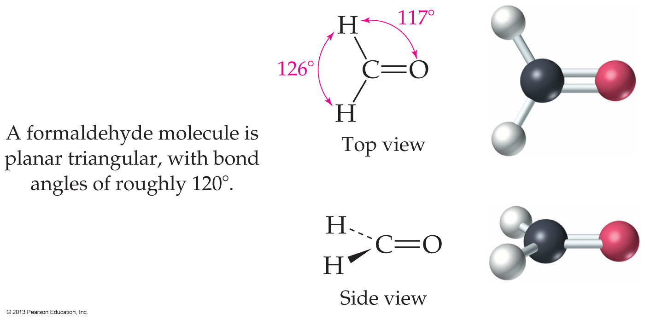
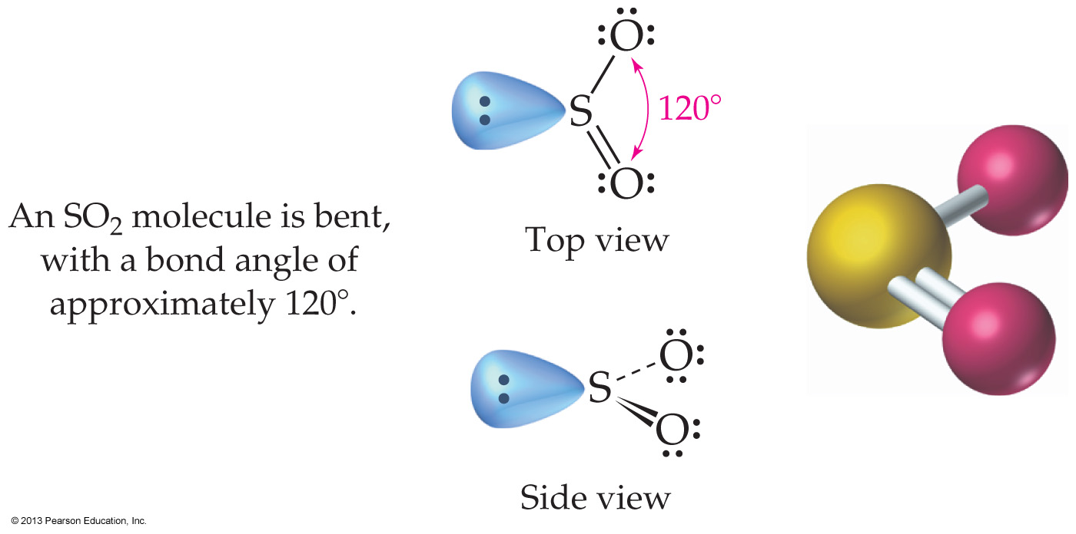
fyi: Three electron clouds
Three electron charge clouds are farthest apart if they lie in a plane and point to the corners of an equilateral triangle
Trigonal planar molecules result with bond angles of 120°
If one of the charge clouds is a lone pair, the molecule will be called ‘bent’

Slide 94
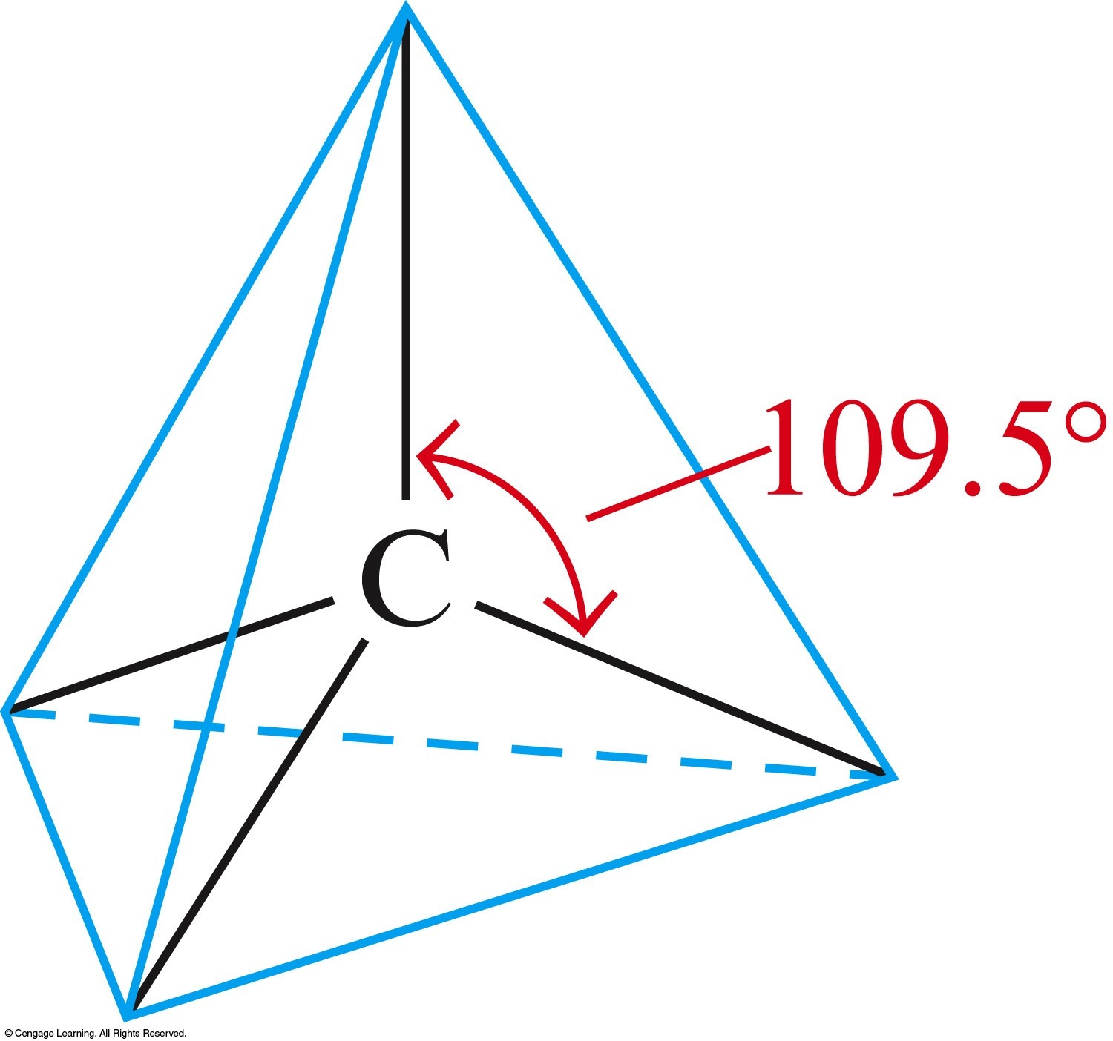
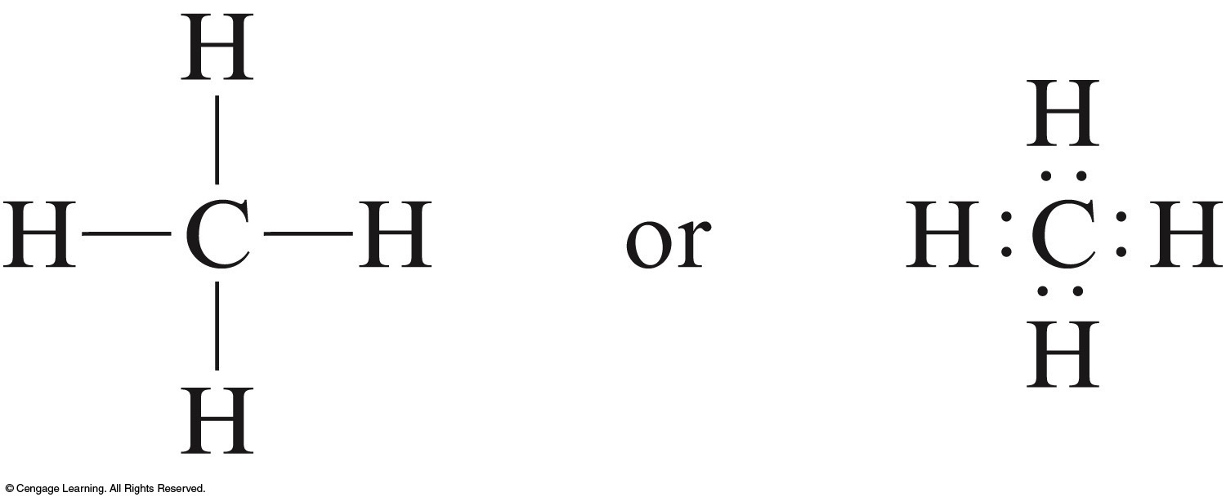
fyi: Four electron charge clouds
CH₄
109.5°
Tetrahedral

Slide 95
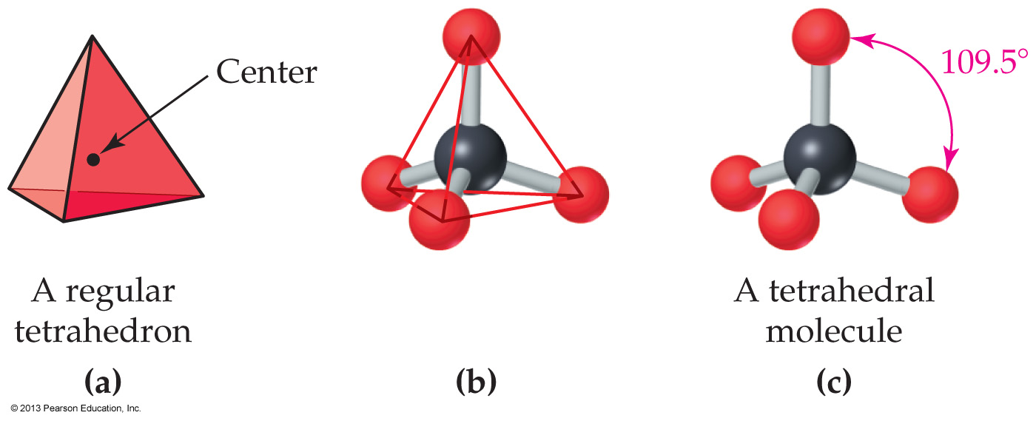
fyi: Four electron clouds
Four electron charge clouds extend to the corners of a regular tetrahedron, with bond angles of 109.5°
Shapes can be tetrahedral, pyramidal, or bent, depending on the number of lone pairs

Slide 96
Summary: The VSEPR Creed
Molecular Geometry around a central atom is determined by minimizing repulsions between its valence-shell electron-pair filled clouds
Both bonding and
nonbonding clouds
determine the shape

Slide 97
Note the MOLECULAR GEOMETRY heading
NUMBER OF ATOMS ON CENTRAL
NUMBER OF ATOMS
ON CENTRAL =
the number of bonding
clouds
NUMBER OF LONE
PAIRS = the number of
lone pair clouds

Slide 98
What is the molecular geometry around the carbon atom in carbon disulfide, CS₂?
Linear
Planar triangular
Bent
Pyramidal

Slide 99
Note the MOLECULAR GEOMETRY heading
NUMBER OF ATOMS ON CENTRAL
NUMBER OF ATOMS
ON CENTRAL =
the number of bonding
clouds
NUMBER OF LONE
PAIRS = the number of
lone pair clouds

Slide 100
What is the molecular geometry around the central atom in NH₃ and BCl₃, respectively?
Tetrahedral, pyramidal
Trigonal planar, pyramidal
Pyramidal, Trigonal planar
Both are Trigonal planar

Slide 101
How many charge clouds are around the sulfur atom in H₂S and what is the shape of the H₂S molecule?
Two charge clouds, bent
Two charge clouds, linear
Four charge clouds, bent
Four charge clouds, linear

Slide 102
Note the MOLECULAR GEOMETRY heading
NUMBER OF ATOMS ON CENTRAL
NUMBER OF ATOMS
ON CENTRAL =
the number of bonding
clouds
NUMBER OF LONE
PAIRS = the number of
lone pair clouds

Slide 103
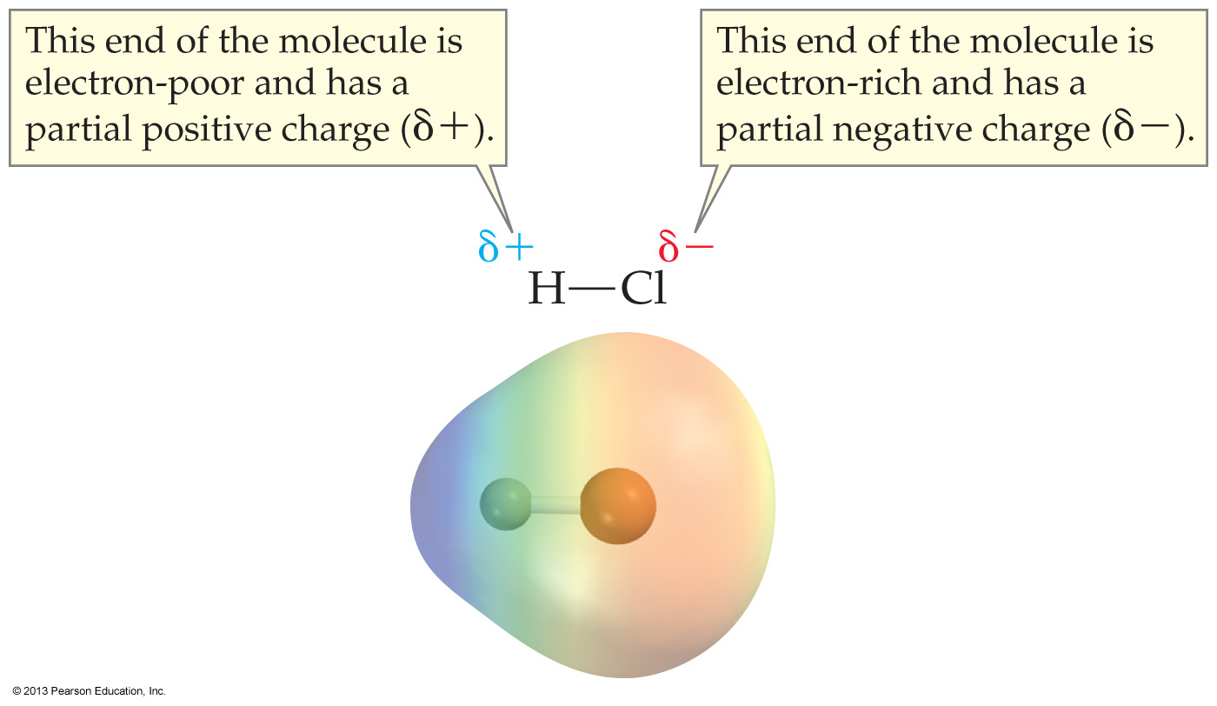
4.9 Polar Covalent Bonds and Electronegativity

Slide 104
Note the heading ‘Bond polar’

Slide 105
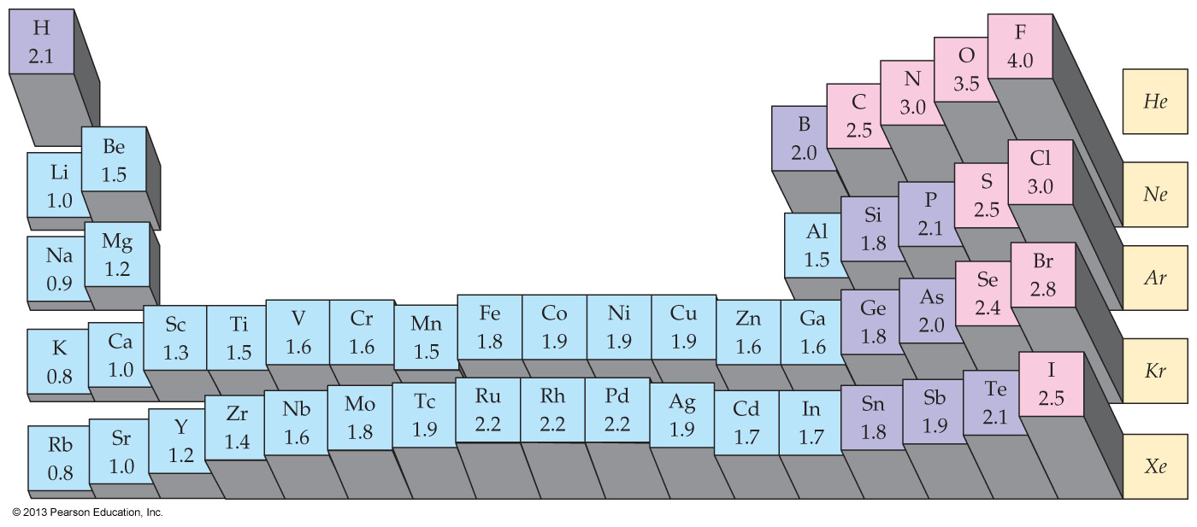
The ability of an atom to attract electrons is called electronegativity
Within a period: Electronegativity increases going from left to right
as always, hydrogen is an exception
Within a group: Electronegativity increases going up the periodic table

Slide 106
Fluorine, the most electronegative element, is arbitrarily assigned a value of 4
all other atoms are assigned lower values
Metallic elements have low electronegativities
Halogens and reactive nonmetal elements have higher electronegativities

Slide 107
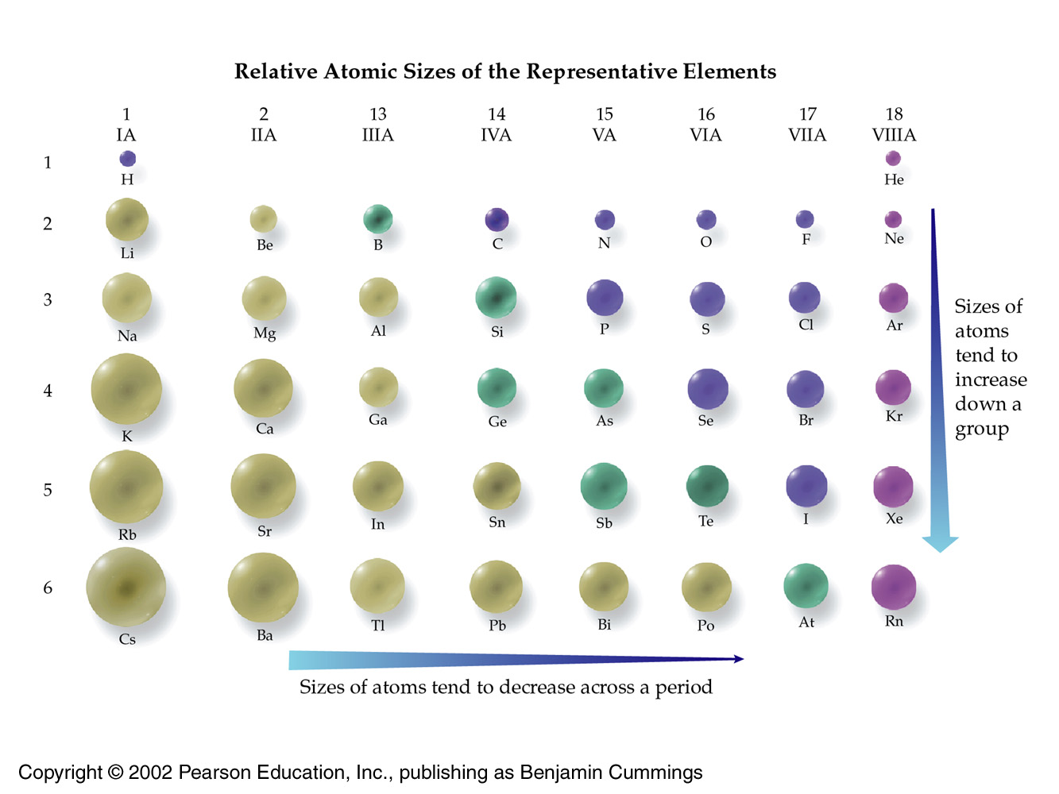
Remember this?

Slide 108
Disambiguation
We will clearly distinguish these two concepts
the concept of the compound type (2 types)
molecules & salts
the concept of the bond type (3 types)
covalent, polar covalent, and ionic bonds

Slide 109
FYI
Unfortunately, chemists get sloppy
Molecules: They sometimes refer to molecules as covalent compounds
Salts: For Intro Chem, I will adopt the convention of referring these compounds as salts, and only their bonds as ionic

Slide 110
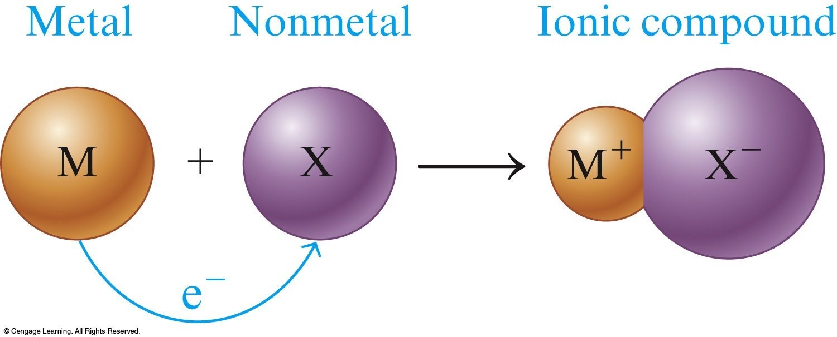
Salts & Ionic Bonding
I will refer to these compounds as salts
I will refer to their bonds as ionic
Technically: These
compounds are salts
only when they are
stable to water

Slide 111
The polarity of an individual bond depends only on the difference between the electronegativity values of the atoms forming the bond
Molecule
Molecule
Salt

Slide 112
FYI: Take note
In order to explain electronegativity differences, we say that a polar covalent bond has both ionic and covalent “components” (ie, characteristics )
But be aware that the bond as such is polar covalent
Electrons are shared, but unevenly
Unfortunately, this is another area of sloppy language that makes learning chemistry more difficult than it should be

Slide 113
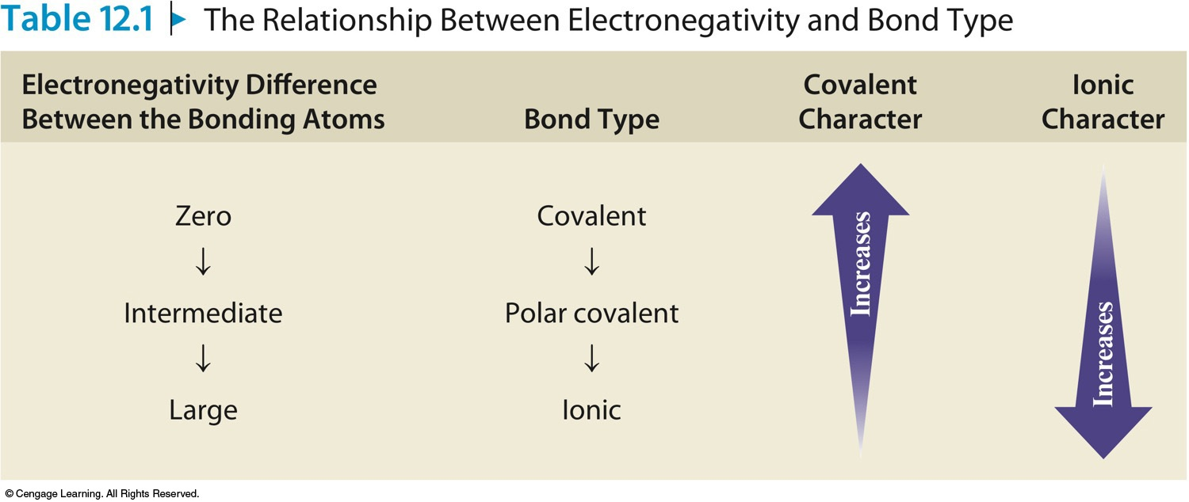
So bonds are classified as having covalent, polar covalent, or ionic character

Slide 114
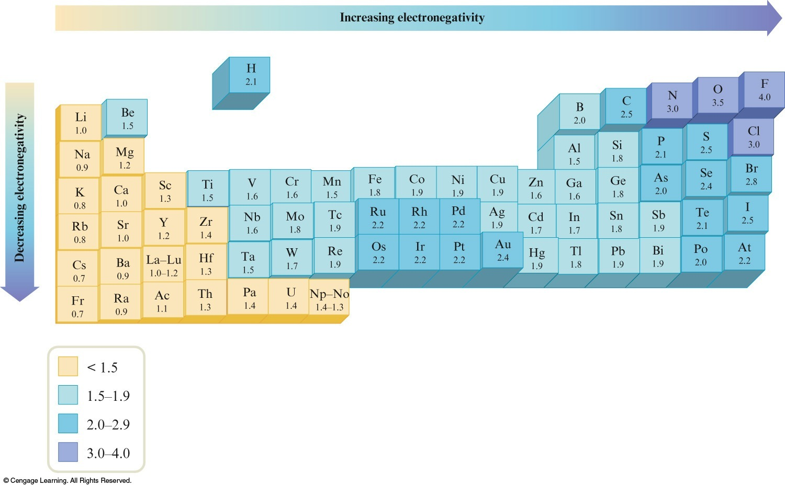
Electronegativity Values

Slide 115
Quantifying bond polarity
For a bond in a molecule where the difference in electronegativites is less than 0.5, this bond is considered non-polar covalent
Consider: H₂
H = 2.1
H = 2.1
ΔEN = 2.1 – 2.1 = 0.0
So the H-H bond is pure non-polar covalent

Slide 116
Quantifying bond polarity
For a bond in a molecule where the difference in electronegativites is less than 0.5, this bond is considered non-polar covalent
Consider: CH₄
C = 2.5
H = 2.1
ΔEN = 2.5 – 2.1 = 0.4
So each C-H bond is also non-polar covalent

Slide 117
Quantifying bond polarity
For a bond in a molecule where the difference in electronegativites is 0.5 or more, this bond is considered polar covalent
Consider CO₂
O = 3.5
C = 2.5
ΔEN = 3.5 – 2.5 = 1.0
Each CO bond in CO₂ is polar covalent
(But the overall molecule is nonpolar as we will see)

Slide 118
Note the heading ‘Bond polar’

Slide 119
Quantifying bond polarity
For a bond in a molecule where the difference in electronegativites is 0.5 or more, this bond is considered polar covalent
Consider HF
H = 2.1
F = 4.0
ΔEN = 4.0 – 2.1 = 1.9
HF is the most polar covalent molecule in Intro
We say the HF bond has a lot of ‘ionic character’

Slide 120
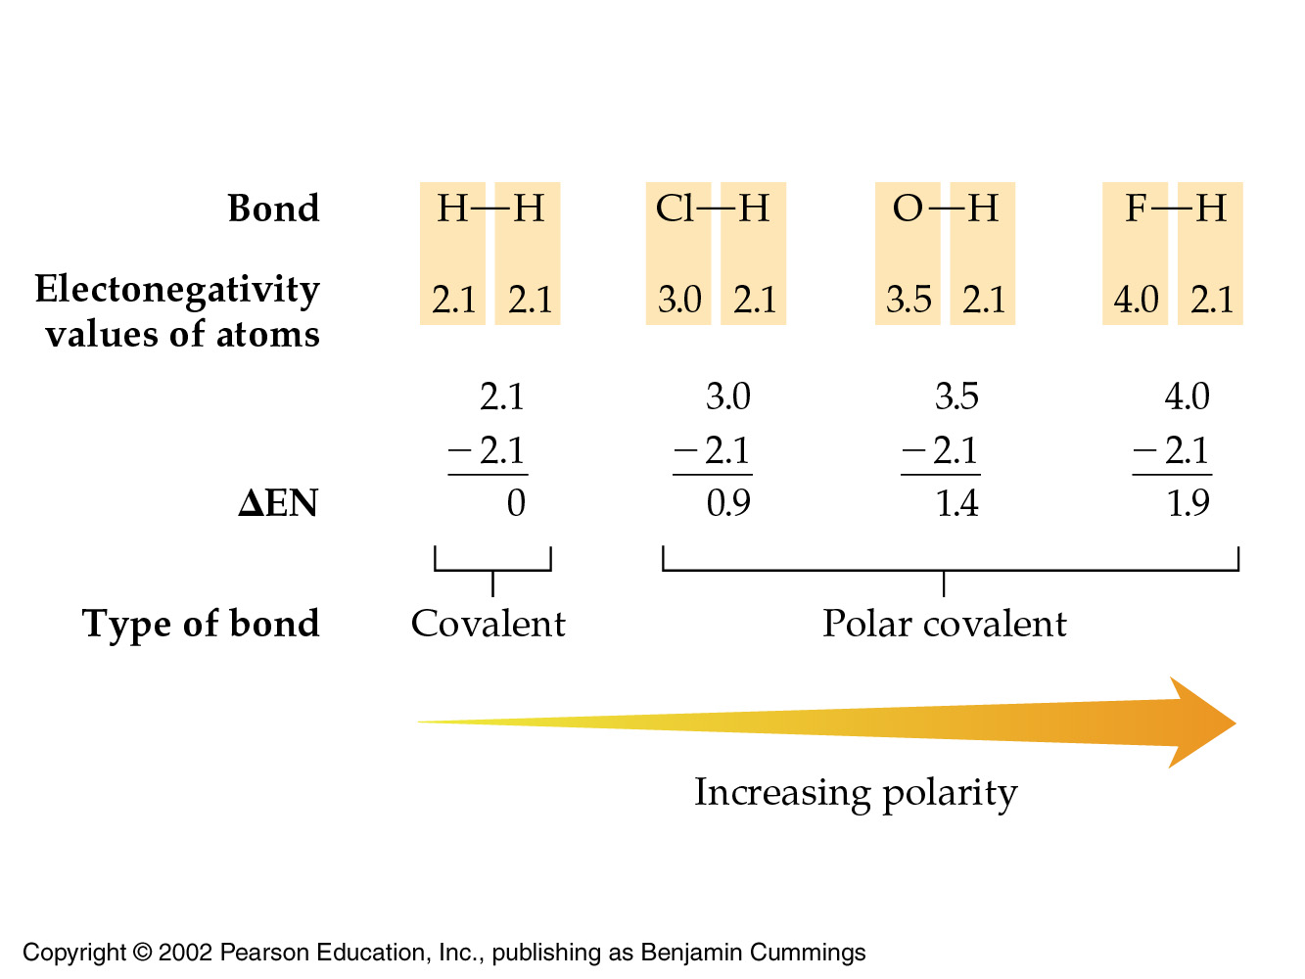
FYI: Quantifying bond polarities

Slide 121
FYI: What about the ΔEN for salts?
Consider AuI
I = 2.5
Au = 2.4
ΔEN = 2.5 – 2.4 = 0.1
This is even less polar than the C-H bond (0.4)
Yet AuI is definitely a salt in Intro Chemistry
Chemists say the bond in AuI has high covalent character
Some chemists get sloppy and say it has high molecular character

Slide 122
Section conclusion
Bond types are determined by the difference in electronegativity values: ΔEN
covalent, polar-covalent, or ionic
Compound types are determined by whether or not a metal is involved in the structure
Salts: Contains metal
Molecules: Contains no metal
HF has a calculated ΔEN of 1.9 but is a molecule
AuI has a calculated ΔEN of 0.1 but is a salt

Slide 123
FYI: Section summary
Electronegativity differences (ΔEN) of less than 0.5 result in nonpolar covalent bonds
Differences up to 1.9 indicate increasingly polar covalent character to the bond
Differences of 2 or more indicate substantial ionic character to the bond
There is no sharp dividing line between covalent and ionic bonds
Most bonds fall between these categories

Slide 124
Concept Check
Which of the following bonds would be the least polar, yet the compound itself still be classified a polar molecule?
Mg–O C–O O–O Si–O N–O
Mg = 1.2
O = 3.5
C = 2.5
Si = 1.8
N = 3.0

Slide 125
Concept Check
Which of the following bonds would be the most polar, yet the compound itself still be classified a molecule (with covalent or polar-covalent bonds)?
Mg–O C–O O–O Si–O N–O
Mg = 1.2
O = 3.5
C = 2.5
Si = 1.8
N = 3.0

Slide 126
Of the bonds C–C, C–N, C–O, and C–F, which is the most polar bond?
C–C
C–N
C–O
C–F

Slide 127
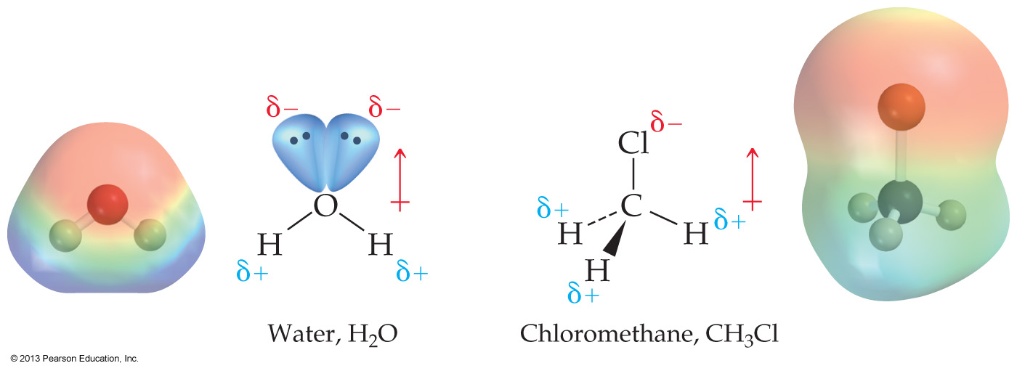
4.10 Polar Molecules

Slide 128
Note the heading ‘Molec. polar’

Slide 130
Overall molecular polarity is due to individual bond polarities and lone-pair contributions
Electrons are displaced toward the more electronegative charge cloud

Slide 132
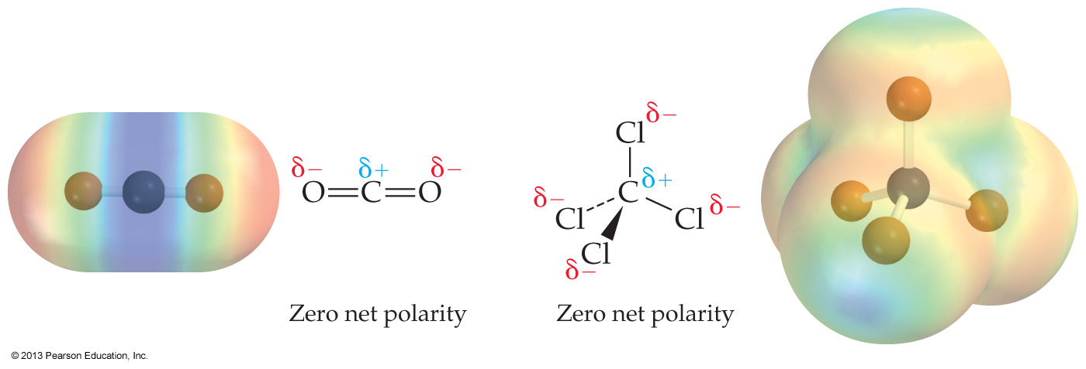
Molecular polarity depends on the shape of the molecule
Highly symmetrical molecules can have polar bonds and yet still be non-polar overall

Slide 133
Practical effects of polarity
Polarity has a dramatic effect on the physical properties of molecules
Would you expect polarity to increase or decrease intermolecular attractions?
What effect would you expect this to have on:
melting points
boiling points
solubilities

Slide 135
Of HCl, Cl₂, and CsCl, which is (are) polar covalent?
HCl and CsCl
Only CsCl
Only Cl₂
Only HCl

Slide 136
CsCl is a salt with an ionic bond

Slide 137
4.11 Naming Binary Molecular Compounds

Slide 138
When two different elements combine, they form a binary compound
The less­electronegative element is written first
H₂O
but there are important historic exceptions: NH₃, CH₄
Molecular formulas show exactly how many atoms of each element are included

Slide 139
fyi: Less electronegative
The (generally followed) rule of writing the less electronegative element first is also followed by the ionic salts
Metals are always written before nonmetals
A metal farther left on the periodic table generally comes before a nonmetal farther right
eg, NaCl

Slide 140
Naming molecules
Name the first element in the formula, using a prefix if needed
Name the second element in the formula, using an -ide ending and a prefix if needed

Slide 141
The prefix mono-, meaning one, is omitted except where needed to distinguish between two different compounds with the same elements, such as carbon monoxide and carbon dioxide
And ‘mono’ is almost never used to name the first element in a molecule

Slide 142
The name of N₂O₄ is _______.
dinitrogen tetroxide
dinitrogen tetroxygen
nitrogen oxide
nitrogen(IV) oxide

Slide 143
How should P₂O₅ be named?
phosphorus(V) oxide
diphosphorus pentoxide
phosphorus oxide
perphosphate

Slide 144
The formula for xenon tetrafluoride is _______.
Xe₄F
XeF₄
XeF
Xe₂F₄

